Slide 1
Monday, July 31st, 2023
STUDENT
Charles E. Jordan High School
Andrew Shan
Corporate Control: How Companies
Manipulate the Legal System for Profit

Slide 2
Page
Agenda
I
Motivation
3
II
Terminology & Research Question
5
III
Thesis & Methodology
7
IV
Findings
9
V
Conclusion & Limitations
12

Slide 3

I Motivation
The Federal Tax rate for major corporations is 21%
as established by the Tax Cuts and Jobs Act of 2017.
73 had an effective tax rate below 14.5%.
39 corporations received money from the government
instead of paying taxes.
Gardner, M., Wamhoff, S. (2021). 55 corporations paid $0 in federal taxes on 2020 profits. Institute on Taxation and Economic Policy
3

Slide 4

I Motivation
In 2019 pharmaceutical companies were able to block a bill that would lower drug prices (Stein & Abutaleb, 2019).
Expert estimations theorize that about 20 to 30 trillion dollars are hidden offshore in tax avoidance schemes (Dillon, 2017).
A ruling by the Supreme Court in AT&T Mobility LLC v. Concepcion declared that requiring corporations do not need to allow class-action lawsuits (131 S.Ct. 1740, 2011).
4

Slide 5
II Terminology & Research Question
Lobbying - The action of influencing members in the legislative or executive branch
Tax Avoidance - The legal method which many corporations use to reduce the amount of taxes used.
PAC (Political Action Committee) - An organization that can take contributions from a variety of sources and can use those donations to support a candidate.
5

Slide 6
II Terminology & Research Question
What strategies do multinational and Fortune 500 companies utilize to dodge legal responsibilities and ignore government restrictions?
6

Slide 7
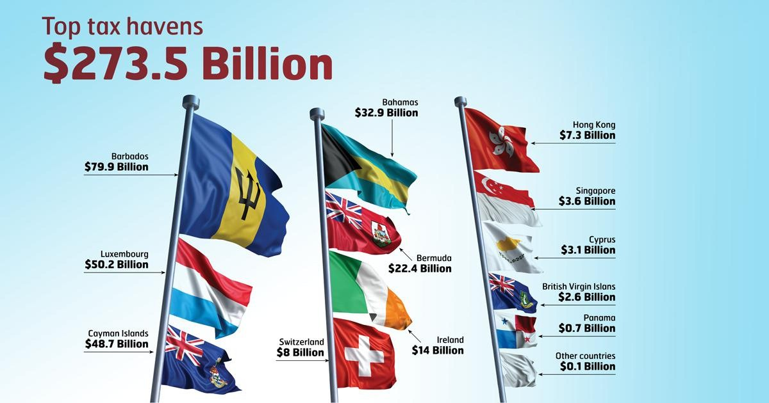
III Thesis & Methodology
Multinational and Fortune 500 corporations often use their vast resources, such as their overwhelming capital or access to legal power, to influence governmental policies, utilize tax breaks, and abuse legal loopholes.
Ducasse, P. (2016). Tax havens: the billions that get away. Canadian Union of Public Employees
7

Slide 8

III Thesis & Methodology
Peer Reviewed Sources
Specific Case Studies
Legal Definitions
18 Sources
JStor, Google Scholar, Duke Library Online Catalogue
Key Terms: “Lobbying,” “multinational corporation,” “PACs,” “tax-avoidance,” and “corporate stalling.”
Taxi drivers protesting Uber in Poland
8

Slide 9


IV Findings
Tax Planning
Corporations rarely pay their full taxes.
Many methods are employed to reduce a company's tax burden.
“When lawmakers allow corporations to avoid taxes, the costs to the United States are enormous. Because the statutory income tax rate for corporations is 21 percent, the total tax breaks a corporation receives is simply 21 percent of its profits minus what it paid.”
Gardner, M., Wamhoff, S. (2021). 55 corporations paid $0 in federal taxes on 2020 profits. Institute on Taxation and Economic Policy
9

Slide 10


IV Findings
Loopholes
“The strategies described in this article, with the possible exception of reinventing classifications, have been used by other corporations long before the emergence of the digital economy. They have been part of the toolbox of lawyers and lobbyists and an element of business power. Stalling strategies, however, are especially significant in the digital economy.”
Corporations often do not follow laws.
The speed at which governments create regulations cannot match corporations.
Mazur, J., Serafin, M. (2022). Stalling the state: how digital platforms contribute to and profit from delays in the enforcement and adoption of regulations. International Political Science Review 56(1) 103-130
10

Slide 11

IV Findings
Influencing Policy
There are many ways corporations support policy makers, both legal and not.
Corporate influence can drastically morph new policy.
“We find a strong connection between corporate PAC contributions and lobbying suggesting that many firms use multiple channels of potential political influence to influence regulatory and policy outcomes.”
Hill, M. D., Kelly, G. W., Lockhart, G. B., Van Ness, R. A. (2013) Determinants and effects of corporate lobbying. 42(4) 931-957
11

Slide 12
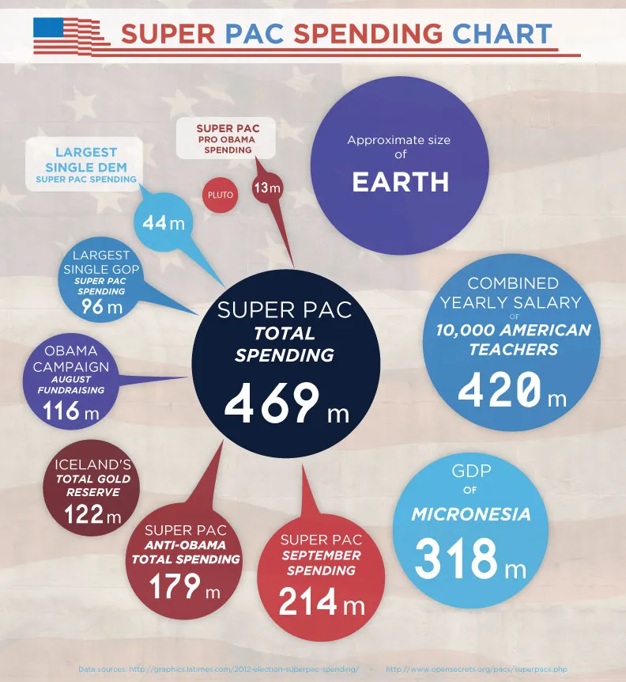
V Conclusion & Limitations
Limitations
This research does not cover specific methods employed by the corporations. The only thing covered is broad methods, with some examples for certain methods.
12

Slide 13
V Conclusion & Limitations
Implications
Future Research
Future research should try to cover cases where corporations were able to be held accountable, and to see exactly why they were unable to dodge responsibility.
If nothing is done to succesfully restrain these corporations, their accumulation of power will make it nigh impossible to stop them.
13

Slide 14
Acknowledgements
Cohort 2 Teachers and Intern
Duke University
Hank and Billye Suber Aaron Young Scholars Summer Research Program Institue
Samuel DeBois Cook Center for Social Equity

Slide 15


Monday, July 31st, 2023
STUDENT
Charles E. Jordan High School
Andrew Shan
Thank you
for listening!
andrew.shan@outlook.com

