Slide 1

Prison’s Prison: Solitary Confinement and its Impacts on the Health of Black Men
By: Amelie Novio

Slide 2
Research Question
How does treatment in solitary confinement impact Black men in prison?

Slide 3
Thesis Statement
Black men are overrepresented in the prison population and are disproportionately given solitary confinement as punishment. This means that Black men are subjected to the most severe mental and physical health issues in prison.

Slide 4
Introduction
Many people are unaware of what exactly happens in solitary confinement and how vulnerable inmates are.
Black men are overrepresented in the prison population and disproportionately given solitary confinement as punishment.
They are subjected to conditions that cause mental and physical health issues.

Slide 5
Key Findings
Environment in Isolation
Racial Bias
Mental Health Consequences
Physical Health Consequences

Slide 6
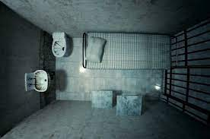
Environment in Isolation
Inmates in isolation spend about 22-23 hours in their cell daily
They are almost completely devoid of human contact.
They are given very few hours of time outside of their cell for exercise and recreation.

Slide 7
Racial Bias
There have been limitations in data about violations and punishment types in prison.
There is evidence of racial bias in the criminal justice system.
Implicit biases in court can influence sanctioning decisions.

Slide 8
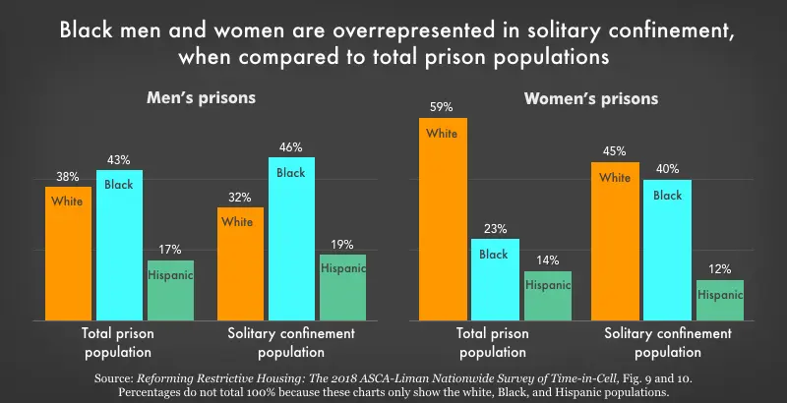
Notes:
Photo:
https://www.prisonpolicy.org/graphs/solitarybyracesex2018.html

Slide 9
Mental Health Consequences
One of the main arguments against solitary confinement is the damage it does to mental health.
Mental illness can last beyond time in prison.
Black inmates are more vulnerable to mental illnesses in prison.

Slide 10
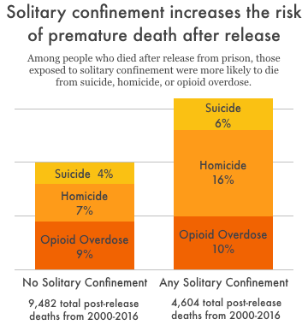

Slide 11
Physical Health Consequences
It is difficult for inmates to get access to medical treatment
Suicide and and self-harm are very common among prisoners in isolation.
The hypertension rate in solitary confinement is higher than the general prison population.
Black inmates have higher risks of contracting diseases and illnesses found in prison.

Slide 12
Conclusion
The environment in solitary confinement has negatively and disproportionately impacted the physical and mental well-being of black male inmates.
Many organizations have pushed for the prevention and banning of solitary confinement.

Slide 13
Solutions
Send mentally ill inmates to treatment rather than confinement
Training of staff
More time out of cells
Incentive programs rather than punishment
“Step-down” programs that integrate segregated inmates to the general prison population

Slide 14
Thank You

