Slide 1

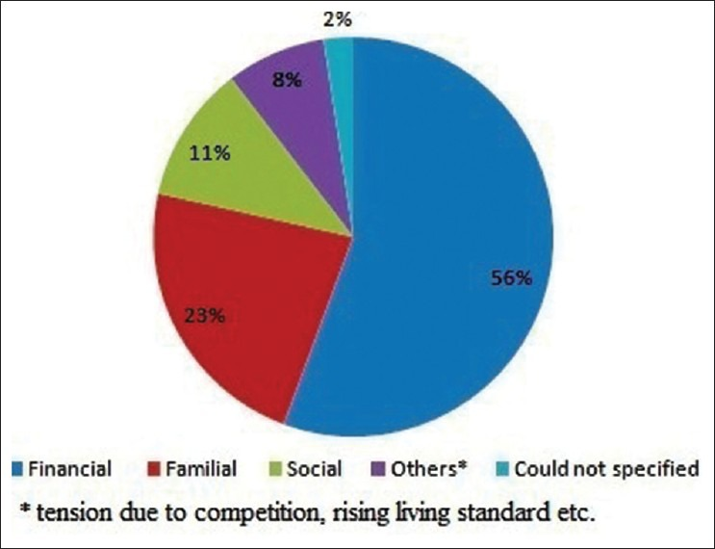
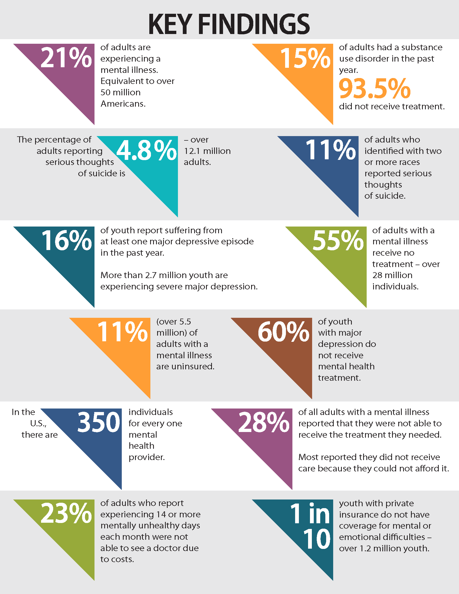
~The Effects and Disparities of Socio Economic Status in Mental Health~
Ailani Alvarez Alcantara
Durham School of the Arts
Introduction
Data and Statistics
Results
Socio-Economic status is your position in both social and economic factors in society, such as education, income, and occupation(Google). In society, your status is determined by these factors and put into different levels, high, medium, and low, however the different levels of status can also affect your mentality and the way it is treated.
Research Question-How does socio-economic status affect Mental Health in the United States?
Thesis Statement- Socio-economic status affects Mental Health in the United States by causing people with a lower socio economic status to undergo financial stress, as well as lack of access to proper health care and education compared to people with a higher socio economic status.
Methodology- I conducted my research on families of low-income and how their health is affected. I found secondary sources from the Duke Library website, JSTOR.org and Google Scholar I read articles that were between the years 1990 to 2021, my research incorporated both qualitative and quantitative data. I looked into what socio-economic status is and how it affects mental health. It was difficult to find the right sources to correlate with the topic.
Impact Evaluation of the Community Mental Health program at Habra (Kamlesh Kumar Lash, Apr 2014)
(Sahu, 2014)
The Impact Evaluation of the Community Mental Health Program at Habra, West Bengal, India, shows why mental illnesses are increasing in their community. The respondents were families that contain individuals with mental illnesses. The data conveys 56% of families responded that their issues were due to financial struggles in the community, 23% reported that familial problems were the cause, 11% attributed it to social issues, and the remaining 8% stated tension, competition and rising living standards. The second chart below talks about the key findings of the condition of mental health in the United States. The majority points to mostly adults and children in the U.S. who lack access to mental health care because of costs. "The association between low socioeconomic status and poorer mental health is the result of disparities in the extent and quality of treatment for mental disorders obtained by socioeconomically disadvantaged individuals compared with those without such disadvantage"(Roy-Byrne et al.).
Background
2023 Key Findings of the State of Mental Health in America (MHA)
(Beers, 2023)
Socio-economic status (SES) is determined by both social and economic factors; people are put into three different categories: high, medium, and low. Families of the lower status suffer with more financial problems than those with a higher socio-economic status. Due to their low socio-economic status, they suffer from stress and anxiety as a result of debt and lack of accessibility. According to the Socio-Economic status and Children’s Mental Health: results from the Bergen Child Study of Springer link, “Low familial socio-economic status (SES) is one of the several environmental adversities found to increase the risk of mental health problems in these age groups.”(Boe et al.) Studies convey how low SES is a risk for individuals growing up with mental health problems. Low SES also affects the way children grow up and behave. As said in The Simultaneous Effect of Socio-economic Disadvantage and Child Health on Children’s Cognitive Development, “A marker of a child’s wellbeing that is strongly correlated with the social and economic processes within and across generations, is strongly affected by family socio-economic status (SES) and health (Lee and Jackson)”. Children can develop several disorders and mental illnesses like anxiety and mood disorders. Many families struggle to gain access to mental health care because of their low SES.
Conclusion
In conclusion, Socio-economic status greatly impacts mental health in the United States based on an individual's status level. In the U.S, families with a low SES struggle to provide education and health care for their children and themselves. As they struggle with health expenses and lack of accessibility, their mental health deteriorates. As a result, they can develop mental illnesses and face difficulty obtaining proper mental health care due to the expensive costs and their low status.

