Slide 1

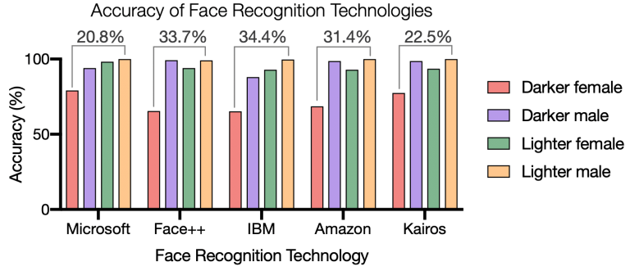
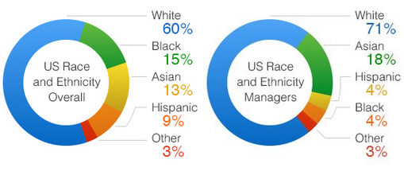
AI Discrimination; A Reflected Bias
Adam Kareem El-Ramly
Durham School of the Arts
Introduction
Data Analysis
Results
Artificial Intelligence (AI) is the concept of computer programming being trained to make its own decisions. Its growth and relevance in our lives has increased tremendously over the past few years, as all major tech companies are shifting their focus to developing these algorithms (a set of computal rules and calculations)(citation).
Question: Why do AI programs contain discriminatory bias and who is responsible?
Thesis: Programmers lead to the functionality of AI being less effective towards specific minorities due to a lack of diversity when AI is trained, and personal bias being reflected into the program.
Methodology: I conducted research on discriminatory AI by using secondary sources from Google Scholar as well as Duke and Harvard search engines. I read and analyzed sections with “AI bias”, “fairness” and “AI discrimination”. Due to how new this topic is, finding sources was a tedious task, however I continued to search for credible sources.
Amazon, some law enforcement organizations, and some medical establishments \have adopted AI that contributes to discriminatory practices. According to Najibi at Harvard University , “As Amazon has marketed its technology to law enforcement, these discrepancies are concerning”. This explains how Amazon denied any discriminatory biases in the AI they were programming (while other companies opened up to them and continued to sell their technology). These practices take place in medical establishments as well: which causes biases or inaccurate results during diagnosis. If Amazon, some law enforcement organizations, and some medical establishments, were aware of the discrimination this AI was causing, studies have shown this would not be problematic (Najibi, 2020).
Law Enforcement’s adoption of AI has led to discriminatory practices in places such as Detroit, Michigan. The Project Green Light, PGL, was a system of high profile identification cameras in Detroit, Michigan. These cameras were placed around all of Detroit and millions were identified by a face identification system. The PGL system in Michigan was used to identify a person’s face, criminal database, driving record, and ID. The results of this project were more accurate towards Asians and Caucasians however those of color were misidentified. According to Najibi at Harvard University, “PGL illustrates how systems of face monitoring can perpetuate racial inequality if their application is not regulated.”, this is a representation of the negative impact of the discriminatory practices of current AI (Najibi, 2020).
The rising use of AI in healthcare systems contains issues that need to be addressed. These issues include discriminatory practices and misdiagnosis. According to Karimian, “Developers of AI algorithms must be vigilant regarding potential dangers, including dataset shift, accidental fitting of confounders, unintended discriminatory bias, the challenges of generalization to new populations, and the unintended negative consequences of new algorithms on health outcomes [8]. It is important to build information systems that are capable of detecting unfairness and dealing with it in an adequate manner.”, this quote conveys the point of the developer being responsible for the fairness of AI. In conclusion, medical bias in AI needs to be addressed by those who design it (Karimian, 2020).
As seen the article by Dr. Darity, “Still, the NASCC face-to-face data do help us identify the statistical correlation between skin tone and appearance and earnings, wealth accumulation, and health outcomes.”. This quote helps support the claim that faces are often associated with status and trends. If computer systems pick up on these trends and apply them through algorithms, people can be accused of things unjustly by AI systems (Darity, 2021).
This chart is a representation of facial recognition technologies and their accuracy towards different skin types, depending on the company. As visible in the chart, Amazon, FACE ++, and IBM are the least consistent when it comes to people of darker skin. However what this graph doesn’t show is change over time. All of these companies adopted different approaches to training their AI after these results were brought attention, with the exception of amazon. This chart was released nearly two years ago, and amazon’s statistics towards people of color haven't changed (Najibi, 2020).
Background
There are three types of AI bias according to Paul Langer and Jan Weyerer, (1) Direct bias, less favorable treatment towards certain groups or minorities being implemented into datasets used to train algorithms. (2) Indirect bias that originates from a social order or policy being incorporated into algorithms. (3) Intersectional bias which is when a differentiation of certain characteristics is programmed into systems. The reason why these several biases exist in AI algorithms is because the programmed system is reflectant of human opinions and biases of its programmer. AI must be trained with an open mind by having the system analyze several sets of data. If these sets of data lack diversity and versatility, the algorithm will unfortunately be less successful towards certain minorities (Paul Langer and Jan Weyerer, 2019).
Recently, an AI system was implemented in thousands of hospitals around the US, and was used to determine access for care programs. Because there are historically lower medical expenditures for black people, it was primarily successful towards white people. According to Giovanola and Tiribelli, a solution to this issue would be to reassess and equalize the groups of people in the dataset that were used to train the system (Giovanola and Tiribelli, 2022).
An early example of AI bias dates back to the 1980s. A medical school in the UK designed a computer program to admit applicants into their school by incorporating the methods admissions officers at their school utilize. The results of the computer program were extremely discriminatory as little to no immigrants or women were selected by the program. Additionally, a 2013 study showed that when people searched for African-American “sounding names” on Google, “advertisements suggesting arrest record” would pop up; white “sounding names”, would not do this. Aspired by (Zuiderveen Borgesius, 2018).
Seven major tech companies met at the White House on July 21, 2023 (Microsoft, Amazon, Google, Inflection, Meta, Anthropic, and Open AI) to place water marks on their AI technology. They all supposedly agreed to avoid algorithm bias.
As seen in this chart, the majority of Amazon workers and programmers are white. Specifically as seen on the right, the program managers are primarily white. This is why face recognition artificial intelligence fails on people of color, the people programming it, aren’t people of color. It’s not likely at all to be trained to recognize people of color if those training it containing it have biases, or simply train it to recognize themselves. As 89% of Amazon’s managers are white or Asian, the results are to be expected (Soper/Amazon, 2014).
Conclusion
To sum it up, the reason why AI has performed discriminatory acts is at the fault of the programmer containing discriminatory bias. In order for AI to truly be inclusive and accessible to everyone, the programmer must train the system with the same intention. More diversity in the datasets used when training algorithms would significantly help us achieve more ethically fair Artificial Intelligence.

