Slide 1

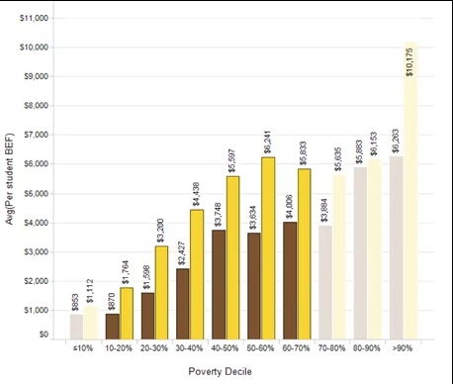
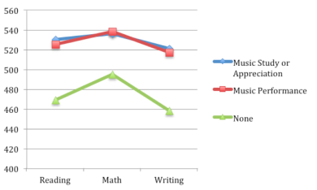
HOW LACK OF SCHOOL FUNDING AFFECTS STUDENTS OF COLORS ACCESS TO HIGH-QUALITY MUSIC EDUCATION
Adaeze Ezuma-Igwe
Durham School of the Arts
Introduction
Data Analysis
Results
Music education positively contributes to the success of a child's education by improving memory, literacy, and executive function which are all useful skills that can be used in an educational environment. Unfortunately, that opportunity is not offered to many in low-income communities housing students of color.
Research Question:
How does lack of school funding limit access to musical education for students of color?
Thesis Statement: The lack of school funding limits access to musical education for students of color because of the lack of income in their communities which has affected the outcome of their education compared to those with access to high-quality musical education.
Funding per person, by Race and Income
Urban low-income communities receive $870 per
student compared to the rural communities receiving
$1,761. For urban high-income communities,
they receive $3,884 per student while rural
communities receive $5,835. “Researchers have
shown that students whose families have a lower
SES are less likely to persist in school music or
participate in school music at the Secondary
level” (Culp et al, 2020). This data proves how
race and economic status determines the amount of
funding provided for students and prove how music
study can affect the education of a student.
(White, 2015 )
Background
The brown in this graph represents funding of schools in less white communities while the yellow represents the funding of predominantly white communities demonstrating that race takes part in the funding provided for students of color.
Methodology
Schools around low-income communities do not receive much funding for extracurricular activities, so they turn to Parent Teacher Associations (PTAs) and booster clubs for fundraising. According to Elpus. “the small local music booster associations familiar to many practicing music educators. coined profits to refer to “parent teacher associations (PTAs), parent teacher organizations (PTOs), alumni associations, booster clubs, school of foundations, and local endowments” operating primarily to support one local school or district”(Elpus et al, 2019).
Improved literacy, memory, and executive function are shown to be an effect of musical comprehension. According to Collins, “musicians have been found to have higher levels of Executive Function, which refer to a group of interlinked tasks that include planning, strategizing, setting goals, and paying attention to detail” (Geake, 2009; Hanna-Pladdy & MacKay, 2011). Literacy and music education have a shared resource according to Psyche Loui, Rachel E. Guetta. “Slevc and Okada (2015) suggest that cognitive control, and the implicated prefrontal cortical mechanisms, may be one shared resource between the musical and linguistic domains,” showing that learning and understanding music can cause literacy skills to also increase.
(Collins, 2014) (Guetta et al, 2018)
Music rehearsals have also been shown to improve short-and long-term memory as stated by Collins, “It has been suggested that music rehearsal helps improve the memory pathways in the brain ”. It is also shown by Collins that, “Musicians have been found to possess advanced skills in both long and short-term memory (Jonides, 2008) and memory storage and retrieval (Dunbar, 2008).” (Collins, 2014)
For this project, I gathered literature from ERIC, Duke Library and Google Scholar ranging from the years 2014-2022. It was difficult to find sources that related directly to the outcome of music education, but I found many articles related to music education and its connection to the brain. During my research I focused on urban areas, funding inequality, and benefits of music education
SAT scores of those who took music classes versus students who took none.
Conclusion
Music education should be accessible to all students as it improves their education but is not, as a result of the lack of funding in communities housing students of color. Neither race nor income should be a factor in determining a student's quality of education within schools. Quality music education should be provided for all students to improve their overall education. To prevent this problem, things… “such contributions, school districts could provide letters to allow families to claim tax deductions for donations.” (Culp et al, 2020). Another solution would be to recycle instruments, books, etc. used to conserve money. Schools can also find volunteers to provide music education for students. Music education should be considered a valuable part of a student's education and implemented into school's curriculum.
(Becker, 2016)
The lack of funding reduces their accessibility to music education therefore decreasing their educational outcome. The graph shows students with music education have higher SAT test scores especially in literacy proving why music education should not be a privilege but instead attainable to students of all races.
Notes:
Define arts for background
Elpus et al,page or yr

