Slide 1
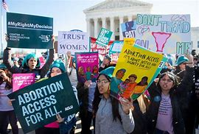
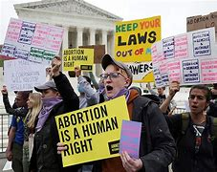
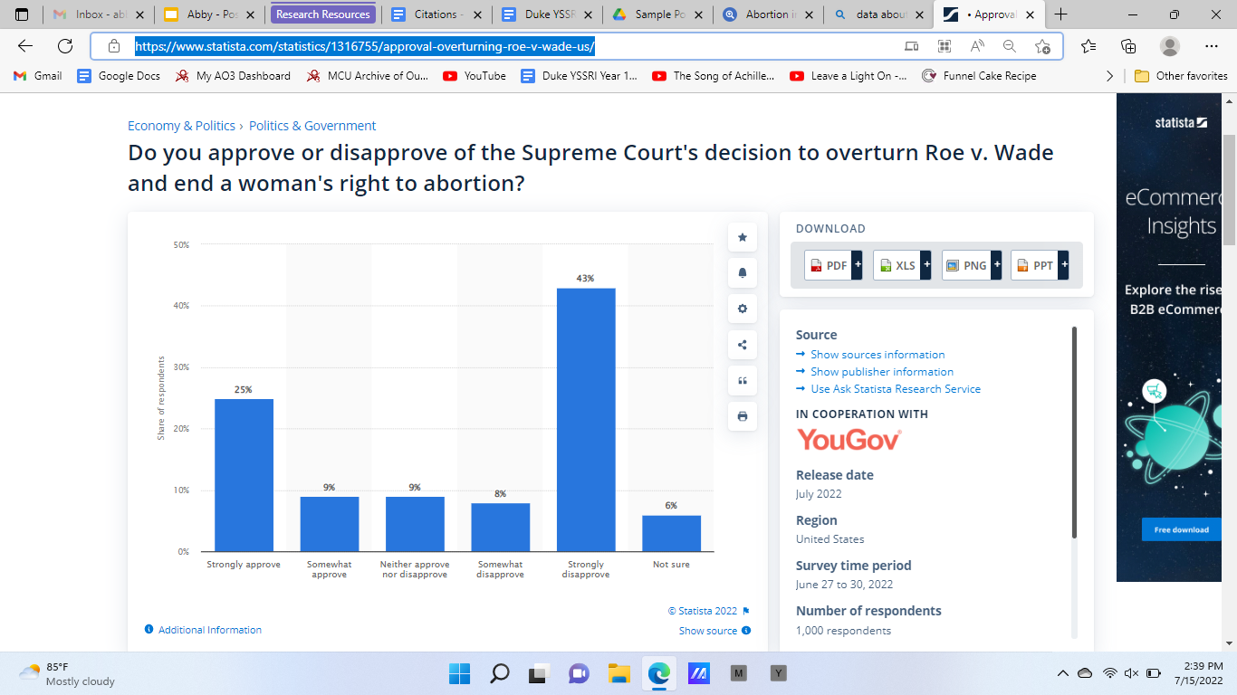
Roe v. Wade and its Effects on Women’s Reproductive Health
Abby Courliss || Hillside New Tech High School
Introduction
Methodology
Impacts
In 1973, the Surpreme Court issued Roe v. Wade, which made abortion a constitutional right. The effects of this decision lasted for almost 50 years, until June 24th, 2022, when the Supreme Court overturned Roe v. Wade on the 24th of June and ruled that abortion was no longer a constitutional right (History.com Editors, 2022). This decision has had serious consequences for women. My research aims to answer the question: “What are the current and possible future effects of Roe v. Wade being overturned on women’s reproductive health?”
I have mostly qualitative research, as I preferred to find scholarly articles to find information. One source that was very helpful to me was Google Scholar, which I used to find many scholarly articles that were helpful with my research. I ran into a bit of a challenge in the beginning of my research with finding enough sources, but then i widened my search parameters and found more sources.
Abortion is now totally banned in 13 state so far, with no exceptions for rape or incest (US Abortion Clinic Locator, N.D.). This means that for women in states where there is a total ban on abortion, they must travel out of that state to another state where they are able to get an abortion. This poses serious problems. A pregnant woman who needs an abortion and who lives in a state where abortion is banned may not have the time, money, and support needed to travel to a state where she is able to get an abortion. Furthermore, restrictions and regulations vary from state to state (US Abortion Clinic Locator, N.D.). For example, a woman in California is able to get an abortion until her pregnacy reaches “viability”, which usually happens around 24-26 weeks of pregnancy (US Abortion Clinic Locator, N.D.). But a woman in Texas cannot get an abortion at any stage in pregnancy unless there is danger to her life or serious risk to her physical health (US Abortion Clinic Locator, N.D.). This creates an unfair and unjust situation for the women in Texas, and the women in other states with total bans on abortion.
Pictures of people defending abortion rights
Data
Below is a survey done by the website Statista. It asks US adults if they disapproved or approved of the Supreme Court’s decision to overturn Roe v. Wade, which ended women’s rights to abortion. This graph shows that most US adults strongly disapprove of the Supreme Court’s decision (Statista, 2022)
Background
1965 - The Supreme Court rules that a law banning the distribution of birth control to married couples violated their right to privacy in the Constitution, so they strike down the law (History.com Editors, 2022).
1972 - Supreme Court strikes down a law banning contraceptives from being distributed to unmarried couples (History.com Editors, 2022).
January 23, 1973 - Roe v. Wade is issued by the Supreme Court, recognizing a woman’s right to an abortion and legalizing abortion across the country (History.com Editors, 2022).
June 24, 2022 - The Supreme Court overturns Roe v. Wade, stating that it is no longer a constitutional right and leaving states to decide their own rules about abortion (History.com Editors, 2022).
Conclusion
The impacts of the decision by the Supreme Court to overturn Roe v. Wade are serious and widespread. Women now have a much harder time getting an abortion than they did before Roe v. Wade was overturned, and there is the possibility for even more restrictions and threats to medical freedom in the future.

