Slide 1
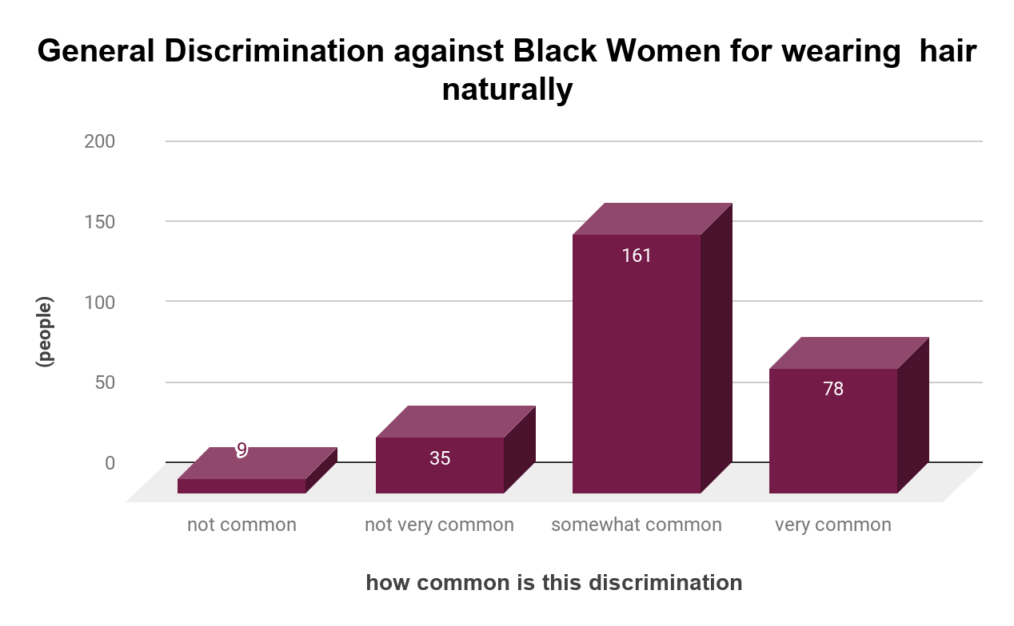

Don’t Take My Hair: Discrimination in the Workplace
Tiya Walker || Northern High school
Introduction
Data
Results and Solutions
How do implicit biases about hair affect the way Black women are treated in the workplace?
Natural hairstyles being seen as inappropriate leads to discrimination of Black women in the workplace. Often companies use grooming policies to target hairstyles that are historically associated with Black people, mainly Black women. Black women are denied jobs or promotions because they do not change their hair.
Implicit Bias are the attitudes or stereotypes that affect our understanding, actions, and decisions in an unconscious manner. These biases, which encompass both favorable and unfavorable assessment, are activated involuntary and without an individual’s awareness or intentional control.
Black women have a 60% chance of a getting promoted to manager while their white women co workers have 84% chance to be promoted to manager
Chastity Jones is a Black women that lost a job opportunity in Alabama because she refused to cut off her Locs in 2013
Renee Rogers another Black women who claimed she was discriminated against because she had a braided hairstyle and got fired in 1981
80% of Black women believed that relaxed hair is easier to maintain than natural hair because society has inforce the idea of European hair on Black women for decades. This is showed through the Doll Test
Many times this type of discrimination against a Black women due to their hairstyle is dismissed by the court because they do not see the connection between their biological and cultural race, as seen in “Rogers v. American Airlines.” But it has been proven that most companies grooming policies targets many hairstyles that are historically associated with Black people like Afros, Braids, Locks, faux locs, cornrows, twist, ect.
The case of Chastity Jones: The Federal Appeals court ruled in favor of the employer because they see no connection between Black people and locks
Rogers v. American Airlines: The court ruled that the distinctions between biological and cultural conception of race and gender discrimination has no relation.
Background
Grooming Policies:Employers regulate clothing, piercings, tattoos, makeup, nails, hair, and more.
The professional look is based on European features and standards which consist of white features; light skin, straight, tamed hair
The court case, The Equal Employment Opportunity(EEOC) & Chastity Jones V. Catastrophe Management Systems(CMS), made it to the Supreme Court but they rejected the case because they did not see hair policies as racial discrimination
The Good Hair Study did an Implicit Association Test(IAT) which showed pictures of Black women with natural hair and straight hair and did word association with both pictures. Most people of all race and gender had some bias towards Black women with natural hair.(Karen G. Bates, National Rubic Radio)
Solutions: We can fix this by making laws that stop, such as the laws recently created in California and New York, that protect Black women's traditional hairstyles and enforce them. We can also develop and mandate trainings that help dismantle employer’s and companies’ implicit biases.
The California Create a Respectful and Open Workplace for Natural hair(CROWN) Act passed on June 27, 2019
New York City Human Rights Law
Source https://file.scirp.org/pdf/JSS_2014010814473478.pdf
Methodology
Conclusion
I did my research by going on Google Scholar and found multiple articles. I found 3 of my articles that came from heinoline.com, a law journal library, that gave me multiple cases, lawsuits, and most of my qualitative data. The key words I used to look for my articles were Black women, discrimination in the workplace and hairstyles. I found a lot of my quantitative data from an online study by Taibora A. Johnson and Teiahsha Bankhead on Black women experience in society wearing their natural hair. From the article “A Hair Piece: Perspective On The Intersection of Race and Gender,” I learned about the stories of Cheryl Tatum and Renee Rogers.
I have found that Black women do face discrimination in the workplace such as not getting the job, getting fired, or just unfair treatment and less opportunity then their White co workers because people’s implicit bias about their hairstyles. The military has also done this, they deemed it inappropriate for Black women to have locs while serving their time in the military. Even in media you see this trend of Black female celebrities are criticized about wear traditional hairstyles like faux locs, weaves, box braids, and other braid styles because of people’s implicit bias of those hairstyles but not when White female celebrities wear them. To fix this problem we have to learn not to act on implicit biases on Black women and accept this culture difference to make the workplace more diverse. We can follow in California footsteps and make it illegal for employers to discriminate against Black women due to their hairstyle.

