Slide 1
Racial Discrimination in the American Legal System
Ruben Cedillo, Samuel Dixon, Bethany Graham, Jazlyn Moore, and Syniaa Pace

Slide 2
This presentation delves into the corruption and consequences in our criminal “justice” system.
Origins of Colorism, In The Media, In The Criminal Justice System
Police Brutality
Racial Bias’ Influence on Prosecutorial Discretion (Pre-trial)
Discrimination in Criminal Justice (Sentencing)
Collateral Consequences for Ex-Convicts

Slide 3
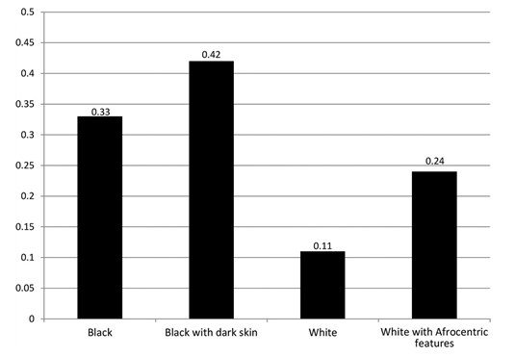
Colorism is discrimination based on skin color.
Colorism started during American slavery.
In the media, women with lighter skin are portrayed more often than women with darker skin(Urban Time Magazine)
In the criminal justice system, most of the time, people with lighter skin receive a shorter sentence than people with darker skin.
Origins of Colorism, In The Media, In The Criminal Justice System
Source: King & Johnson, 2016

Slide 4
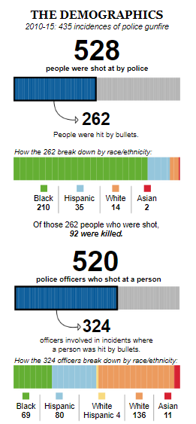
Why is it an issue?
Who’s trying to stop it?
How to stop it?
In Chicago there are 32.9% African Americans, 31.7% Whites, 28.9% Hispanics, and 5.5% asian. About four of every five people shot by police officers in Chicago in the past six years were African-American males.
Police Brutality In Chicago

Slide 5
How does race affect pretrial prosecutorial decisions?

Slide 6
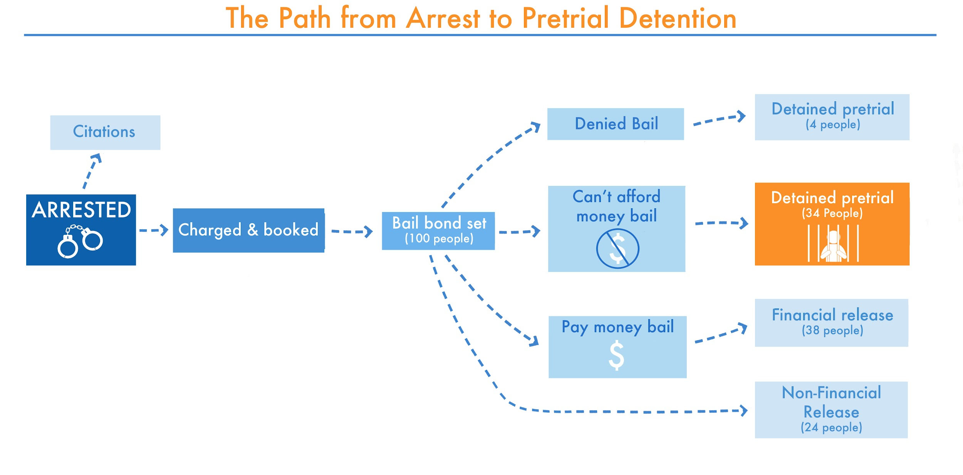
Expense Complications
  46% of all Americans cannot afford a “small” $400 emergency expense.
Racial Influence
  Black and Hispanic defendants are more likely to be offered plea bargains that include a prison sentence than whites and Asians charged with the same crimes.
Sentencing Complication
  Higher numbers of minority defendants who are unable to make bail and who are remanded to jail cells until the their trial begins are either found guilty, plead out and/or receive some form of sentencing.
Racial Bias’ Influence on Prosecutorial Discretion

Slide 7
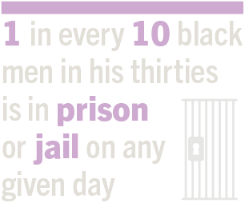
The criminal justice system discriminates against African American males.
Prison sentences of black men were nearly 20% longer than those of white men for similar crimes.
Future trends indicate that one of every three black American males born today will expect to be in prison in his lifetime, one of every six Latino males compared to one of every seventeen white males.
Discrimination in Criminal Justice (Sentencing)

Slide 8
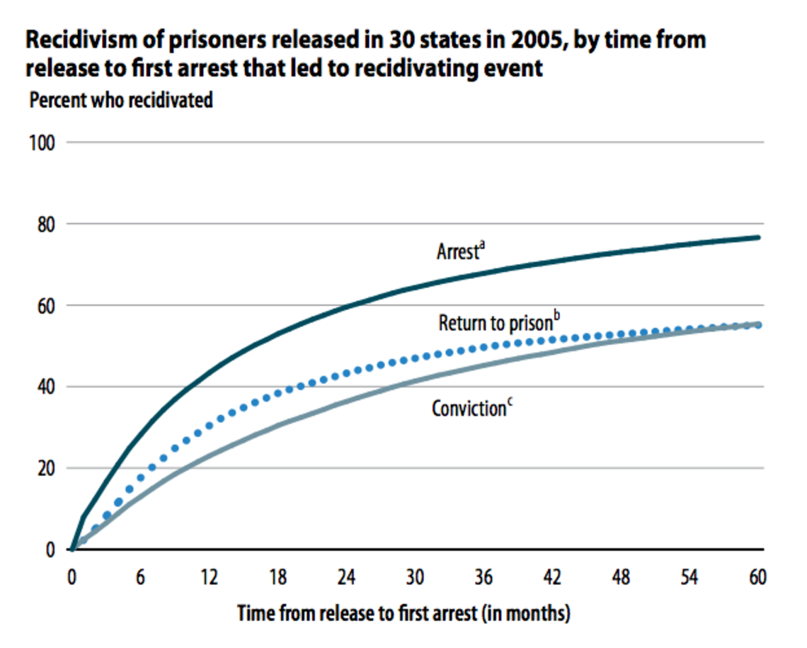
Ex-convicts face numerous restrictions such as:
  Employment
  Housing
  Neighborhood disparities
These consequences are institutionalized.
  As a result, this makes them more susceptible to criminal relapse and thus, re-incarceration.
Collateral Consequences for Ex-Convicts
Sources: (Warren, 2016);(Michelle, 2010);(Bushway, 2007);(Massoglia, Firebaugh, Warner, 2012)
(Chart source: The Marshall Project)

Slide 9
Conclusion
Minorities are treated unequally compared to their white counterparts.
Colorism continues to be unrecognized in the criminal justice system.
It is unacceptable that people receive harsher sentences for similar crimes.
These legal inequalities hinder people's ability to prosper economically, socially, and eventually aid to the repeating cycle of incarceration

Slide 10
30 2015 Jan Ransom Globe Staff September. "Black defendants more likely to be held before trial than whites in some counties, study finds - The Boston Globe." BostonGlobe.com. N.p., 30 Sept. 2015. Web. 26 July 2017.
Alexander, Michelle. The New Jim Crow : Mass Incarceration in the Age of Colorblindness. New York : [Jackson, Tenn.] :New Press ; Distributed by Perseus Distribution, 2010. Print.
Bushway, Shawn D. "ABOLISH LIFETIME BANS FOR EX-FELONS." Resource Link. N.p., 01 Nov. 2007. Web. 19 July 2017.
Hannon, Lance. "White Colorism." Sage Journals, Social Currents, 5 Feb. 2015, journals.sagepub.com/doi/full/10.1177/2329496514558628#articleCitationDownloadContainer.
Hunter, Margaret. "The Persistent Problem of Colorism: Skin Tone, Status, and Inequality." Sociology Compass, 3 July 27, onlinelibrary.wiley.com/doi/10.1111/j.1751-9020.2007.00006.x/full.
Kahn, Andrew, and Chris Kirk. "Eight Charts That Show How the Justice System Is Stacked Against Black Americans." Slate Magazine. N.p., 09 Aug.
2015. Web. 26 July 2017.
Massoglia, Michael, Glenn Firebaugh, and Cody Warner. "Racial Variation in the Effect of Incarceration on Neighborhood Attainment." American Sociological Review 78.1 (2012): 142-65. Journals.sagehub. Web. 23 July 2017.
Money Bail: Freedom and Justice Out of Reach for Far Too Many Californians." ACLU of Northern California. N.p., n.d. Web. 25 July 2017.
Person, and Kathleen Wong. "10 Police Brutality Statistics That Are Absolutely Shocking." Mic. N.p., 09 Dec. 2015. Web. 16 May 2016.
"Police Brutality." The Free Thought Project. N.p., n.d. Web. 18 May 2016
Pretrial Racial Justice Initiative." Projects. N.p., n.d. Web. 26 July 2017.
Reilly, Katie . "Most Chicago Police Shooting Victims Black Males: Report." Time. Time, n.d. Web. 31 July 2017.
Sanders, Topher. "The Lighter the Skin, the Shorter the Prison Term?" The Root, 5 July 2011
Shadow Report to the United Nations on Racial Disparities in the United States Criminal Justice System." N.p., n.d. Web. 31 Aug. 2013. "Racial Disparities in Sentencing ." N.p., 27 Oct. 2014. Web. 21 July 2107.
Statistics, Source: Bureau of Justice, and Dana Goldstein. "The Misleading Math of 'Recidivism'." The Marshall Project. N.p., 16 Nov. 2016. Web. 26 July 2017.
Turner , Jennifer , and Jamil Dakwar. "Racial Disparities in Sentencing." ACLU.ORG (October 27, 2014): n. pag. Web.
Wheelock, Darren. "Collateral Consequences and Racial Inequality ." Journal of Contemporary Criminal Justice 21.1 (July-25-2016): 82-90. Journals.Sagepub. Web. July & aug. 2017.
Webb, Sarah L. "Colorism: Roots and Routes." Colorism Healing, 13 July 2013, colorismhealing.org/colorism-roots-and-routes/.
“Williams, Pete. "Justice Department Says Poor Can't Be Held When They Can't Afford Bail." NBCNews.com. NBCUniversal News Group, 19 Aug. 2016. Web. 26 July 2017.
Winters, Mary-Frances. "The Impact of Colorism." The Inclusion Solution, 13 Feb. 2014, www.theinclusionsolution.me/the-impact-of-colorism/.
Citations

