Slide 1
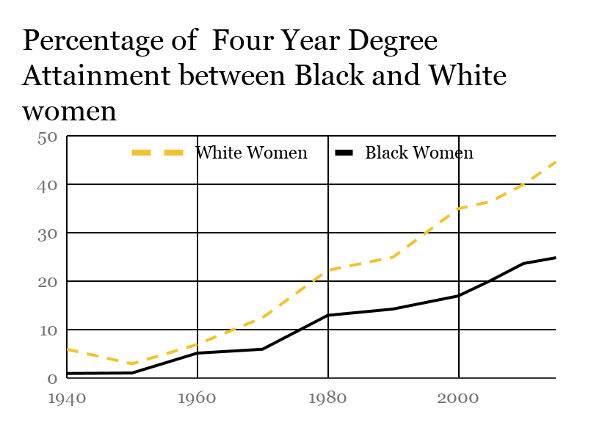
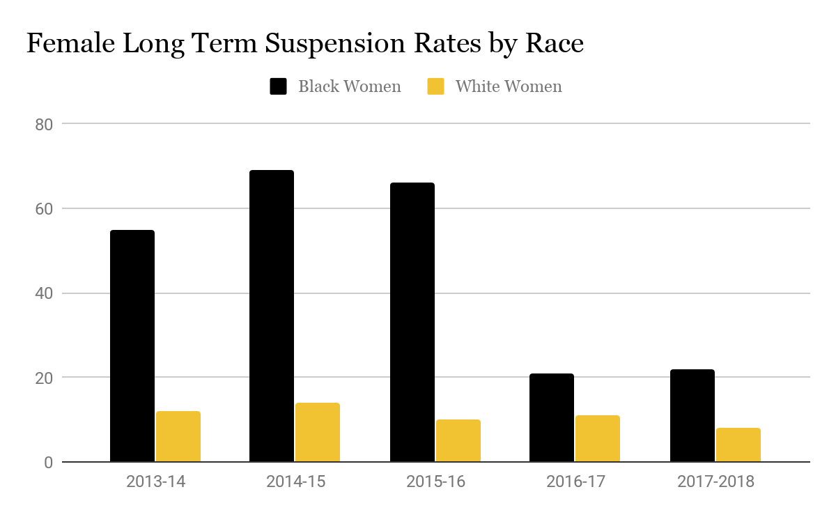
Tainted Records: High School Disciplinary Actions Affecting the College Graduation Rate of African American Women
Oluwafunmilayo Adio || City of Medicine Academy
Introduction
Data
Solutions
How do school disciplinary actions affect the college graduation rate of African American women?
African American women continuously face disadvantages and setbacks in the education system. In high school, African American females are more likely to receive disciplinary actions than White females. These circumstances can cause African American women to have problems obtaining undergraduate degrees. In 2015, a study reported that about 45% of White women had at least undergraduate degrees, in comparison to only 25% of African American women. Disciplinary actions used in high schools such as suspensions, expulsions, and zero-tolerance policies can hinder college acceptance.
A report from Columbia Law School’s Center for Intersectionality and Social Policy Studies found that black girls are six times as likely to be suspended than white girls. The study from the Center for Community Alternatives also found that half of all high schools disclose such information to colleges, even though they are not required to do so. Some scholars argue colleges should continue to weigh disciplinary records into college acceptance. They argue that weighing disciplinary records into admissions will make college campuses safer. Disciplinary actions disproportionately affects students of color. Students of color often experience implicit and explicit bias when it comes to school discipline. These circumstances make it unfair for disciplinary records to be weighed in college admission decisions.
Implicit biases are the reason African American females experience harsher disciplinary sentences than their White female counterparts. According to the Kirwan Institute for the Study of Race and Ethnicity implicit bias are the actions, thoughts, or beliefs about a certain group of people based on stereotypes given to them by society. By teaching teachers to be conscious of their implicit bias, we can reduce the number of negative actions taken in schools because of implicit bias. Restorative justice programs are also helping to reduce this issue. Restorative justice programs are programs that focus on fixing issues between students and teachers, instead of resorting to more punitive measures. These programs are already reducing suspension and expulsion rates in districts. By reducing the number of suspensions and expulsions in schools, this will remove several barriers, including disciplinary records, that African American women face in their path to college graduation. My research shows that disciplinary actions are weighed in college admissions. You cannot complete an undergraduate degree, if you are not accepted. My research also shows there are systems put in place that make it harder for African American women to graduate college, which goes on to affect many aspects of their life, including future income earning power.
Background
School Discipline
Zero Tolerance Policies: Predetermined policies enforced in schools for specific offensives. Policies are often severe. Zero Tolerance Policies include but are not limited to: Suspensions and expulsions.
College Admissions
Colleges look at specific criteria before accepting and enrolling students into their institutions. High school disciplinary records are a part of this criteria. A study found that 3 out of 4 colleges and universities collect high school disciplinary information, and 89% of those institutions use that information to make admission decisions
Methodology
I gathered my research through numerous scholarly articles and websites such as Education Week and the Greater Good Magazine. The majority of my information ranges from 2014-19. To create my graphs, I used information gathered from the Brookings Institution and the 2017-18 North Carolina Annual Report on Suspensions and Expulsions. I compiled my data into a graph using Google Sheets. I used the studies ¨Education Suspended: The Use of High School Disciplinary Records in College Admissions” and a study conducted by the Center for Community Alternatives to gather information on the impact of school disciplinary actions on college admissions. I believe all of the websites I chose were unbiased because I chose websites and articles that were either reporting studies, reporting facts, or reporting information from prominent people such as psychologists and superintendents. While researching I found my information by using search terms, such as ¨North Carolina suspension rates 2018-19 school year¨ and ¨Discipline discrepancy between African American women and White women in schools¨ on Google Scholar.
Conclusion
After gathering my research I found that school disciplinary practices are causing African American women to have a lower college graduation rate than their White female counterparts. My data provided statistics that showed that African American females are more likely to receive disciplinary actions than their White equivalents. My data also showed that colleges use disciplinary records in admission decisions. A tarnished disciplinary record can affect a students chances of being accepted into a college, which is something many African American females have at a rate higher than their White counterparts. By understanding my findings, new policies can be enforced to improve the undergrad graduation rates in the African American female community.
Contact Information
Email: adiofunmi48@gmail.com

