Slide 1
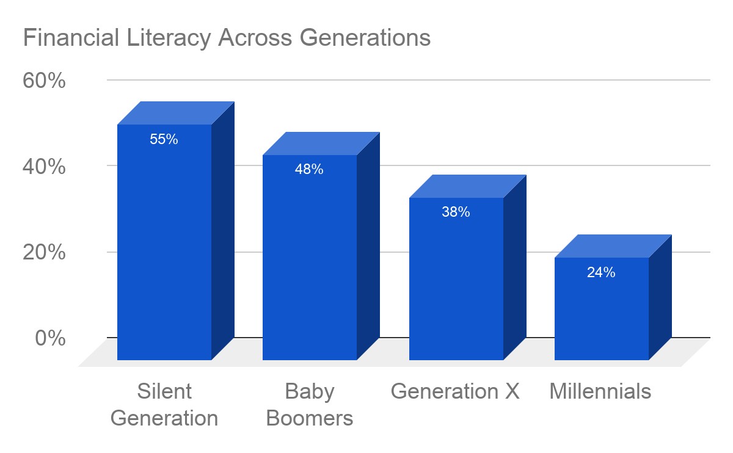
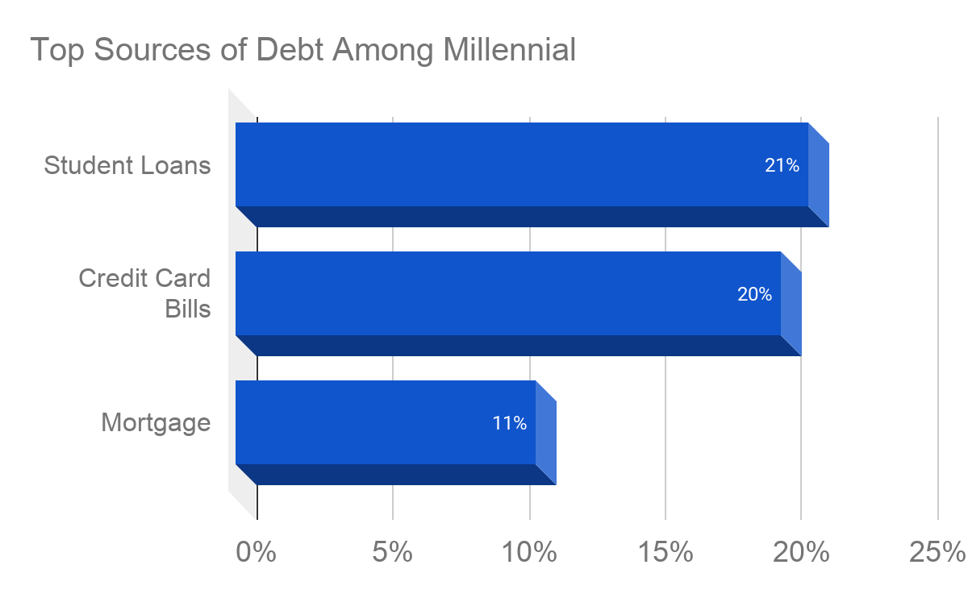
Taught to be Broke: Financial Literacy in Public School Systems
Obieze Udemadu || JD Clement Early College High School
Introduction
Data and Results
Methodology
To what extent does financial literacy matter to the debt held by millennials?
Financial literacy is defined as a set of skills, such as investments and saving habits, that enable an individual to make cost-efficient economic decisions given their financial resources. Debt is an accounting entry or asset which exceeds the monetary expense of an account. Credit is an accounting entry that has the ability to increase or decrease the liability of an account.
As the issue of financial illiteracy continues to grow, generations have been progressively less financially literate than their predecessors which is continuing to affect the financial wellbeing of many individuals. Many studies have also shown that marginalized communities are considered to be less financially literate in comparison to their white counterparts.
While conducting my research, I searched for scholarly articles that established a clear link between the absence of financial education in school systems to higher rates of financial illiteracy in future generations. Through extensive research, I found that individuals who lived in states where financial education was not a mandated course were more likely to have more forms of long term debt in comparison to those who attended schools in states which mandated financial courses. Many financial surveys also attest to this fact, one being Jump$tart Coalition for Personal Financial Literacy which is a financial education program that is centered around teaching students essential personal finance skills. When studying scores from Jump$tart financial examinations, it concluded that students who were mandated to take a financial education course performed significantly better than students who lived in states with no financial education mandates. This gives irrefutable reasoning to believe that mandating financial education is effectively increasing students financial knowledge.
Background
Financial illiteracy has been a growing problem in America over the past several generations. With the widespread absence of mandated financial education courses in America’s school systems, financial literacy rates have dropped significantly over past generations leaving millennials as the least financially literate generation in history. When studying the demographics of debt in the millennial generation, the greatest sources of debt are personal education loans, accounting for about 21% of the debt held by millennials, followed by credit card bills which account for another 20% of the generation’s debt. Recent studies have also shown that 40% of monthly income obtained by the millennial generation is used on discretionary costs such as entertainment or other non-essential items. Currently, only 17 states in the country require high school students to take a financial education course, and many studies have shown that individuals who have never taken a financial education course are more likely to have lower credit scores and higher rates of debt.
Only 24% of millennials are considered to be financially literate.
80% of millennials have one or more forms of long term debt.
30% of millennials demonstrate clear financial fragility.
Conclusion
Conclusively, the issue of financial illiteracy has been a growing crisis among generations. With the absence of financial education courses in America’s school systems, rates of financial illiteracy continue to increase with each generation. The millennial generation has been the most diverse age group in American history, while simultaneously being the least financially literate. One could argue that as marginalized communities begin to grow in population, rates of financial literacy concurrently have begin to drop significantly which poses a detrimental trend to future generations. By reading through a multitude of articles pertaining to financial literacy in America, I concluded that the lack of financial education courses in public school systems is a prime factor affecting the financial literacy rates in the country. Studies prove that students who take mandated financial education courses in high school perform significantly better financially in comparison to students with no financial education mandates. A plausible solution to the issue of financial illiteracy is to mandate nationwide financial education as it has been proven to be effective.

