Slide 1
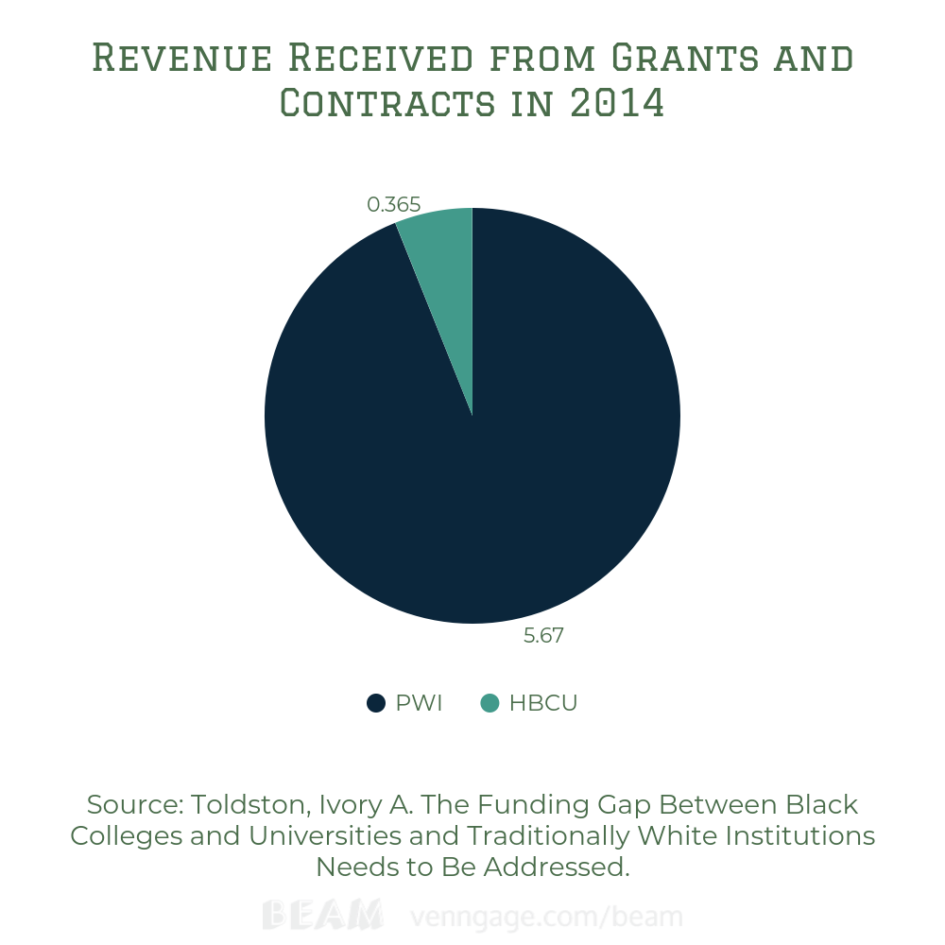
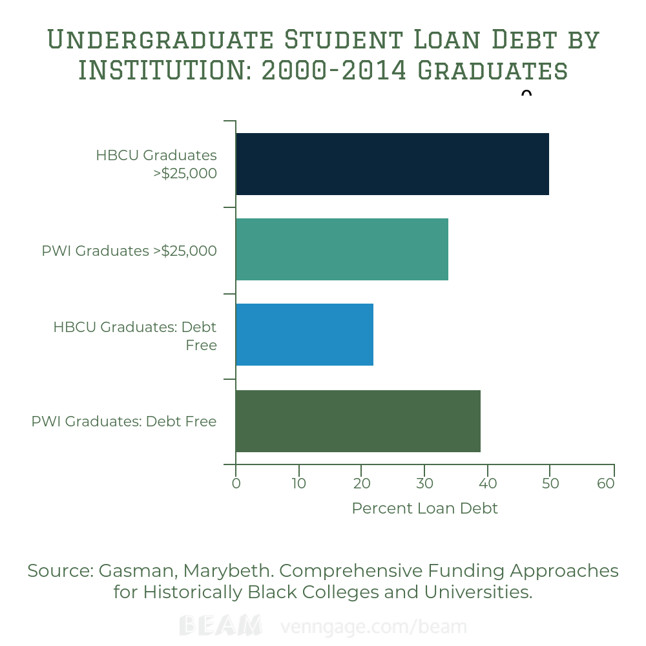
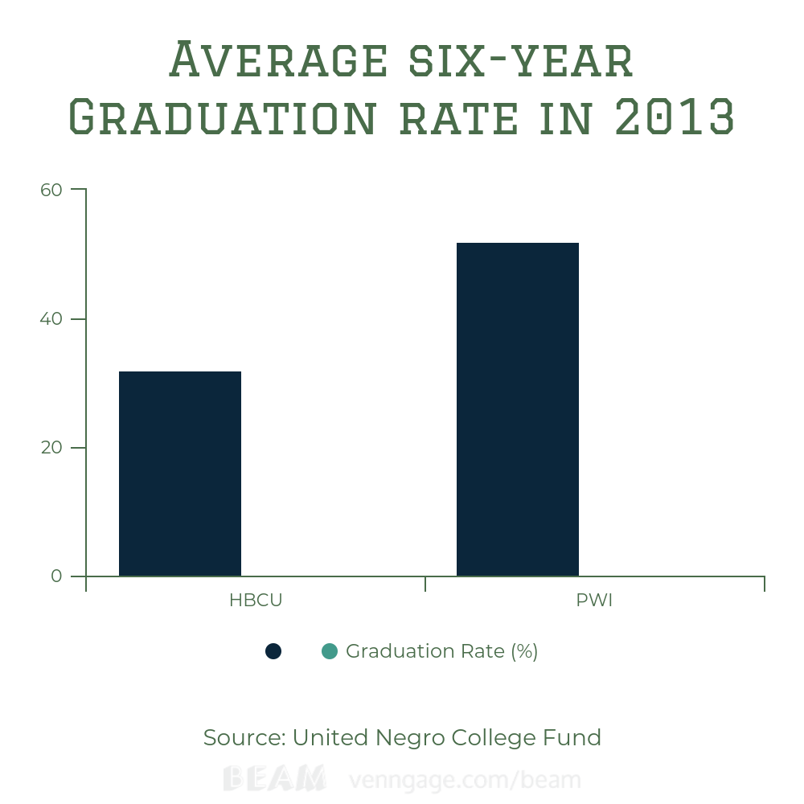
The Funding of HBCUs and the Impact on Students of Color
Naia King || Riverside High School
Introduction
Results
Methodology
How does the underfunding of HBCUs affect current and postgraduate students in the future?
Historically Black Colleges and Universities (or HBCUs) were established prior to 1964. HBCUs have an important role in the Black community as schools that first gave Black students the opportunity to obtain higher education when virtually no other colleges would. I chose this topic because HBCUs are the epitome of Black achievement, however many HBCUs face growing competition with Predominantly White Institutions (PWIs) to recruit high-achieving African American students who are often aggressively recruited by other types of institutions. HBCU enrollment represents about 14% of African American students (graduate and undergraduate) in the nation. However, while HBCUs represent 3.3% of all American colleges and universities, they are graduating 50% of African American teachers and 22% of African American scientists and engineers; roughly 28% of all African American engineers go on to receive a PhD (according to a study created by Dr. Lezli Baskerville of the NAFEO- the National Association for Equal Opportunity in Higher Education).
In 2014, four traditionally White institutions received more revenue from grants and contracts than all of the top 10 four-year historically Black colleges and Universities combined [HBCU TOTAL: $365,725,753.00 - PWI TOTAL: $5,669,955,783.00]
Using Duke Library and JSTOR, I was able to find various scholarly articles. I received the statistics from the first graph from an article written by Professor Ivory Toldson of Howard University, which emphasized the funding gap between HBCUs and PWIs. I received the statistics from the second graph on the undergraduate student loan debt from an article written by Professor Marybeth Gasman of the University of Pennsylvania. I received the statistics from the third graph from an article from the United Negro College Fund, which focused on the differences in the graduation rates between HBCUs and PWIs. Many of those who argue that public Black colleges should not operate at the public’s expense argue that these institutions are racially identifiable. However, HBCUs have never excluded students based on race and since the Brown v. Board of Education ruling HBCUs have actively opened their doors to white students. To further strengthen this argument, I’ve collected data from several reliable sources on the differences in revenue received, differences in student loan debt, and the differences in graduation rates between HBCUs and PWIs, and have constructed a series of graphs to illustrate both the cause and the impact of the underfunding of HBCUs.
Half of all HBCU graduates from 2000-2014 reported graduating with more than $25,000 in loan debt, while only 34% of predominantly white college graduates reported similar levels. Only 22% of HBCU graduates left school with no debt, compared to 39% of graduates at non-HBCUs
Background
The second Morrill Act of 1890 required states to provide land-grants for institutions for Black students if admission was not allowed elsewhere. As a result, many Historically Black Colleges and Universities (commonly referred to as HBCUs) were established. Within the past few decades, the financial health of many schools have taken a turn for the worst. Public HBCUs have even more problems, typically receiving inequitable government funding at both the federal and state level, in comparison to PWIs. In 2015, public four-year HBCUs received about $2.2 billion in federal, state and local funds, while non-HBCUs received a little over $94 billion from the same sources. In that same year, the unemployment rate of African American graduates between 22 and 27 was roughly 12.4% more than twice the rate of their White counterparts. Several schools are experiencing financial challenges or are facing closure after its accreditor, the Southern Association of Colleges and Schools Commission on Colleges (SASC), voted in December of 2018 to end Bennett’s accreditation citing major budget deficit after two years of probationary accreditation
Conclusion
Today, the Nation’s 106 HBCUs make up just three percent of America’s colleges and universities, yet they produce almost 20 percent of all Black graduates. For more than 100 years, HBCUs have been educating minorities, giving them economic opportunities and instilling great values. There is much that can be done by both private and federal entities to increase the funding of these institutions. The federal government can help by strengthening HBCUs with support for loan forgiveness programs. These programs would help eliminate student debt so they don’t have to worry about it in the future. HBCUs receive less in private gifts due to the ever-growing gaps in racial wealth, which can put HBCU alumni at a disadvantage to supporting philanthropic efforts.
In 2013, the six-year graduation rate for HBCUs was 32% compared to 52% for other four-year public and private, nonprofit colleges and universities

