Slide 1
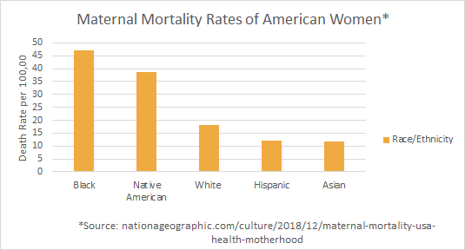
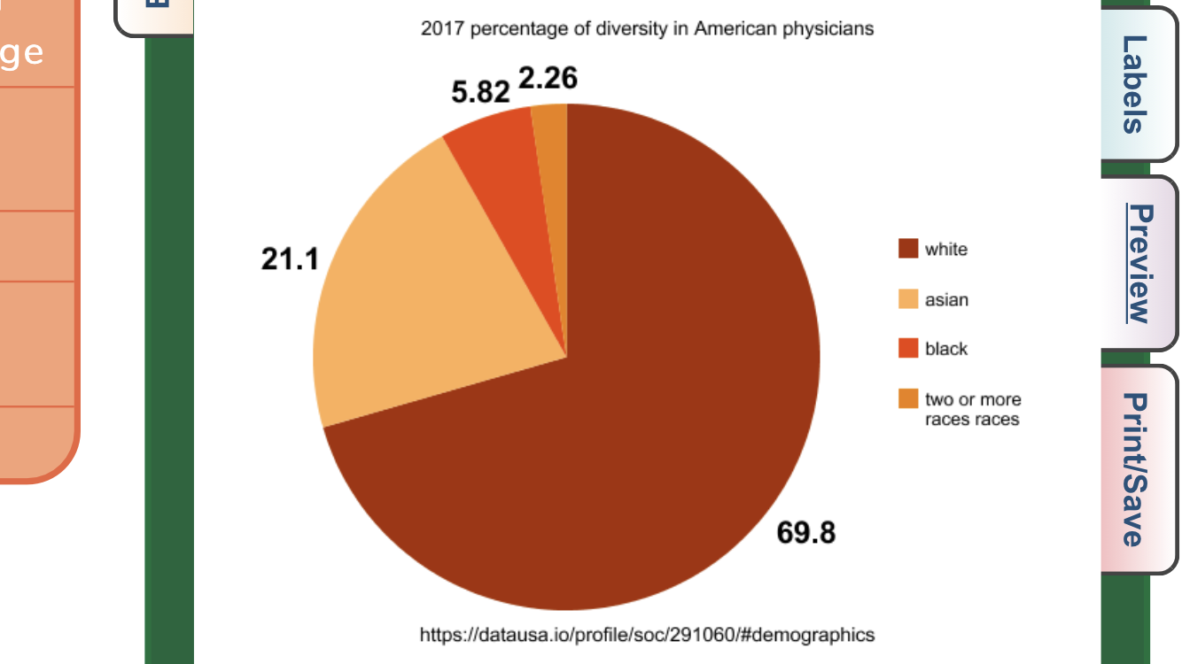
Death by Delivery: Implicit Bias Against Black Mothers
Mya Parker || Northern High school
Introduction
Data
Results and Solutions
To what extent does implicit bias play a role in the mortality rates of Black mothers in American hospitals?
Implicit bias
Implicit bias refers to the attitudes or stereotypes that affect our understanding, actions, and decisions in an unconscious manner. These biases, which encompass both favorable and unfavorable assessments, are activated involuntarily and without an individual’s awareness or intentional control.
Institutionalized racism and biased healthcare in the medical field play a role in the alarming rate of Black mothers dying during or shortly after childbirth. Just as the case of hundreds of Black women, like Serena Williams, healthcare professionals often choose to ignore the concerns of Black women.
In the more than 200 stories of African-American mothers that ProPublica and NPR have collected over the past year, the feeling of being devalued and disrespected by medical providers was a constant theme.
In 2011, the CDC reported that Black women comprised 42.8 percent of deaths resulting from pregnancy or childbirth whereas White women constituted 12.8 percent of this population.
Results
Implicit bias has certainly played a role in the growing numbers
of Black women dying after childbirth due to many medical
providers simply ignoring Black women’s concerns and
symptoms, and assuming they are simply exaggerating. But we
must address the fact that there are also a number of other
contributors to the high mortality rate such as unequal access to
health care, environmental disparities, and existing health problems that many pregnant mothers face such as diabetes, obesity and high blood pressure
Solutions
Target implicit bias by giving medical students courses that teach them how to avoid unconsciously discriminating against Black women
Dismantling the racist stereotypes that Black women over exaggerate their symptoms.
3. Diversifying doctors and healthcare professionals, by actively recruiting people of color, who will be able to connect with their patients.
Background
America is considered one of the worst industrialized nations to give birth in, with its alarming high mortality rates of mothers either during or after they give birth (Velasco,1). Among these high mortality rates, Black women are concerningly the most at risk of dying after giving birth-with them being three to four times more likely to die in childbirth compared to white women. Doctors with implicit biases are the main cause for this, as they tend to assume Black women are overreacting and do not take their concerns seriously. Implicit racial bias of hospitals workers (ie. doctors and nurses) plays a role in the growing mortality rates of Black mothers after giving birth.
Maternal mortality rates of American women*
Conclusion
Methodology
Implicit bias and racism in American hospitals has a significant impact on the growing disparities of maternal mortality rates of Black mothers. Neel Shah, an Assistant Professor of Obstetrics, Gynecology, and Reproductive Biology at Harvard Medical School and Director of the Delivery Decisions Initiative at Ariadne Labs says “We believe Black women less when they express concerns about the sympotions they’re having, particularly around pain. And that's the common thread in all the stories we've been hearing about in the media.” Doctors and other medical officials tend to believe Black women less compared to white women when it comes to Black mothers concerns over symptoms they believe to have developed after or during birth.
I went about this research by looking at information that analyzed the growing disparities between the mortality rates of Black women giving birth compared to white women and then looked for reasons as to why Black women were more likely to die after childbirth. While i was able to find a sufficient amount of research that helped to support my claim like info from the center of disease control (CDC).There was also information that brought up a different perspective and counterargument. Like the fact that the gap may be a cause of previous health problems that Black mothers could have had. I found this not be true because an experienced doctor could have easily taken care of existing health problems.. Most of my information came from places such as duke libraries, and other scholarly articles. This research consists of both quantitative and qualitative evidence.The quantitative part dealing with numbers of Black women dying after or during childbirth and the qualitative evidence being personal testimonies of those who faced discrimination in American hospitals like Serena Williams.
(2017) Percentage of diversity in American physicians
White
Asian
Black
Two or more races

