Slide 1
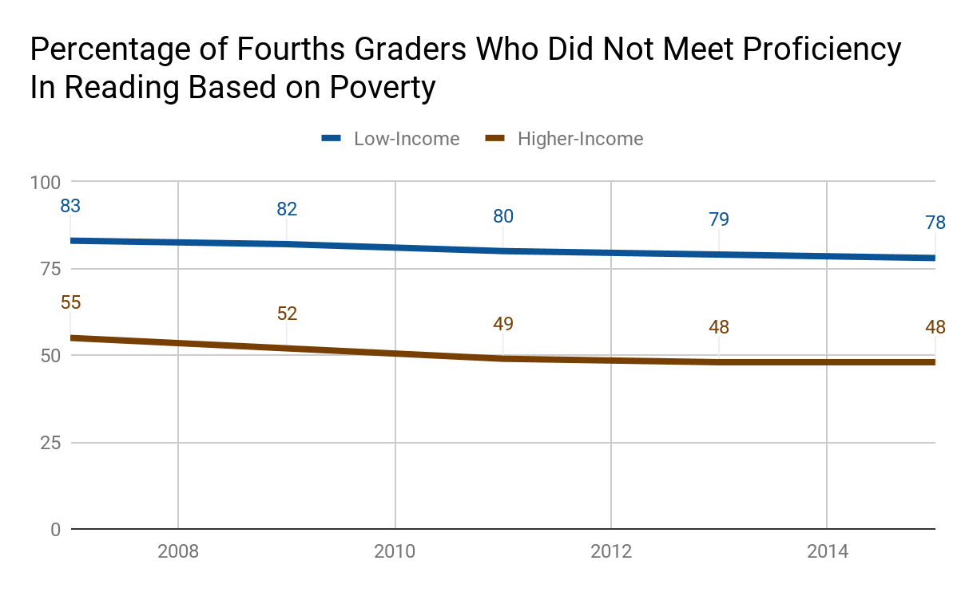
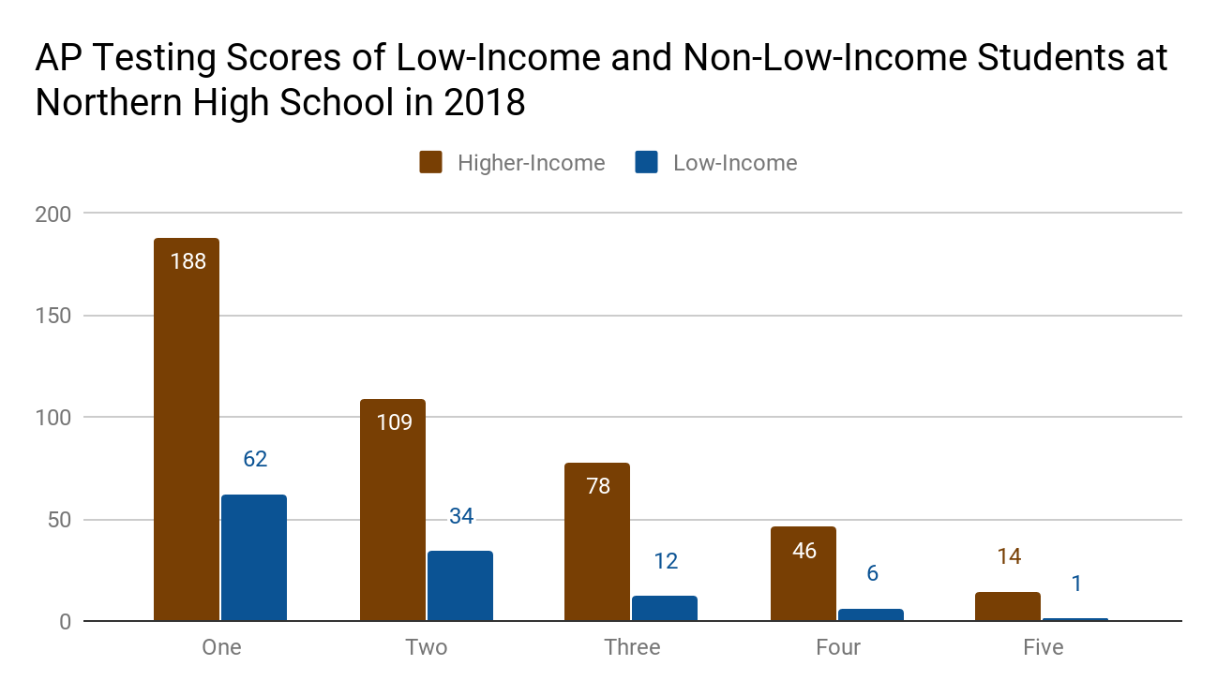
Impoverished Students: The Track to Standard Courses
Michael Jennings || Northern High School
Introduction
Data
Methodology
Does poverty impact the probability of a child being placed into advanced academics programs?
In the United States, if a family’s income is less than its threshold, which can vary by the size of the family and age of its members, then that family is considered impoverished. When a child is raised in poverty, they have less access to the resources that their peers have, creating an achievement gap that tracks them into standard classes.
I analyzed information from several research papers and online articles, including those from Duke University’s library resources, JSTOR, Google Scholar, and ProQuest database, that primarily focused on the effects of poverty on a child’s education. Some other information came from several additional reputable sources including the U.S. Census Bureau, the National Center for Education Statistics, the UNC School of Law, and the Washington Center for Equitable Growth. I also included statistics from the data on AP enrollment and proficiency rates at Northern High School from the 2017-2018 school year. This quantitative data compared low-income to higher-income academic achievement in students. I found information on factors that have an increased chance of affecting children in poverty that could also prevent or lower the probability of them being placed in honors, AP, or other classes that may be recognized as being advanced academics programs.
Background
ChildFund found that children raised in poverty are, on average, beginning school with reduced readiness. Poverty negatively influences the attentiveness, concentration, and the motivation for children to want to achieve more advanced learning. All of these further go on to decrease the test scores and increase the dropout rates of children in poverty.
In several schools in the United States that have a majority population of low-income students, the demographics of the advanced academics classes in those schools do not accurately represent those of the actual school.
In this research poster, the term poverty will primarily refer to the federal poverty level of 2018, which indicated that a family of four that has an income of $25,100 or below is impoverished. It also will sometimes refer to children who qualify for free or reduced lunches. Advanced academics are honors classes, courses that are slightly more challenging than the standard and require teacher recommendations, and Advanced Placement (AP) classes, high school courses that are college-level and can allow students to earn college credits.
Approximately 13,616,000 children in America are impoverished.
Although the quantity of children that meet the requirements for free or reduced-cost lunches has decreased over the past six years, during the 2014-2015 school year, 25,596,274 students were eligible for these meals.
Nearly 30% of all children in poverty drop-out of high school due to them having less access to economic, material, and community resources as compared to their counterparts, of whom are not in poverty.
Conclusion
Children in poverty are far less likely to be placed into advanced academics programs at their schools when compared to their higher-income peers. From a young age, a decreased access to resources can contribute to a lack of recognition by teachers and a lower academic achievement. These students have an apparent disadvantage that can be seen by the disproportionate drop-out rates, low test scores, and lower proficiency rates.
Possible solutions to this include:
Changing the process by which children are selected for advanced academics to include the revision of eligibility by a board of educators and staff instead of one possibly biased teacher. This would happen along with the children taking the Cognitive Abilities Test (CogAT) or another test that can show proficiency in core subjects.
Hiring more counselors at schools that are willing to provide helpful resources more often to all students no matter their socioeconomic status, level of academic achievement, or any other factors.

