Slide 1
Media Reinforcement of Racial Stereotypes
Vivin Zheng, Ellison Graham, Akieliah Robinson, Alana Petifer, Avauni M

Slide 2
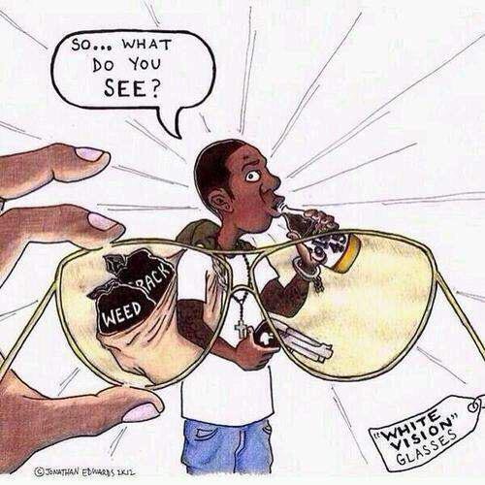

Introduction
The media has played a big part in American culture, especially since it is protected by the First Amendment of the United States Constitution. However, the media often may not give the most honest portrayals of events and people. Our presentation aims to look into how the media reinforces these stereotypes and how they influence people today.

Slide 3
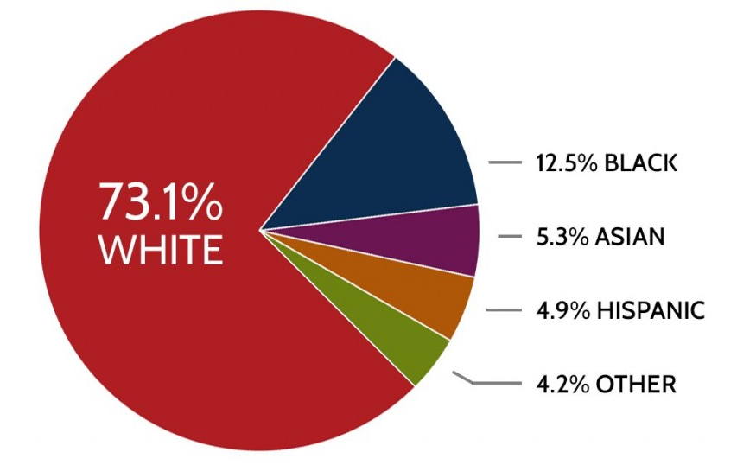
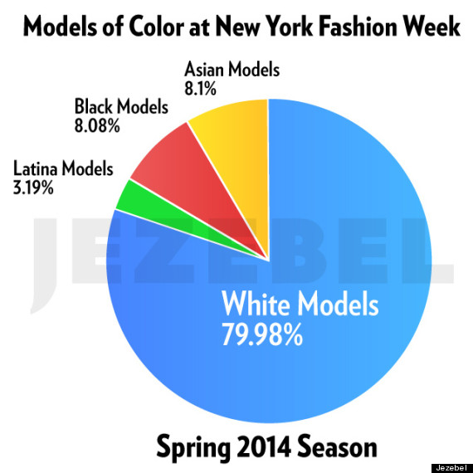
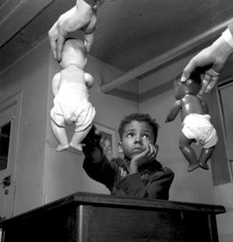
How is beauty defined in the media based on race?
Before 1939 when The Ethel Waters Show came out there were little to no black people involved in television and everywhere else black people were seen in a negative light, as criminals while white people were running the media.
Today compared to 1940s, almost nothing has changed when it comes to our views even if there are more black people in the media we still see blond hair, blue eyes and lighter skin as the standard.

Slide 4
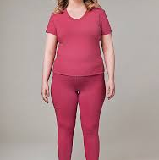
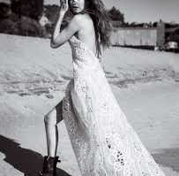
Sizing Up The Media
Due to the media’s promotion of smaller sizes over other sizes some stores don’t include a plus size section or a tall section. Even though this is true for womens sizes this is not the same for men.
Average Woman
Gigi Hadid
89% of women have dissatisfaction with their body 0.84% of these women wanting to be thinner.
The media gives more coverage to the thinner models such as Kendall Jenner and Gigi Hadid.

Slide 5
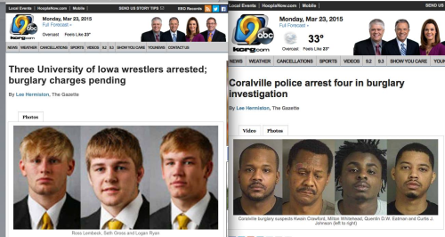
Social & Judicial Injustice
One of the ways the media puts an image in people's minds about black people is the way they are often presented on television. For instance when a person of color commits a crime, they use their mugshots on TV, but when a white person commits a crime they don’t use mugshots on T.V.
One reason the media misrepresents black people, is that when you look up three black teens vs. three white teens, When you look up three black teens you see black teens in mugshots.When you look 3 white teens you will seen 3 white teens smiling.
When people of color commit the same crime they on average get 178 more days in jail than white people.

Slide 6
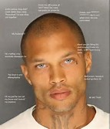
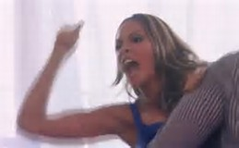
Media Portrayal of African Americans
Everyday, African-American men and women are looked at differently because of stereotypes.
Reality TV show, Basketball Wives, gives us misperceptions of black womens.
Examples of such stereotypes include: black families are not stable, black women are sassy, loud and aggressive, and black men are nothing but thugs.
The media is slowly corrupting the black community, making them turn against each other when they really should be coming together.
Due to stereotypes African American men and women lose their lives daily.
The media is slowly corrupting the black community, making them turn against each other when they really should be coming together.
Jeremy Meeks

Slide 7
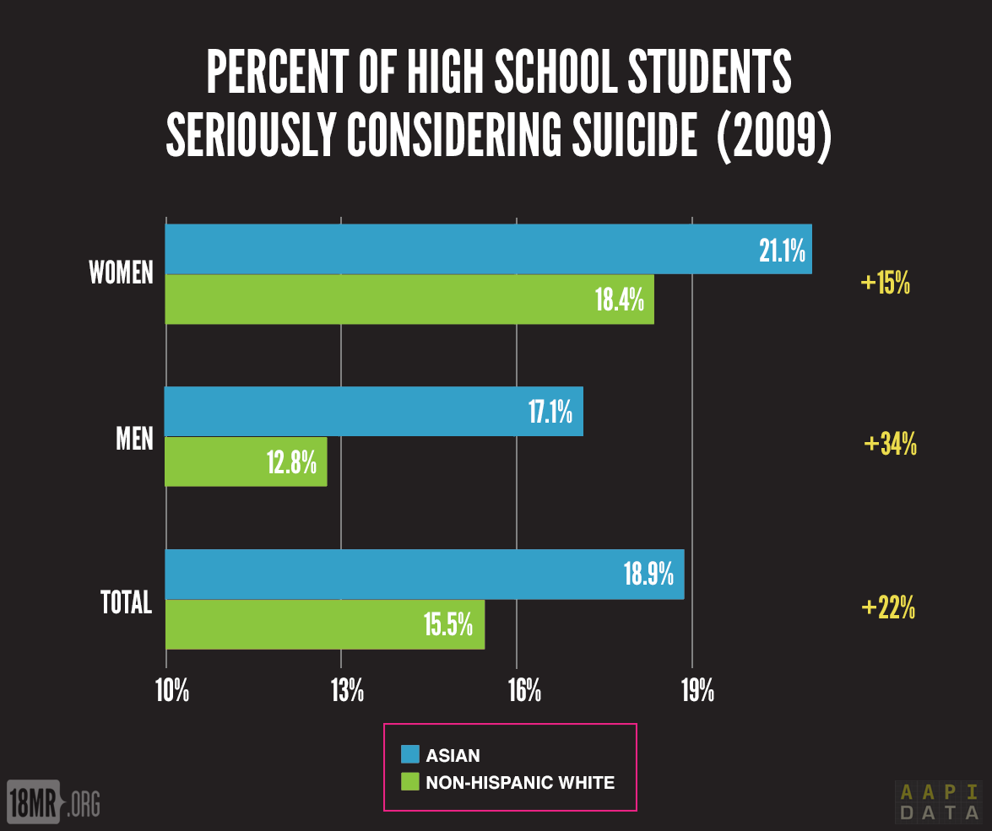
The Model Minority: How the Media Influences the Treatment of Asians in the US
Asians* are arguably the more “privileged” minority in America.
*It is important to note, that in this case, the term Asians refers to those of East Asian or Southeast Asian descent, as well those from India, Pakistan, Nepal, Bhutan, and Bangladesh.
Chinese workers first arrived in the 1850s and quickly became competitive.
Protests & 1882 Chinese Exclusion Act (First restriction upon immigration to the US; Repeal in 1943 left a strict limit)
442nd Infantry Regiment (all Nisei volunteer unit)
Confucian beliefs = model citizens
Negative impacts socially; Outsiders
Educational pressure (Harvard & SAT)
Notes:
Asians have had it better off than many other minorities in the US ever since Chinese migrant workers came to the US in the 1850s.
They took dangerous jobs for far less pay than white workers. A PBS article on the history of Chinese Americans said, “Initially, Chinese employees received wages of $27 and then $30 a month, minus the cost of food and board. In contrast, Irishmen were paid $35 per month, with board provided.”
The habits of the Chinese workers seemed alien to their Irish counterparts. They ate healthier, had higher sanitation, and avoided the much of the illness other workers didn’t. Their robust health and successful business caused white workers to begin protesting against Chinese immigrants. Eventually, in 1882, the Chinese Exclusion Act was passed, the first major law restricting immigration to the United States. It wasn’t until 1943 that the act was repealed, and even then, it still had a tight limit set upon the number of Chinese immigrants allowed.
442nd Infantry Regiment (Nisei volunteers; 7 Distinguished Unit Citations, 21 Medals of Honor, 4000+ Purple Hearts, 29 Distinguished Service Crosses, 588 Silver Stars, and while in internment camps.
Asians parents told stories of their obedient children who did well in school. (Confucian beliefs to the nerd stereotype.)
Fu Manchu, Long Duk Dong, & and the transition from white actors playing Asian roles to Asian actors playing Asian roles.
Over half of Harvard’s applicants with exceptional SAT scores are Asian, yet only 17% are admitted. In 2014, the average Asian student had to score 140 points higher than their white counterparts in order to enter Harvard.

Slide 8
Conclusion
Throughout our presentation, we hope you have seen how the media widens the gap between expectation and reality, ideal and unideal. Overall, the media has hurt many, while helping few. Thus we should all beware of what conclusions we draw from the news, TV, the radio, or any other form of media. Thank you.

Slide 9
Bibliography
"FAQs." Chinese Railroad Workers in North America Project. N.p., n.d. Web. 31 July 2017.
Beach, Web Design. Asian American History Timeline. N.p., n.d. Web. 31 July 2017.
Mounk, Yascha. "Opinion | Is Harvard Unfair to Asian-Americans?" The New York Times. The New York Times, 24 Nov. 2014.
Web. 31 July 2017.
Chow, Kat. "'Model Minority' Myth Again Used As A Racial Wedge Between Asians And Blacks." NPR. NPR, 19 Apr. 2017. Web. 31 July 2017.
Guo, Jeff. "The real reasons the U.S. became less racist toward Asian Americans." The Washington Post. WP Company, 29 Nov. 2016. Web. 31 July 2017.
Slide 7 :Faust, Marie (Faust)‐Eve, and Serge Carrier. "Women’s wear sizing: a new labelling system." Journal of Fashion Marketing and Management: An International Journal 14.1 (2010): 88-126. Web. 19 July 2017.

