Slide 1
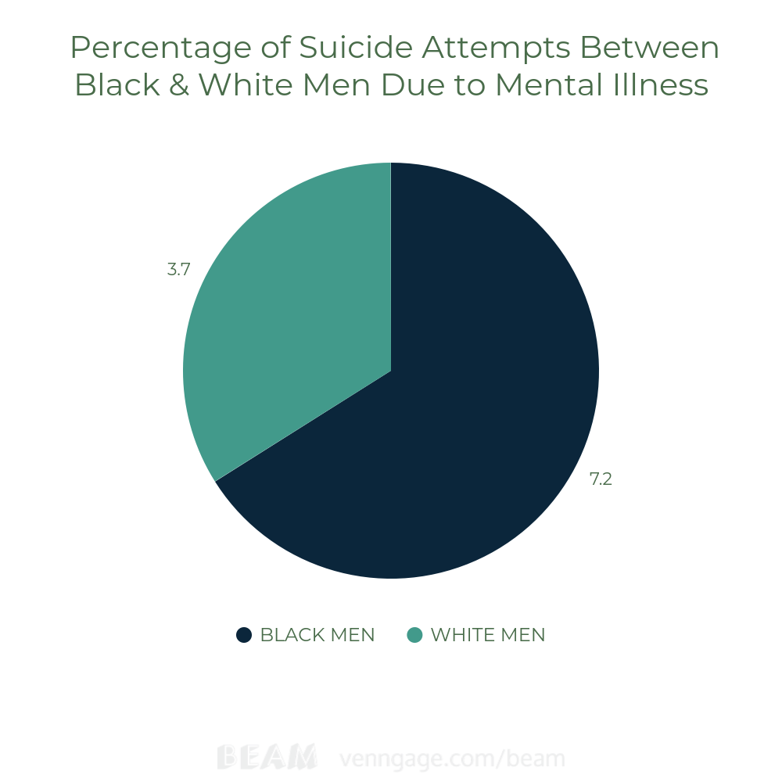
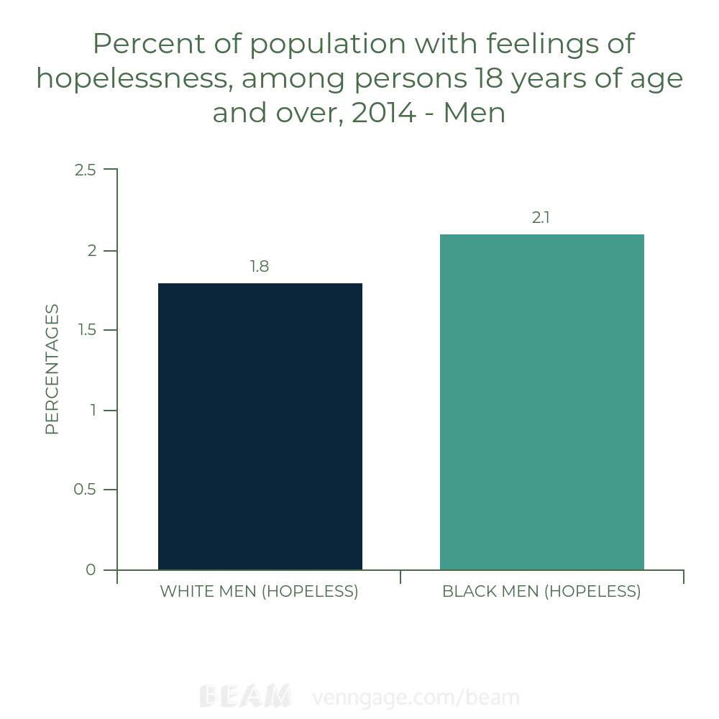
Stereotypes of Black Men in the Media
Maren Henry || JD Clement Early College High School
Introduction
Data & Results
Methodology
Do the stereotypes of black men and the criminal roles they play in the media affect their criminality?
Media stereotypes of black men influence their mental health, and the way they perceive themselves. This results in major issues which are caused by how the media discriminates black men, and exploited instances of black mens criminality and their lives in a negative connotation. The media targets black men on news sites portraying them as a threat to American society. As the media continues to abuse their right, they alter black men's mental state, and everyday life. Misinterpreting black men is a negative way for people who differ from black men to invoke prejudice.
Negative representation of black men in the media increases mental health issues which can affect their success rate and future opportunities including going to college and finding occupations. Statistics have shown that many mental health issues black men experience have ranked higher than any other race. Many black men experience more feelings of hopelessness and unworthiness,than others
Inaccurate depictions can also affect black males self perceptions and lead to diminished self esteem
I found my research by using scholarly sources including, mental health data sites, and scholarly sources such as Duke Library, Proquest and statistic articles of minority mental health of 2014 research on black men’s mental health compared to others and Mental Health of America articles that related and included information on causes/solutions of mental health and success of black men. Using keywords including mental health, stereotypes of men, criminality in media and more. Regarding how the media falsely represents black men’s masculinity which alters their well being overall because of societal views.
Conclusion
Overall, from the data we have produced, shows that when black men are targeted and falsely shown in the media and wrongly judged being a threat or a criminal can cause them to create mental damage by media and cause diagnosable mental illnesses
Background Information
Stereotypes are perceived opinions about a person or a group of people. Some of these stereotypes may be racist towards specific ethnicities. Criminal roles are represented as having criminal like tendencies and actions which are seemed to be against by criminal law, which can be caused by the roles in the media that black men play. This concept can also be defined by the word, criminality.
Adult black men are 20% more likely to report serious psychological distress than white adults
7.2% of black men students have attempted suicide, higher than the white percentage
(3.7%)
Too often studies on Black men typically focus on ‘ghetto culture’ which reduces Black masculinity to classed and sexualized depictions of violent hustlers, drug dealers, and pimps.
-

