Slide 1
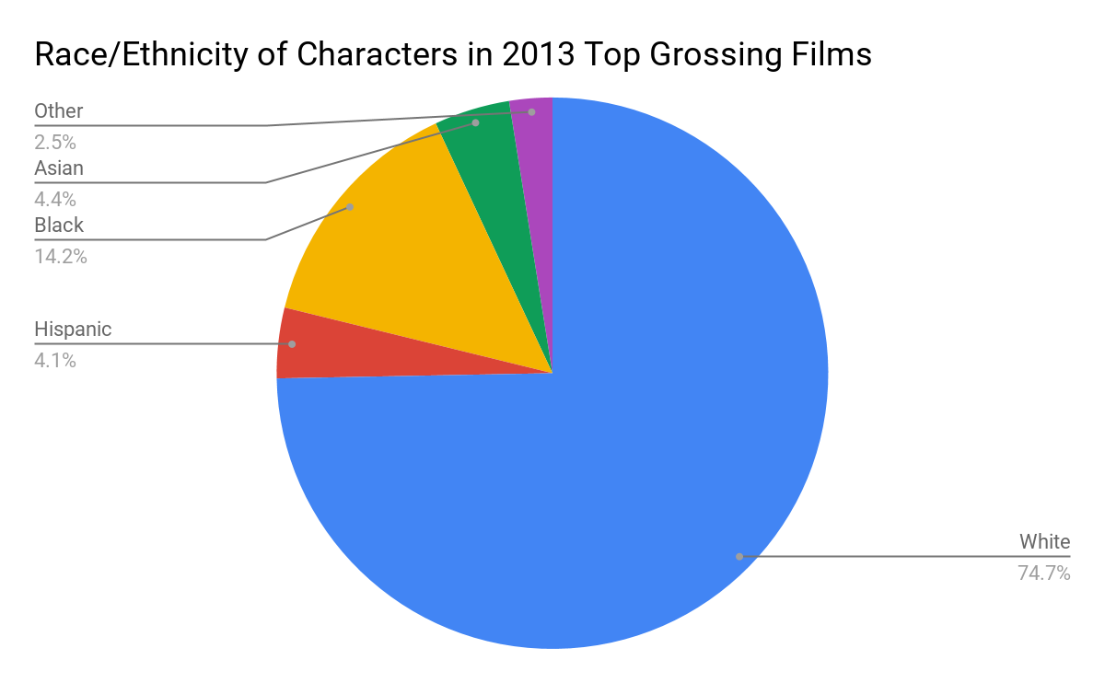
White Washing Black Identity
Langston Brooks || C.E Jordan High School
Introduction
Data and Results
Methodology
How does colorism in television media today impact Children of Color?
Colorism is the allocation of privilege and disadvantage according to the lightness or darkness of one's skin. This discrimination within the Black community, finds its roots in history. During slavery, white slaveholders created distinctions by placing slaves with lighter skin in the house, and darker skin in the fields.
When acquiring and collecting data, I was reliant on educational resources such as Google Scholar and the Boston University Arts and Sciences Writing Program. I gathered data from the 1970s to the 2010s and found that although there have been more shows with a dominant African American lead, still the majority of actors playing these roles have light to fair skin tones.
Society is pushing issues of colorism into the media and is expanding throughout cultures as well as becoming more prevalent in other countries. I decided to focus on colorism in the media to study its effects on young children of color. I wanted to explore how external influences of colorism within the media affect the youth. It is essential for us to understand that young children can be easily influenced at a young age. It is essential that the media effectively controls what our children see on television so they will not internalize colorist messages they see since young children are affected more by images than words.
Young children can be influenced by such shows or commercials that glorify a lighter-skinned individual.
Black children believe in what they have seen on television more than any
other groups of children and associate with identities of black television characters (Anderson & Merritt, 1978; Dates, 1980).
According to a study done by San Diego State University, black female characters made up 14% of the top 100 films of 2016. Meanwhile, their white counterparts made up 76% of roles. This shows how young children of color see fair or lighter skin tone actors in the media more than their darker skin toned counterparts.
Conclusion
Background
In US culture, lighter skin tone has been known as superior to other shades of skin. Mental health issues in African American children may stem from a culture rooted in colorism and the disruption of identity.Through television and other media outlets, young minorities are constantly exposed to this skin hierarchy, specifically African Americans. An Example of this would be the show Black-ish. The show stars Anthony Anderson, who is light- skinned and Tracee Ellis Ross, who is biracial. Although the show covers multiple subjects that African Americans face every day, the show’s main cast is light-skinned while the darkest character is Diane, who is a medium complexion.

Slide 2
Bibliography
Network, Jvillage. “Colorism.” NCCJ, 9 Jan. 2019, nccj.org/colorism-0.
Santos, Mariel De Los. “Boston University Arts & Sciences Writing Program.” Full-Colorism Television » Writing Program » Boston University, www.bu.edu/writingprogram/journal/past-issues/issue-10/delossantos/.
Rollins, William. “Does the Negative Portrayal of African-Americans on Television Affect Their Self-Identity?” Gonzaga University, 2016, pp. 1–47.
Hunter, Margaret. “The Persistent Problem of Colorism: Skin Tone, Status, and Inequality - Hunter - 2007 - Sociology Compass - Wiley Online Library.” Sociology Compass, John Wiley & Sons, Ltd (10.1111), 3 July 2007, onlinelibrary.wiley.com/doi/full/10.1111/j.1751-9020.2007.00006.x
Gonzalez-Barrera, Ana. “Hispanics with Darker Skin Are More Likely to Experience Discrimination than Those with Lighter Skin.” Pew Research Center, Pew Research Center, 2 July 2019, www.pewresearch.org/fact-tank/2019/07/02/hispanics-with-darker-skin-are-more-likely-to-experience-discrimination-than-those-with-lighter-skin/.
Burke, M. (2008). Colorism. In W. Darity Jr. (Ed.), International encyclopedia of the social sciences (Vol. 2., pp. 17-18).
.

