Slide 1
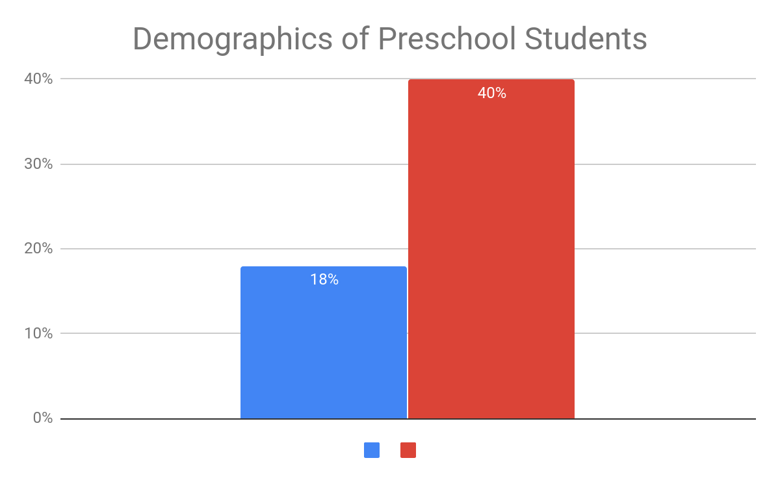
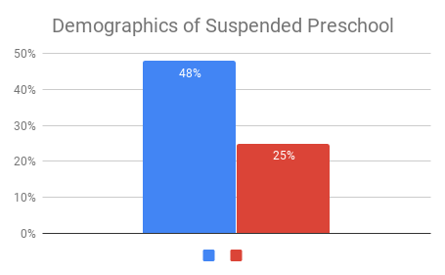
Keeping Black Students in the Dark
Jazmin Rawls II New Tech High School
Introduction -
Data -
How does racial bias in the education system affect African American males and female students?
Racial biases are prejudiced beliefs in favor of one race over another that influences actions and decisions in a senseless manner towards a specific race. In this presentation, racial bias will be explained on how it affects black students.
While 18% of black kids make up the enrollment of preschool, 48% of those students have been suspended once or multiple times.
Some college students took a survey on how different races come across them and 52% of people “ … acted as if they thought the individual wasn’t smart… “compared to people who don’t have a college experience, which was 37%
While 18% of black students are enrolled, 27% percent of students who have come across of the law enforcement 31% have been arrested
25,000 black males have showed “ significant disidentification “ throughout the 12th grade
U.S. Census Bureau data stated that 887000 black women enrolled in college compared to 618000 black men ( black males end up in prison than in college )
Black girls are 3x more likely to be suspended than white boys
Black boys are 4x more likely to be suspended than white girls
Background -
Results -
Implicit Bias started in education when “separate but equal” from Plessy v. Ferguson was enacted. Even after Brown v. Board of Education, when the Supreme Court banned segregation from public schools, racial bias has still been alive throughout the world, especially in our educational system.
Black males end up in prison more than college
Black colleges and universities enrollment has increased
In 2016 data report by the Journal of Blacks in Higher Education black women had the highest graduation rate at The University of Georgia
v
Methodology -
Conclusion -
Finding a particular topic has been tough and worthwhile but I knew I wanted to focus on the educational system and racial bias. After doing research for 3 specific topics I finally found my topic and research question. I did find a counter argument stating that black kids don’t meet the expectations to take advanced classes if they wanted to but I also found another source stating that non-black teachers do have lower expectations for black students. But using Duke Library and Google Scholar I found all of my sources and I used Google Sheets to do my graphs.
My research concludes that black students are more likely to be expelled than their peers in school and experience more bias which many lead to the black students to feel unsafe and the other students to feel like the black students are a “threat,” or lack of access to get into classes because of their “behavior issues.”
Red - white students
Blue - black students

