Slide 1
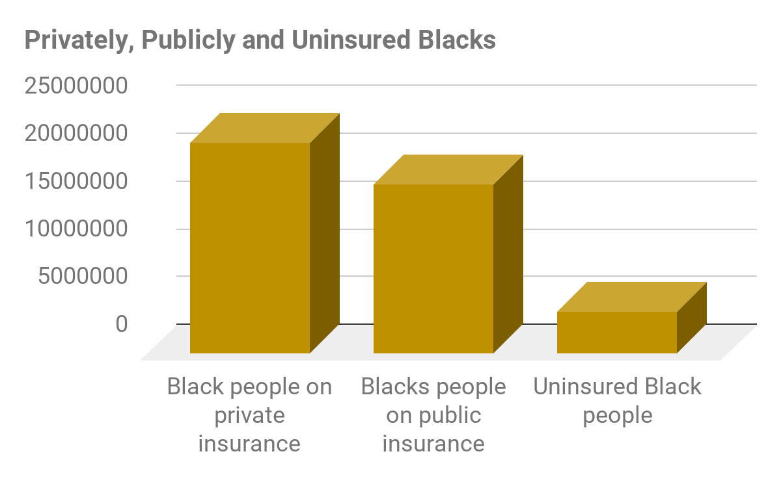
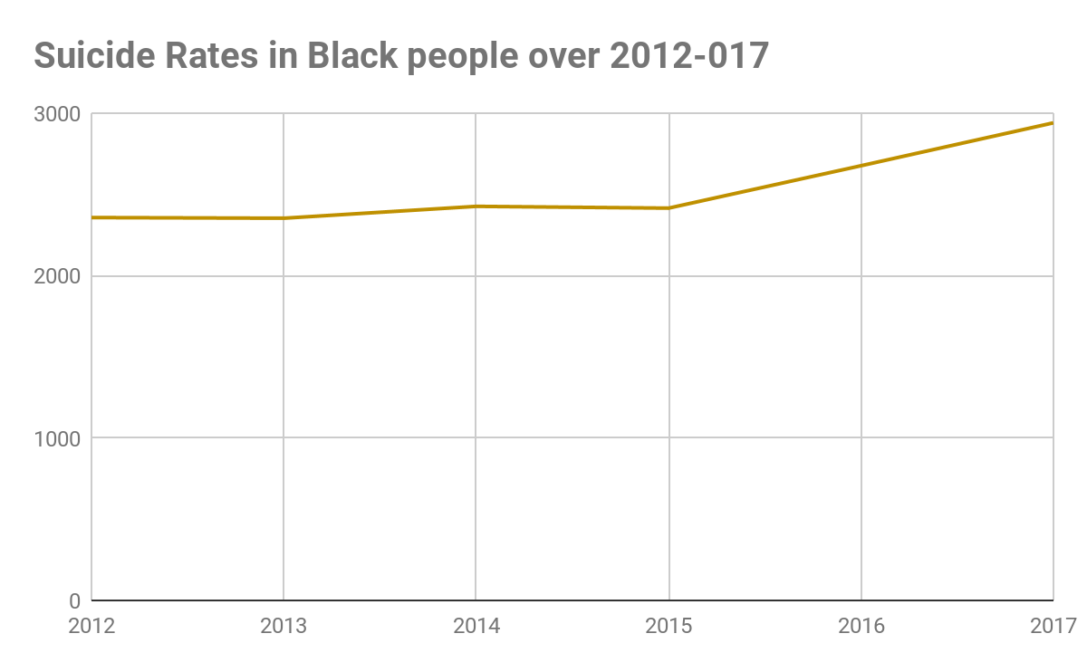
Behind the Mask: Mental Health and Young Black Men
Jaden Henderson || J.D.C Early College
Introduction
Does a lack of adequate mental health services affect the mental health and wellbeing of adolescent African American males on public assistance?
Mental health services such as therapy sessions are not covered in affordable medical care and have to be paid out of pocket. Mental health itself is the state of a person's psychological and emotional wellbeing. The state of being comfortable and healthy can be described as someone's well being. Deinstitutionalization, the process of replacing psychiatric hospitals with less isolated community mental health services.
Data and Results
Methodology
According to the data there is a noticeable difference in African Americans with private, public and no insurance at all. Data on Suicide rates in Black people between 2012 and 2017 is represented in the graph.
Data for this research was collected using secondary sources from scholarly articles obtained from Google Scholar that provided me with articles that supported and disputed my original hypothesis however the research examined in this study found a clear correlation between medical coverage and mental health. While conducting my research keywords such as ‘Suicide’, ‘Blacks’, ‘Mental Health’, and ‘Medical Insurance’ were used to accumulate the data. The reason I used these keywords was because they directly corresponded with my hypothesis and provided me with adequate data relating to my question. I encountered counter narratives in that conveyed another side to the argument I am posing. Some articles argued that if Black people or people in general were given free or affordable mental health services that they would not use them. The majority of the scholarly articles I found were quantitative. In the future and further expanding this research, I not only want to look at quantitative but qualitative data to generate a deeper and broader view of the correlation between medical insurance coverage and mental health illness among African American adolescent males.
Background
During the Jim Crow period, Black people were not only kept from equal facilities but also restricted from obtaining equal Medical Insurance. Insurance policies didn’t include mental health in its health category until after World War II. Private insurers in the 1950s did not feel the need to pay for mental health care because it was publically paid for by deinstitutionalization. More recently, the Paul Wellstone and Pete Domenici Mental Health Parity and Addiction Equity (MHPAE) Act was passed in 2008 and it was passed to eliminate the disparities in insurance for behavioral health (mental health and illnesses). With the passage of the Affordable Care Act, there are some provisions for mental health coverage but is not covered in totality. Some private medical insurances cover therapy sessions but they tend to be expensive and ultimately a copay still has to be paid. The lack of affordable medical insurance covering mental health can lead to the deterioration of mental states and the development of mental illnesses in African American males ranging from ages 13-18. Without appropriate medication and therapy for maintenance, African American males can fall into a cycle of mental illness.
Whites have an uninsured rate of 7% and Black people have an 11% rate of being uninsured
Black youth 3.2% reported some suicidal thoughts in the past year; 1.4% reported attempting suicide
Suicide is the third leading cause of death among Black youth
Conclusion
Upon analyzation of data, results found a strong correlation between African American males with private insurance having better behavioral health than ones with public insurance. This draws a connection between lack of medical insurance and the state of mental health in African American males. A possible solution to this dilemma is to institutionalize Universal Health Care, a system that provides medical services to all citizens. Providing affordable and adequate health care to all citizens can better their mental health and lower suicide rates. Another solution could be making mental health services more affordable across the board. The prices of medication, therapy/counseling sessions and days at psychiatric treatment should be reduced, but the quality of service should remain the same or even increase. If practices such as this become more prominent in mental health care, suicide and depression rates in African Americans will decrease.

