Slide 1
Impact of Wealth Inequalities in America
Oyinkan Ajasa, Joren Biggs, Lauryn Futrell, Tyreek Lloyd,
Elson Roaquin

Slide 2
Topics addressed in this presentation
The wealth gap
Wealth gap within Native Americans
Wealth gap regarding retirement
Wealth and its impact on healthcare
Gentrification
Environmental injustice

Slide 3
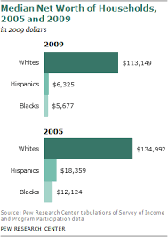
Closing wealth gaps in America
Wealth is an abundance of valuable possessions or money (Healthy 2017).
The house household wealth gathers the sum of assets to house, cars, savings, checking accounts, stocks, and mutual funds etc.
The negative sum of debt are, auto loans, credit cards, mortgages, etc.

Slide 4
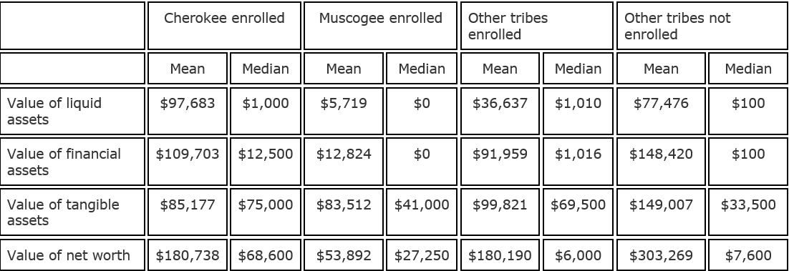
The Wealth Gap Within Native Americans
-Tribal benefits create assets and remove liabilities.
-In 2008 the Cherokee Casino gave 416.8 million dollars back to the Cherokee community.(Where the money goes, 2008)
-Indian Affairs, Indian Health Services(IHS), and other government agencies provide health care among other benefits (US Dept. of the Interior).
Chart: Randall Akee, Sue K. Stockly, William Darity Jr, Darrick Hamilton & Paul Ong (2017) The role of race, ethnicity and tribal enrolment on asset accumulation: an examination of American Indian tribal nations, Ethnic and Racial Studies, 40:11, 1939-1960, DOI: 10.1080/01419870.2016.1216141
Notes:
-mention skewed data
-Casinos
-Tribal benefits=res hospitals, gov agencies
-Unemployment among American Indians is 9.3 percent compared with 5.1 percent nationwide
-Departments of Housing and Urban Development, Justice, Agriculture, Education, Labor, Commerce and Energy
- Indian affairs=education, social services, law enforcement, courts, real estate services, agriculture and range management, and resource protection,
- IHS= maternal and child health, mental health, substance abuse, home health care, nutrition, etc.
-speak slowly

Slide 5
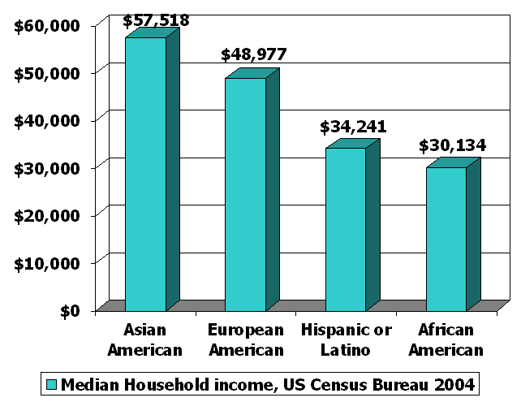
Wealth and income and how it affects different racial groups
Retirement Retirement is a huge impact to economic health. People save money for economic plans in the future.
The more money that has been passed down from generations the more money available and saved up for wealth. (Linda shin,2015)
Income Across america, people of color fail to get the excess amount of money they need to survive. Income can affect wealth; the more you earn the more you save.

Slide 6
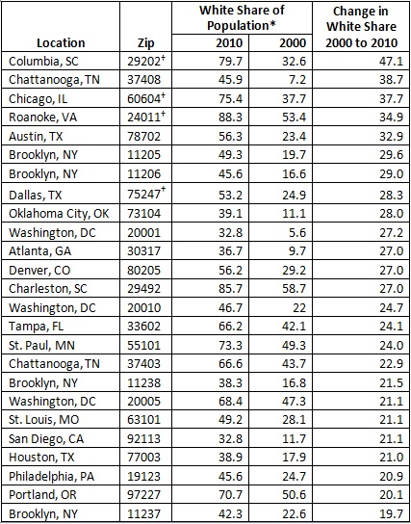
Gentrification “Pushing the lower class even lower”
Began as an effect of Redlining
-A subtle way of targeting people of color and efficiently segregating them from whites.
Urban Growth
-Introducing white families into “black neighborhoods” which eventually leads to the displacement of those families.
Affecting communities including Durham NC
According to Lisa Sorg, since 2005, the median home prices have increased from 100% to nearly 400% in six of Durham’s central neighborhoods (Sorg 2015).

Slide 7
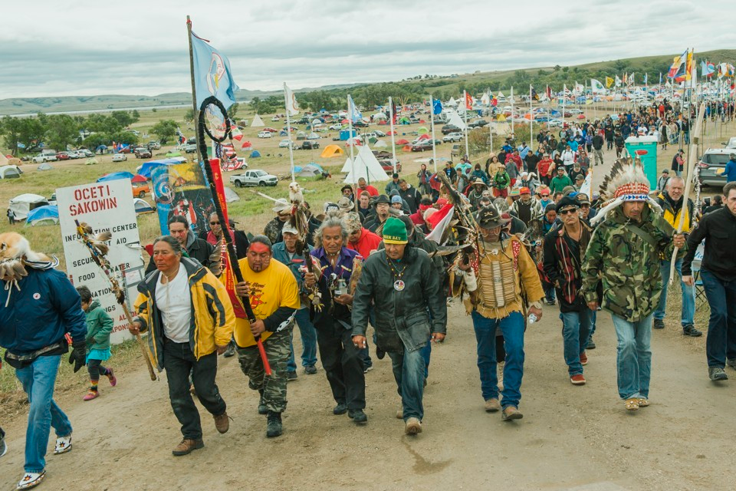
Environmental Justice
Low income, predominantly communities of color are disproportionately exposed to hazardous substances
Native Americans are a little researched, but heavily affected racial group
Comes in more forms than pollution
  Food Insecurity
  Alcohol Exploitation

Slide 8
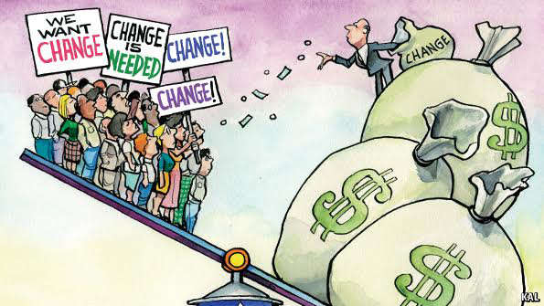
Conclusion
The wealth gap is in effect and increasing causing a wide gap between the rich and poor.
Wealth affects Native American employment and divides races.
Gentrification uses wealth to segregate people.
Wealth determines treatment of people.

Slide 9
References
Fullilove, Mindy Thompson and Rodrick Wallace. "Serial Forced Displacement in American
Cities, 1916-2010." Journal of Urban Health, vol. 88, no. 3, June 2011, pp. 381-389.
EBSCOhost, doi:10.1007/s11524-011-9585-2.
Glick, Jonathan. "Gentrification and the Racialized Geography of Home Equity." Urban Affairs
Review, vol. 44, no. 2, Nov. 2008, pp. 280-295. EBSCOhost, search.ebscohost.com/login.aspx?direct=true&db=a9h&AN=34775927&site=ehost-live&se=sit.
Hwang, Jackelyn. "While some Things Change, some Things Stay the Same: Reflections
on the Study of Gentrification." City & Community, vol. 15, no. 3, Sept. 2016, pp.
226-230. EBSCOhost, doi:10.1111/cico.12188.
Sorg, Lisa. "Take 4: Durham’s gentrification challenge." News and Observer. N.p., Oct. & nov.
2015. Web. 25 July 2017.
Randall Akee, Sue K. Stockly, William Darity Jr, Darrick Hamilton & Paul Ong (2017) The role of race, ethnicity and tribal enrolment on asset
accumulation: an examination of American Indian tribal nations, Ethnic and Racial Studies, 40:11, 1939-1960, DOI: 10.1080/01419870.2016.1216141
"THINK AND GROW WEALTHY COACHING ." THINK AND GROW WEALTHY COACHING . N.p., n.d. Web. 28 July 2017.
<http://www.thinkandgrowwealthycoaching.com/>.
https://www.google.com/search?q=retirement+rates+between+races&safe=strict&source=lnms&tbm=isch&sa=X&ved=0ahUKEwjj-J3YhKfVAhXDVz4KHXGzAJ4Q_AUICygC&biw=1301&bih=620#imgrc=vzUpGLmTIesPVM:&spf=1501078779994
https://www.theatlantic.com/business/archive/2012/01/5-of-americans-made-up-50-of-us-health-care-spending/251402/

