Slide 1
International Inequalities
By: Catherine Kiplagat, Wynter Henderson, Jaqueline Garcia, and Thomas Bennett

Slide 2
Introduction
Our topics all happen around the world and they are all international issues that need to be solved. Our topics are:
Modern Day Slavery
Israeli-Palestinian Conflict
LGBT Inequalities
Immigration

Slide 3
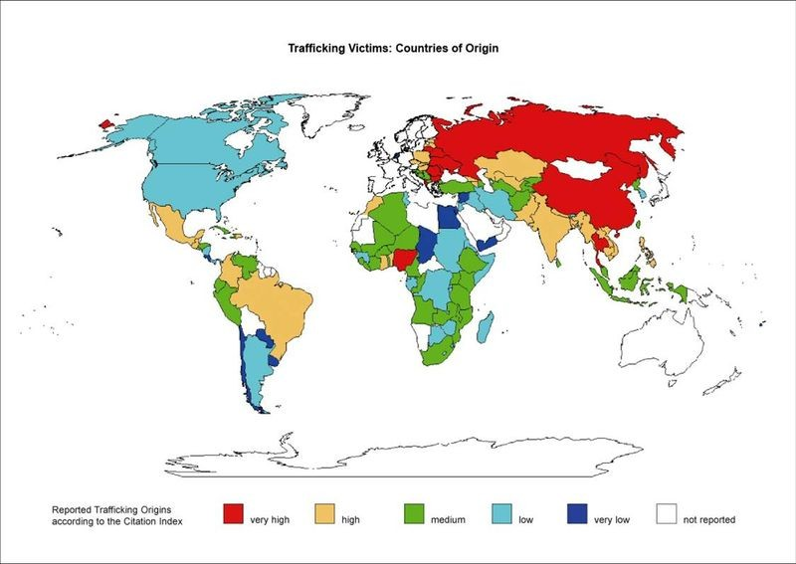
Modern Day Slavery
Sex trafficking
Child Sex Trafficking
Forced Labor
Domestic Servitude
Forced Child Labor
Trafficked persons often have limited access to basic necessities such as safety, food, sleep, hygiene, and medical care. The effects of trafficking vary depending on the type of trafficking and the specific situation.Given that trafficking is based on the exploitation of individuals, all victims of trafficking may be subject to physical, psychological, and social impacts. Victims of trafficking often experience harsh physical impacts due to excessive work or the use of force by traffickers.In addition, victims may be exposed to serious health risks, such as HIV/AIDS, as well as serious mental health risks. Anxiety, insecurity, fear, and trauma are all products of trafficking. Several studies indicate high levels of Post-Traumatic Stress Disorder (PTSD) in former trafficked persons.
Notes:
LOOKUP!!

Slide 4
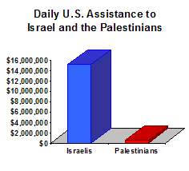
Israeli-Palestinian Conflict
What is the US involvement in the Israeli-Palestinian Conflict
History
  Palestinian/McMahon Agreement
  Israel/Balfour Declaration
Money US gives to Israel
  How much/How it's used
Peace Agreements
  Resolution 242/Camp David Accords/Oslo Agreement
Who benefits from these agreements

Slide 5
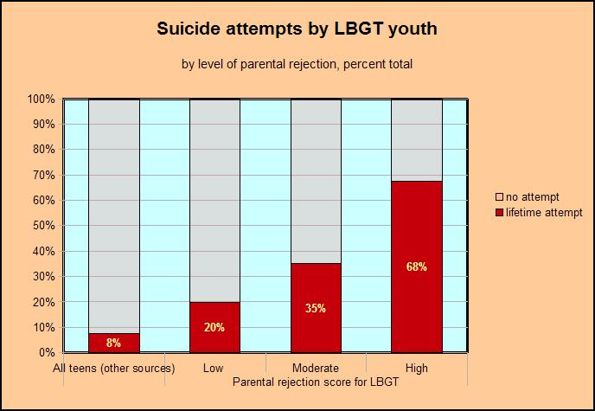
LGBT SOCIAL INEQUALITY
LGBTQ-lesbian,gay,bisexual,transgender,queer
How are people who identify themselves as LGBTQ+making an impact on the US today educationally and legally?
LGBTQ+ gets critical because of bullying and harassment.
School leaders are to meet the needs for LGBTQ+ students.
Legalizing same-sex marriage- The supreme court ruled that same sex couples could get married nationwide.
HB2 in NC-House Bill that restricts anti-discrimination towards transgenders.
Bathroom bill in Texas-The senate of Texas gave an approval to a bill restricting public restrooms for transgenders.

Slide 6
Immigration and its effects on children
Children who have illegal Parents tend to be affected in a negative way. They are affected socially, mentally and it affects their education.
- How does immigration affect children’s education? The children of immigrant parents - mostly illegal mothers - tend to have fewer years of school than those whose parents are legal. The first six months of an immigrant parent being arrested, the child’s school performance and study habits decrease.
- How does immigration affect children socially and mentally? Most kids become depressed from bullying and for economic problems. Most immigrants can’t afford many things like U.S citizens. They struggle paying bills because of minimum wage. This causes children to feel helpless and depressed because they feel like they can’t help their parents.

Slide 7
Conclusion
Little has been done to stop human trafficking
LGBTQ community aren't being treated fairly
The US is helping the inequalities in the Israeli-Palestinian Conflict
Immigrant children are not getting the government support they need

Slide 8
Citations
Radio, Southern California Public. "How Parents' Immigration Status Affects Kids' Education."Southern California Public Radio. N.p., 08 Jan. 2015. Web. 26 July 2017.
  http://www.scpr.org/blogs/multiamerican/2013/05/30/13829/how-parents-immigration-status-affects-their-child/
  https://gradpsych.apags.org/pi/families/resources/newsletter/2016/11/immigration-effect.aspx
Michael Gordon, Mark S. Price and Katie Peraltamgordon@charlotteobserver.com. "Understanding HB2: North Carolina's Newest Law Solidifies State's Role in Defining Discrimination." Charlotteobserver. N.p., 16 Mar. 16. Web. 29 July 2017.
  http://www.charlotteobserver.com/news/politics-government/article68401147.html
Beauchamp, Zack. "Everything You Need to Know about Israel-Palestine." Vox. N.p., 21 Nov. 2014. Web. 28 July 2017.
  https://www.vox.com/cards/israel-palestine
Admin. "U.S. Role in the Israeli-Palestinian Conflict." PBS. Public Broadcasting Service, n.d. Web. 28 July 2017.
  http://www.pbs.org/newshour/updates/middle_east-jan-june06-us_05-11/
U.S. Department of State. U.S. Department of State, n.d. Web. 28 July 2017
  https://www.state.gov/r/pa/ei/bgn/

Slide 9
Citation
Booth, William. "Israeli Government to Refugees: Go Back to Africa or Go to Prison." The Washington Post. WP Company, 14 May 2015. Web. 30 July 2017
  https://www.washingtonpost.com/world/middle_east/toughening-its-stance-toward-migrants-israel-pushes-africans-to-leave/2015/05/14/e1637bce-f350-11e4-bca5-21b51bbdf93e_story.html?utm_term=.5d763fd18a6f

