Slide 1
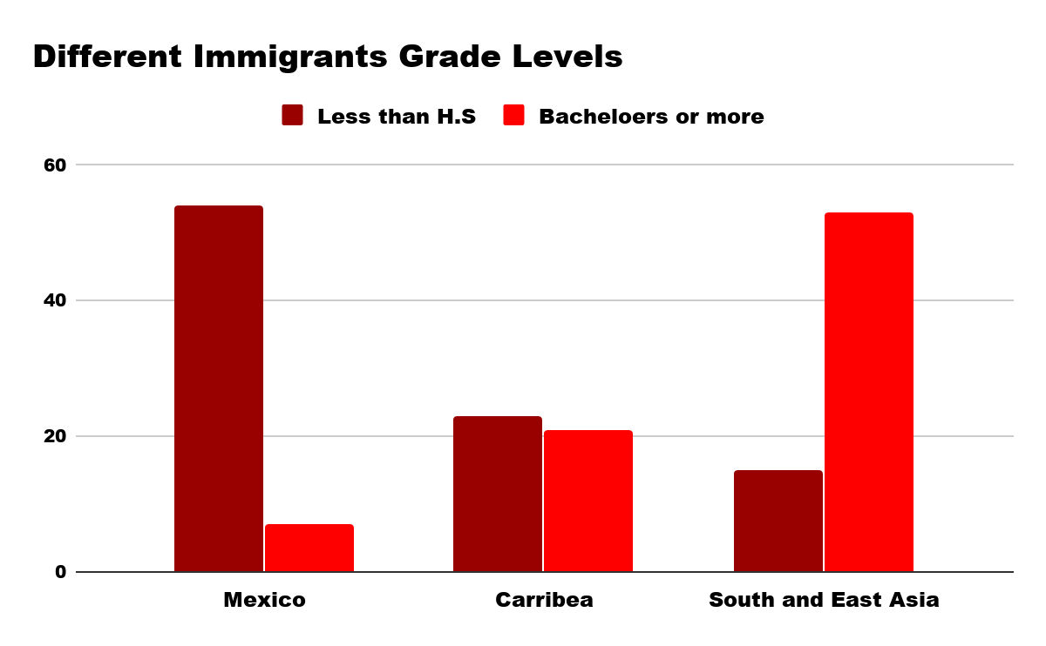
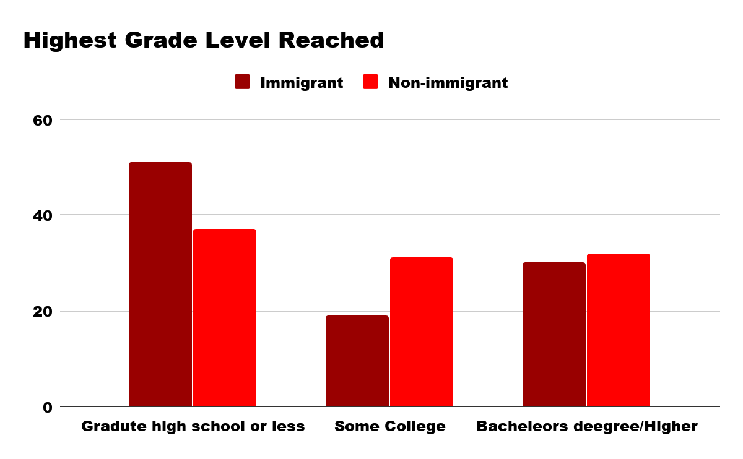
Immigrant Adolescents: Coming Here to Get Set Back
Farleyson Tarley||Hillside New Tech High School
Introduction
Data and Results
Methodology
How does the educational gap between first-generation immigrants and U.S. natives affect immigrants’ ability to obtain college degrees?
The educational gap between first-generation immigrant students and U.S. native students is obstructing first-generation immigrants from reaching achievements such as a bachelor's degree or higher. U.S.native born students do not have the issues immigrant students have to go through, which include language barriers and immigration status anxiety. In American schools, teachers speak English and students in the U.S. grow up speaking English. Since immigrants know their native language, and not English, it creates a difficult learning environment. Immigration status is also a barrier that first-generation students face. According to the Pew Research Center, about 3.9 million kindergarten through 12th-grade students in U.S. public and private schools in 2014 were children of unauthorized immigrants. Concern for your family’s status can be a heavy burden to carry with you everyday in school.
In terms of academic success, immigrant children have barriers that lead to them more likely to do less than graduating high school and less likely to acquire a bachelor's degree. There is also research showing how South and East Asians are quicker at learning the english language than most immigrants and immigrants from Mexico have the most
Trouble learning it.
While conducting research, I used sources from the last five years. The sources I used consisted of, scholarly articles, peer-reviewed journals, and research center data. I used the Pew Research center to get the number of immigrant students in K-12 schools.
The other sources I used gave me information and data showing the effects of the different factors that can affect a child’s educational experience. This includes dual-language programs, the immigration status of the child, and anxiety caused when the students are undocumented.
Solutions
The following are policies that could help immigrant children overcome the barriers that they face.
Tutors that speak different languages and can help students with classwork.
Improve English Language Learning classes and the curriculum, so that it benefits all students.
Mandatory counseling sessions for students who are suffering from anxiety about their, or their families, immigration status.
Background
Since 2014, the educational achievements reached by immigrants are underwhelming, in comparison to US natives. Immigrant status anxiety is when students may be concerned about the status of their parents. Whether they are documented or undocumented and how long they will stay in the country.
The language barrier is also a reason. Many students are in the class without knowing the language; so, they cannot keep up with the material being taught.
37% of United States born children vs. 51% immigrants only have a high school education or less.
31% of United States born children have some college vs. 18% of immigrants.
32% of the people born in the United States have a bachelor's degree or higher vs. 30% of immigrants
Conclusion
While some people could argue that there is no excuse for immigrants not being successful in school, educational barriers immigrants face have to be addressed. The success of students in general depend on many factors that include emotional well-being, and access to resources. We should make sure that all immigrant students who face the language barrier, and immigration status anxiety can succeed.

