Slide 1
By: Jacob Adams, Joshua Nicholson, Laura Searles, Oyinda Ajasa, Angeli Novio, & Niayla Hairston
Inequalities in American Education

Slide 2
Topics
Wealth Gap
Opportunities Matter
Modern Segregation
The Achievement Gap in American Education
Minorities in Academically or Intellectually Gifted Programs
Lack of Diversity in Honors/AP Classes

Slide 3
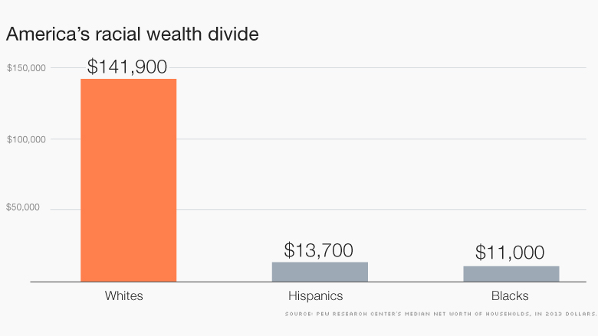
Wealth Gap
The wealth gap is a gap created to represent the imbalanced wealth distribution of the world.
Net Worth/wealth
How this affects minorities
What is the leading cause of this inequality
How this affects the education of minorities compared white families with wealth.

Slide 4
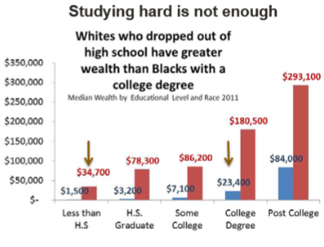
Opportunities Matter
Wealth Inequalities In America
Let’s Think
~ Is education really helping Afro-Americans ”converge” in society or is it hindering a discoverance of equality?
~ Does education necessarily always put you in the ideal position to accumulate the most wealth?
~ Should education be the only thing Afro-Americans prioritize?
According to the Duke Samuel Dubois Cook Center on Social Equity

Slide 5
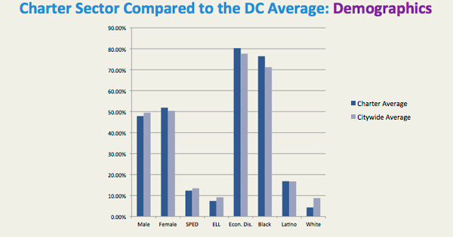
Modern Segregation
Wealth impacts where families can live and go to school
African American and white families are tending to choose schools with majorities of their races, especially charter schools
Charter schools offer an alternative to underfunded public schools (Hoxby, 2004)
Money alone does not define a quality education (Pike, 2017)
(DeVeaux, 2015)

Slide 6
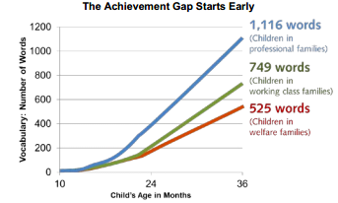
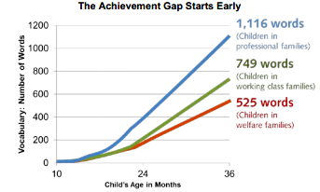
Refers to the gap in academic performance between groups of students
Factors that influence the ‘achievement gap’:
Race: Stress of perceived discrimination and stereotype threat (Anderson 2016)
Socioeconomic status: Children in wealthy families perform better than those in poor ones (Reardon 2011)
Access to literacy: Low-income families are most likely to live in ‘book deserts’(Steinhardt 2016)
The Achievement Gap in American Education

Slide 7
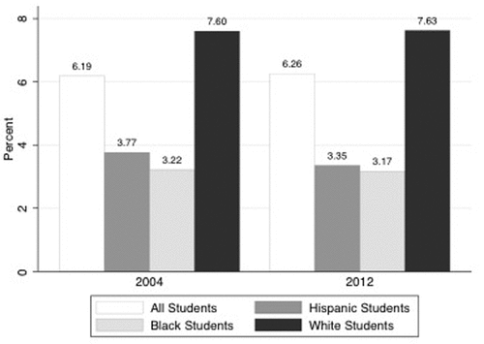
Minorities in Academically or Intellectually Gifted Programs
Causes of Discrepancy:
Teacher impact:
-Nominations
-Racial biases
-Low expectations
-Unfamiliarity
Wealth impact:
-Tests
-*Duke TIP
Percent of US student population in gifted programs compared to demographics of those recommended for gifted services.
(Grissom, Rodriguez, Kern, 2017)

Slide 8
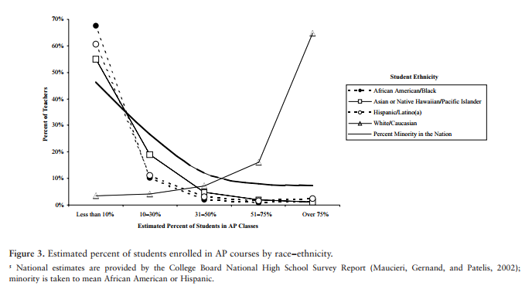
Lack Of Diversity in Honors & AP Classes
Sheer demographics in a classroom alone should not equate to whether or not the class is advanced.
Student’s Choice Factors
Teacher Expectations
Student’s Attitudes
  Peer Influences
  Family Influences
  Relationships to School/Teachers
Advanced Class Biases
Students identified for AIG programs in elementary school have a direct pipeline into the honors classes offered in middle schools and AP/Honors classes offered in high school.
-70% of teachers find less than 10% of black students in their class
-60% of teachers find about 10% of hispanic students in their class
-55% of teachers find about 10% of asians in their class
-70% of teachers find over 75% of white students in their class
Notes:
Mention

Slide 9
Conclusion
Education is one of America’s many basic human rights, shouldn’t cause educational attainment to be any less for any group of people.

Slide 10
Citiations
KIM, JINHEE, et al. "The Cost of Access: Racial Disparities in Student Loan Burdens of Young Adults." College Student Journal, vol. 51, no. 1, Spring 2017, pp. 99-114.
COHEN, PATRICIA. "Racial Wealth Gap Persists despite Degree, Study Says." New York Times, vol. 164, no. 56961, 17 Aug. 2015, pp. B1-B2
Woldoff, Rachael A. and Seth Ovadia. "Not Getting Their Money’s Worth: African-American Disadvantages in Converting Income, Wealth, and Education into Residential Quality." Journal of Planning Literature, vol. 24, no. 3, Feb. 2010, p. 298
Keister, Lisa A. and Stephanie Moller. "Wealth Inequality in the United States." Annual Review of Sociology, vol. 26, Aug. 2000, p. 63
"Wealth Inequality." Inequality.org. N.p., n.d. Web. 26 July 2017.
"Criminal Justice Fact Sheet." NAACP. N.p., n.d. Web. 26 July 2017.
Tama, Mario. "Where Slavery Thrived, Inequality Rules Today." BostonGlobe.com. N.p., 24 Aug. 2014. Web. 26 July 2017.
Difference Between Canadian & American University Degrees." Difference Between Canadian & American University Degrees | Education - Seattle PI. N.p., n.d. Web. 26 July 2017.
-----------------------------------------------------------------------------------------------------------------------------------------------------------------------------------------------
"Beth Shulman Is an Expert on the American Workplace, the Impact of the Economy on Workers and Their Families, Low-wage Work and Inequality, and the Policy Changes and Practices Needed to Create a Country with Greater Opportunity and a More Broadly Shared Prosperity." Beth Shulman. N.p., n.d. Web. 25 July 2017.
Google Books. N.p., n.d. Web. 25 July 2017.
Shin, Laura. "The Racial Wealth Gap: Why A Typical White Household Has 16 Times The Wealth Of A Black One." Forbes. Forbes Magazine, 25 Jan. 2016. Web. 25 July 2017.
"The African-American Labor Force in the Recovery." DOL Special Reports - The African-American Labor Force in the Recovery. N.p., n.d. Web. 25 July 2017.
Mejia, Paula. "Gun Deaths in U.S. Twice as High Among African-Americans as Caucasians." Newsweek. N.p., 29 Feb. 2016. Web. 25 July 2017.
"Injury Prevention & Control." Centers for Disease Control and Prevention. Centers for Disease Control and Prevention, 01 June 2017. Web. 25 July 2017.
US Census Bureau Public Information Office. "Facts for Features & Special Editions - Newsroom - U.S. Census Bureau." Facts for Features & Special Editions - Newsroom - U.S. Census Bureau. N.p., 19 May 2016. Web. 25 July 2017.
Mejia, Paula. "Gun Deaths in U.S. Twice as High Among African-Americans as Caucasians." Newsweek. Newsweek, 29 Feb. 2016. Web. 26 July 2017.
Darity Jr., William A. "Young Scholar Summer Research Institute." Young Scholars Summer Research Institute. Duke University, Durham , NC. June-July 2017. Lecture.
Sullivan, Laura, Tatjana Meschede, Lars Dietrich, and Thomas Shapiro. "The Racial Wealth Gap: Why Policy Matters." Institute For Assets & Social Policy , Brandeis University (n.d.): n. pag. Print.
Jacob A. & Joshua N.

Slide 11
Citations
Batchis, Wayne. "Urban Sprawl and the Constitution: Educational Inequality as an Impetus to Low Density Living." The Urban Lawyer, vol. 42, no. 1, 2010, pp. 95-133.
Coulson, Andrew J. "State Education Trends." Policy Analysis 746 (2014).
Frankenberg, Erica, et al. "Exploring School Choice and the Consequences for Student Racial Segregation within Pennsylvania's Charter School Transfers." Education Policy Analysis Archives, vol. 25, no. 22, 13 Mar. 2017.
Hoxby, Caroline Minter. Achievement in charter schools and regular public schools in the United States: Understanding the differences. Harvard University, 2004.
Kochhar, Rakesh, and Richard Fry. "Wealth Inequality Has Widened along Racial, Ethnic Lines since End of Great Recession." Pew Research Center. Pew Research Center, 12 Dec. 2014. Web. 25 July 2017.
Lareau, Annette, and Erin McNamara Horvat. "Moments of social inclusion and exclusion race, class, and cultural capital in family-school relationships." Sociology of education (1999): 37-53.
Reardon, Sean F., and Ann Owens. "60 Years after Brown: Trends and consequences of school segregation." Annual Review of Sociology 40(2014): 199-218.
Pike, Gary R., et al. "Educational Expenditures and Student Engagement: When does Money Matter?" Research in Higher Education, vol. 47, no. 7, 2006, pp. 847-872.
Saporito, Salvatore. "Private choices, public consequences: Magnet school choice and segregation by race and poverty." Social problems 50.2 (2003): 181-203.
Williams, David R., and Chiquita Collins. "Racial residential segregation: a fundamental cause of racial disparities in health." Public health reports 116.5 (2001): 404-416.
DeVeaux, Naomi Rubin. "Honoring Our Contract: D.C.'s Effort to Ensure Equity in Public Education." Center on Reinventing Public Education. University of Washington, 16 Mar. 2015. Web. 26 July 2017.
------------------------------------------------------------------------------------------------------------------------------------------------------------------------------------------------
"Access to Books Is Critical to Ending Illiteracy." Education and Career News. N.p., n.d. Web. 24 July 2017.
Anderson, Melinda D. "How the Stress of Racism Affects Learning." The Atlantic. Atlantic Media Company, 11 Oct. 2016. Web. 24 July 2017.
"Part 1: The Achievement Gap Emerges Early." United States Common Sense. N.p., n.d. Web. 28 July 2017.
Reardon, Sean F. "The Widening Academic Achievement Gap Between the Rich and the Poor: New Evidence and Possible Explanations." N.p., n.d. Web. 24 July 2017.
"Study identifies 'book deserts'-poor neighborhoods lacking children's books-across country." Phys.org - News and Articles on Science and Technology. N.p., n.d. Web. 24 July 2017.
Laura S. & Oyinda A.

Slide 12
Citiations
Cody, Christopher A., and J. E. Moore. "North Carolina's Academically or Intellectually Gifted Children: A Look at the Performance & Participation of AIG Students At the Lea-Level ." N.p., Aug. 2010. Web. 27 July 2017.
Grissom, Jason A., Luis A. Rodriguez, and Emily C. Kern. "Teacher and Principal Diversity and the Representation of Students of Color in Gifted Programs: Evidence from National Data." The Elementary School Journal 117.3 (2017): 396-422. Web. 27 July 2017.
Lee, Seon-Young, Mephie Ngoi, Daphne Ngoi, and Paula Olszewski-Kubilius. "Addressing the Achievement Gap Between Minority and Nonminority Children By Increasing Access to Gifted Programs." Journal for the Education of the Gifted(2004): n. pag. Web. 27 July 2017.
Shugg, Beth. "How Triangle Schools Identify Academically Gifted Students." Carolina Parent. N.p., 6 Feb. 2015. Web. 26 July 2017.
"The State of Racial Diversity in the Educator Workforce." Racial Diversity of Students and Educators(2016): n. pag. Web.
------------------------------------------------------------------------------------------------------------------------------------------------------------------------------------------------
Changing the Face of Honors and Advanced Placement Courses." (2014): n. pag. Web. 27 July 2017.
Kotok, Stephen. "Unfulfilled Potential: High-Achieving Minority Students and the High School Achievement Gap in Math." The High School Journal. The University of North Carolina Press, 04 Mar. 2017. Web. 26 July 2017.
Milewski, Glen B., and Jacqueline M. Gillie. "What Are the Characteristics of AP Teachers? An Examination of Survey Research." (2002): n. pag. Web. 27 July 2017.
"Summary of Committee Activity and Relevant Research." Public School Forum. Public School Forum, n.d. Web. 26 July 2017.
"The Race Connection." Education Next. N.p., 11 Jan. 2017. Web. 31 July 2017.
Angeli N. & Niayla H.

Slide 13
By: Jacob Adams, Joshua Nicholson, Laura Searles, Oyinda Ajasa, Angeli Novio, & Niayla Hairston
Inequalities in American Education

