Slide 1
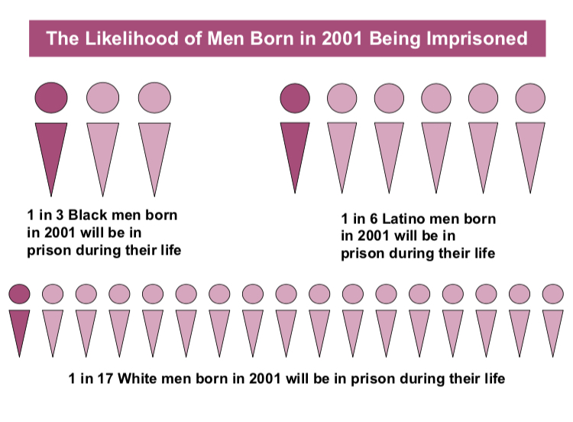
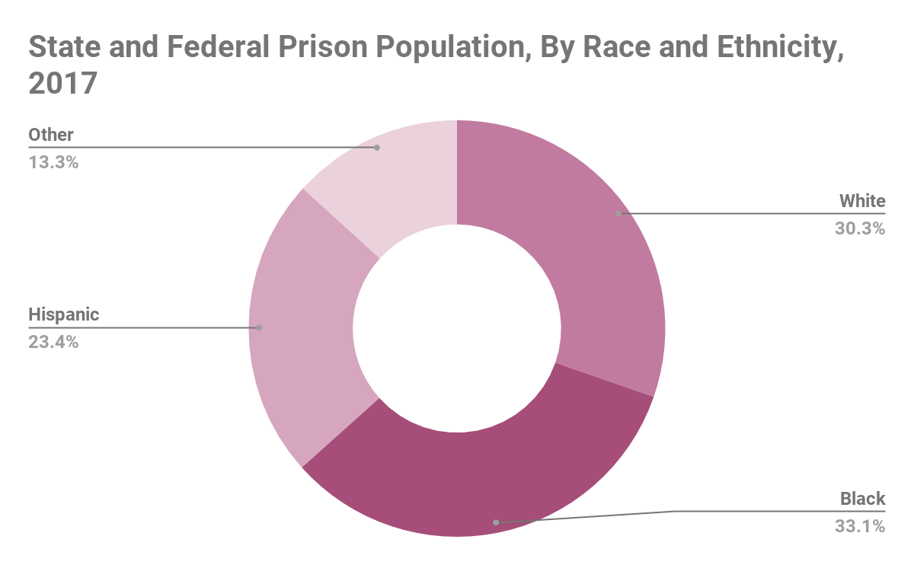
How the Prison Industrial Complex Exploits Men of Color
Amelie Novio || C. E. Jordan High School
Introduction
Data and Results
How has the mass incarceration of men in marginalized groups contributed to the prison industrial complex?
Marginalized men are often the victims of incarceration, usually taking them to the prison industrial complex where they labor for low wages and bring corporations increased profits.
From the information gathered, there is a connection between the incarceration of marginalized men and the private prison industry. Since the "War on Drugs" took action under the Reagan Administration, incarcerations have sparked drastically and have often targeted men of color. This is due to stricter sentencing guidelines and policies. There are harsher sentences for menial offenses.
At least 60% of the prison population are people of color.
Black men are 6 times as likely to be imprisoned as white men.
Hispanic men are 2.7 times as likely.
The number of privately owned prisons is steadily increasing as well as the number of people who are put into those prisons.
United States private prisons incarcerated 128,063 people in 2016. (8.5% of the total state and federal prison population)
The private prison population has increased by 47% since 2000.
There is also a racial disparity found in the private prison population. It is often young, healthy men of color who are placed there as a way for these institutions to make the most money
66% of the private prison population are racial minorities.
African American people make up 43.9% of the population making them the largest group held in private prisons
Hispanic people make up 20.7% of the private prison population.
Background
According to Critical Resistance, “The Prison Industrial Complex is a term to describe the overlapping interests of government and industry that use surveillance, policing, and imprisonment as solutions to economic, social and political problems.” A majority of the population that has been incarcerated are men of marginalized groups. Marginalization is “the existence of a population, group or individual, on the periphery or boundary of mainstream society.”
The United States has the highest prison rates in the world. Throughout history, even today, men have made the majority of the prison population. It is often men of color that have been targeted. African American and Hispanic men have the highest rates of incarceration compared to any other group.
About 40% of all American prisoners, men and women, are African American men.
African Americans comprise of nearly two thirds of the prison population (62%).
These numbers have been increasing along with the number of private prisons there are in the country. The more prisons there are, the more space there is to needed fill to make money. Men are often charged with harsh sentences and lengthy terms in prison which provides more cheap labor to these private prisons.
3,100 corporations profit from mass incarceration
Private prison owners such as CoreCivic (formerly the Corrections Corporation of America) and the GEO Group have spent a total of $5.1 million combined to lobby local, state, and federal governments in 2016.
Methodology
For this project, I used scholarly articles from Google Scholar, ProQuest, and Duke Libraries. I also used sources from reputable organizations such as The Sentencing Project. I gathered sources from recent studies, ranging from 2000 to 2018.
Most of my information comprised of statistical or quantitative data. While researching, I found lots of statistics on the population of those incarcerated. It was difficult to find specific data on the private prison population.
Conclusion
The growing prison population and industry has predominantly been affecting men of color. This has been happening throughout history and is still an issue today. Private prisons and the corporations that endorse them are profiting off of their labor for cheap prices. Of course, it is only just for an individual to be punished for a wrongdoing, but it is an injustice to be punished so harshly for a small offense. A prime example would be categorizing small possessions of a drug as a felony rather than a misdemeanor. Former president, Barack Obama, has addressed issues derived from the War on Drugs, that are still in effect, and has taken some action in reforming federal sentences for minimal drug charges. There have been few efforts to put a stop to this injustice. Awareness should be spread about what happens behind the prison walls.

Slide 2
Bibliography
Anonymous. “50 Companies Supporting Modern American Slavery.” Cagedbirdmagazine, Cagedbirdmagazine, 12 Dec. 2017, www.cagedbirdmagazine.com/single-post/2017/03/28/50-Companies-Supporting-Modern-American-Slavery.
Brewer, Rose M., and Nancy A. Heitzeg. “The Racialization of Crime and Punishment: Criminal Justice, Color-Blind Racism, and the Political Economy of the Prison Industrial Complex - Rose M. Brewer, Nancy A. Heitzeg, 2008.” SAGE Journals, Sage Publications, Jan. 2008, journals.sagepub.com/doi/pdf/10.1177/0002764207307745.
“Confronting the Prison-Industrial Complex.” Arabella Advisors, 11 June 2019, www.arabellaadvisors.com/blog/confronting-the-prison-industrial-complex/.
Hallett, Michael A. “Race, Crime, and Forprofit Imprisonment: Social Disorganization as Market Opportunity - Michael A. Hallett, 2002.” SAGE Journals, journals.sagepub.com/doi/abs/10.1177/146247402400426798?ck=nck.
“Imprisonment and Disenfranchisement of Disconnected Low-Income Men.” ASPE, 21 Feb. 2017, aspe.hhs.gov/report/imprisonment-and-disenfranchisement-disconnected-low-income-men.
“Marginalization and Health Geomatics.” Journal of Biomedical Informatics, Academic Press, 7 Nov. 2003, www.sciencedirect.com/science/article/pii/S1532046403001023.
Neils, Ashley. “The Color of Justice: Racial and Ethnic Disparity in State Prisons.” The Sentencing Project, 14 June 2016, www.sentencingproject.org/publications/color-of-justice-racial-and-ethnic-disparity-in-state-prisons/#V. Recommendations for Reform.
Palta, Rina. “Why For-Profit Prisons House More Inmates Of Color.” NPR, NPR, 13 Mar. 2014, www.npr.org/sections/codeswitch/2014/03/13/289000532/why-for-profit-prisons-house-more-inmates-of-color.
“Private Prisons in the United States.” The Sentencing Project, www.sentencingproject.org/publications/private-prisons-united-states/.
Smith, Earl, and Angela Hattery. “The Prison Industrial Complex.” Sociation Today Fall 2006, Volume 4, Number 2, 2006, www.ncsociology.org/sociationtoday/v42/prison.htm.
“The Moral Failures of America's Prison-Industrial Complex.” The Economist, The Economist Newspaper, 20 July 2015, www.economist.com/democracy-in-america/2015/07/20/the-moral-failures-of-americas-prison-industrial-complex.
“Trends in U.S. Corrections.” The Sentencing Project, www.sentencingproject.org/publications/trends-in-u-s-corrections/.
“What Is the PIC? What Is Abolition?” Critical Resistance, criticalresistance.org/about/not-so-common-language/.

