Slide 1
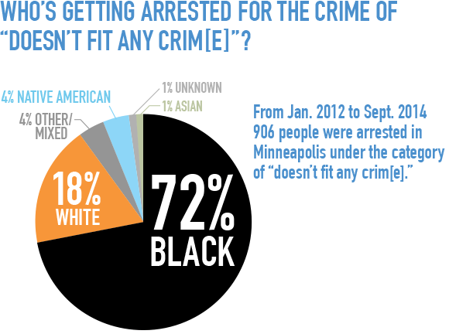
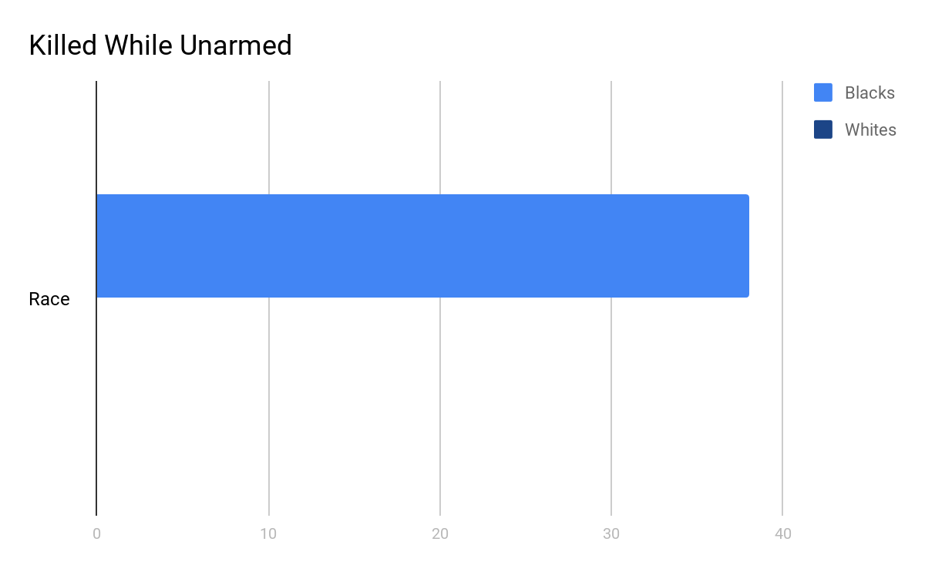
Implicit Bias is the Real Criminal, Not the “Criminals” Incarcerated
Alex McAlmon || Southeast Raleigh High School
Introduction
Data and Results
Methodology
How does the implicit biases held by law enforcement impact Black bodies?
An implicit bias is a judgment that a person does not know they have, towards people that are not the same race, religion as them (Stanford, 2015).
“Every 28 hours a black man, woman, or child is murdered by police or vigilante law enforcement (Nix, 2016).
  These statements imply that the police are overtly prejudiced towards minorities, which is certainly possible but unlikely.
  The results of experimental studies, however, have suggested that officers might be implicitly biased against minorities and more likely to use force against them as a result”.
In 2015, The Washington Post cited that 38 UNARMED Black males were killed compared to 0 whites and 6 were killed for such minor things such as a toy weapon.
  This shows that Law Enforcement officers are implicitly afraid of People of Color, more than whites, because in the same situation, Blacks are killed in an extreme disproportionate fashion.
The sources I used to conduct research came from the Duke Library database, Google Scholar, as well as the help from associates at The Cook Center.
To discover if the sources were reputable, I read through many different articles to pick out pieces of information and data that either related to or answered my question. A challenge I found while researching is that it is hard to know if someone is acting on implicit biases because people do not know they have implicit bias, it is subconscious, therefore they might contribute their actions to something else.
One thing i found significant in my research was the ratio of white cops killing African Americans.
Background
The 21st Century Crime Bill gave police the right to be biased towards People of Color. They prosecuted crack cocaine harsher than cocaine because it was associated with Blackness (13th, 2016).
African Americans get pulled over by the police for no apparent reason other than the color of his or her skin, especially if he or she happened to be driving in the wrong place at the wrong time (ACLU, n.d.).
Conclusion
The implicit biases held by law enforcement endangers Black bodies by “systematically and intentionally targeting them for demise” (Washington Post, 2015).
=

