Slide 1

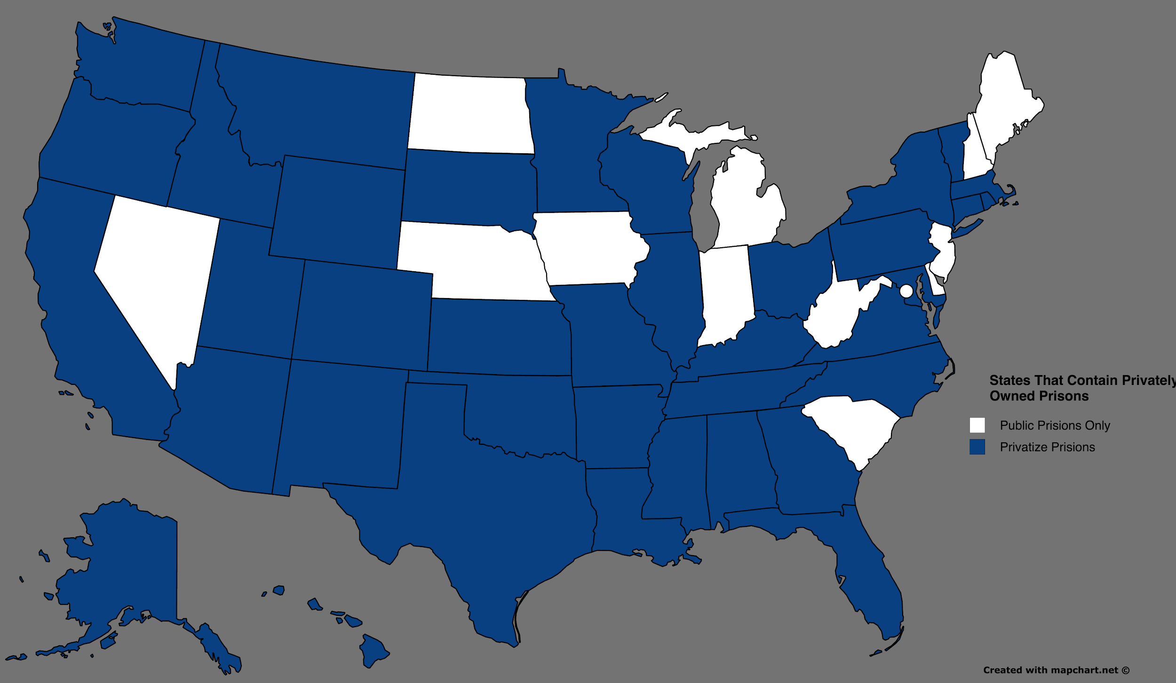
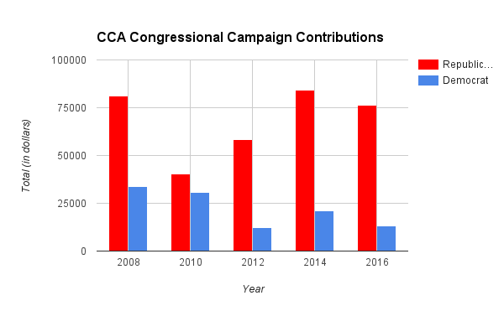
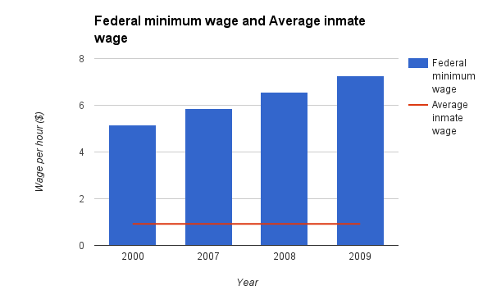
Corporate Wealth and the Prison Industrial Complex
Sydney Grissom || Charles E. Jordan High School
Abstract
Data
Methodology
*
Over the last couple decades, incarceration rates have increased dramatically. A recent study from the Brookings Institute shows that the overall national crime rate has been nearly cut in half since 1990. It’s a perplexing fact that incarceration rates continue to go up while crime rates are decreasing. Many businesses are encouraging our lawmakers to crack down harder on criminals and increase sentencing. The assumption can be drawn that corporations are profiting from convicts. With that assumption the following question arises: How does the prison industrial complex economically benefit big corporations?
This study was conducted through the analysis of scholarly articles and the “Kids for Cash” documentary. After collecting data from various reliable sources, I created graphs depicting the results.The purpose of this study is to convey the message that mass incarceration is not only used as retribution for criminals; but also as an economic gain for monopolies.
When researching I found it difficult to find detailed statistics. Many corporations try to keep their involvement with prison labor underground. It is hard to find exactly how much these companies are making in profit off of prison labor. There is much research about the concept that inmates are being exploited but the data surrounding it is sparse.
Background
Results
Under Lyndon B. Johnson and Richard Nixon’s war on crime, businessmen and politicians collaborated to intertwine work and prison.
Changes in sentencing laws in the 1970’s made the prison population grow exponentially.
In 1973 a right--wing company and conservative politicians combined to form the American Legislative Exchange Council (ALEC).
  The main goal of the ALEC is to imprison more people and access cheap labor from inmates.
The Justice System Improvement Act was passed in 1979. This Act gave businesses the permission to acquire prison labor as a way of making a profit.
  During the mid-1990’s, corporations were able to lobby congressmen into not paying prisoners minimum wage.
Corporations like Walmart and McDonald’s joined the ALEC by 2000. At this time many private prison corporations, like the Corrections Corporation of America, became apart of the interest group as well.
From recent studies, 37 states have made it legal for private organizations to contract prisons for their labor.
According to a Vanderbilt study, more than 600,000 inmates work full time in jail.
Inmates help to make a larger disparity between the “haves” and “have-nots”.
When a new prison is built it gives work to architects and construction companies.
Federal prisoners, on average, get paid between $0.12- $1.15/hour
Most state penitentiaries reward their inmates with minimum wage however private state prisons have paid workers as low as $0.16/hour .
Companies are not required to provide prisoners with the same safety equipment that would be given to ordinary workers. This reduces the company's expenses, in turn increasing the possibility for a profit.
Now that organizations have admittance to the cheapest form of labor, jobs are being taken away from people who were originally employed by these enterprises.
Conclusion
In conclusion, workers are being exploited by businesses for the sole purpose of their revenue. Everyday, corporation founded interest groups are lobbying policymakers to systematically ensure the repeating cycle of the prison industrial complex. Private contracting companies are cutting back in all forms and are threatening the wellbeing of our economy. It is a common misconception that mass incarceration is benefiting prison security, when research shows that private prisons are not employing more guards despite the overcrowding and increasing numbers. The government only gives private companies a limited amount of money per prisoner they house. With limited funds these companies must make a profit by cutting back in other ways and forcing the inmates into an unsafe workplace to be exploited.

Slide 2
Citations
"Wage and Hour Division." N.p., n.d. Web.
"Corrections Corp of America." Opensecrets RSS. N.p., n.d. Web. 28 July 2016.
Wagner, Peter. "Section 3: The Prison Economy." Prison Policy. N.p., Apr. 2003. Web.

