Slide 1
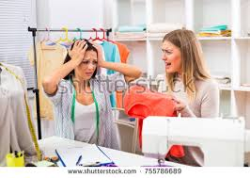
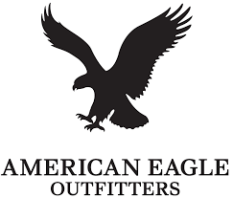

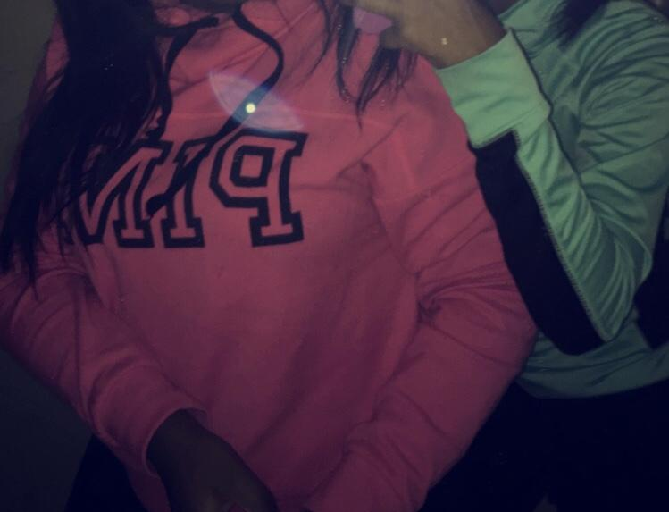

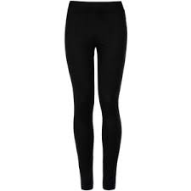
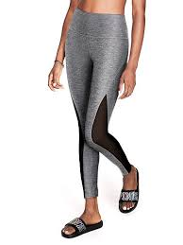
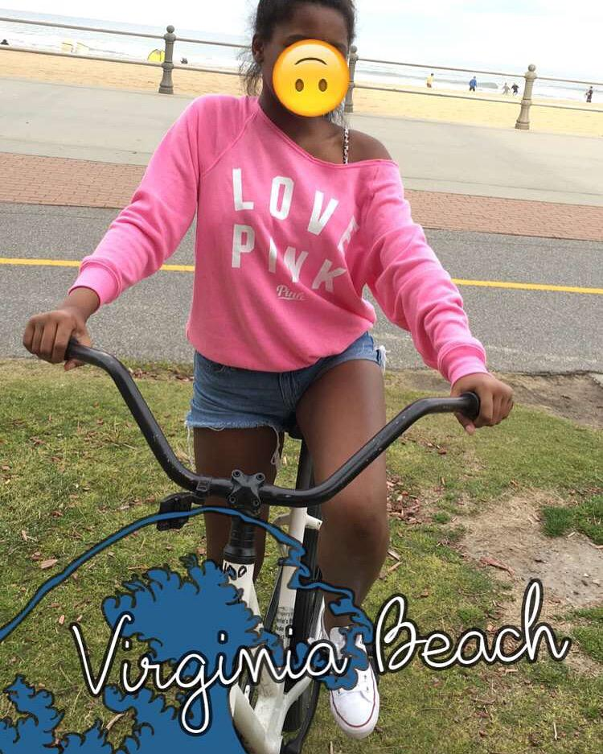
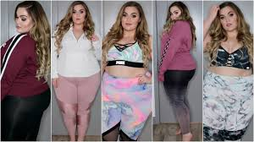

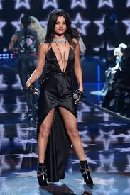
“It’s not about how you wear it, it’s about where you get it!”
Shanya Hayes, Yelie Mendez, Jaetta James
American Eagle Outfitters sucks
Google reviews from VS at Southpoint compared to American eagle at Southpoint
Do you like getting your money’s worth? Then come to victoria secret!
Good Customer Service.
Specializes in: Clothes, accessories, bathing suits, lip gloss, perfume, lotion, body wash, phone cases, undergarments, water bottles, socks, etc.
Size Variety.
Keeps up with all four seasons.
Organized environment.
Target teens and adults.
Good quality items at a decent price.
Victoria Secret “Tonight I had a great shopping experience!! All of the employees were so helpful and even stayed past closing once the after hour sale had ended just to help my friend and I get the best deal!!” -Angelique Colon “The workers are so helpful and nice!!” - Roy Owen “Everyone is very helpful!” -Jordan “All of the employees are very helpful with finding things for you and helping you find styles you may like.” -Christian Alvarez | American Eagle “It's never a fun experience when the cashier skips you twice for people who are not waiting where the line starts and then tells you after you move to where she is pulling people from to move back to where you just came from! And having more people ahead of you because of this. Get you act together AE!” -Ben Dungan “The manager is very disrespectful towards customers. He's a bald and fat man. I simply wanted to return a trivial $10 item and he made a big deal out of it. I highly suggest you go to a different american eagle. The one at southpoint is trash.” -Ronnie Roy
Wear VS and join the “it” crowd!
“YOU deserve the best of the best. Go to VS.”
VS
Celebs endorse V.S. not A.E.
Bad customer service
Doesn't last long
Only targets teens
No variety for plus size
Online orders take forever
Practical people support Victoria Secret! You should too.
Cheap quality and low prices with AE or durable, lasting quality with decent prices?
\
Would you rather: Repurchase $10 dollar leggings everytime they rip or invest in one good pair?
10.99 at american eagle but cheap quality, does not last long. Less wear time
35.99 at Victoria Secret. Pricey but last a lifetime, thicker material, unlimited wear time.

