Slide 1
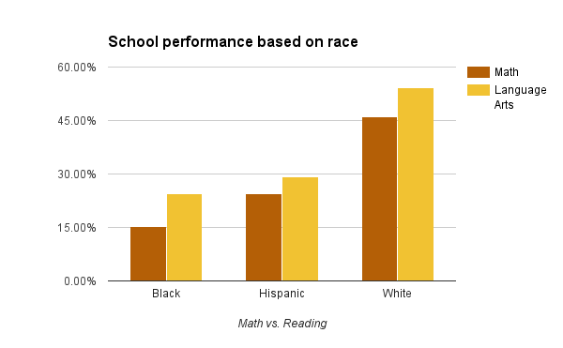
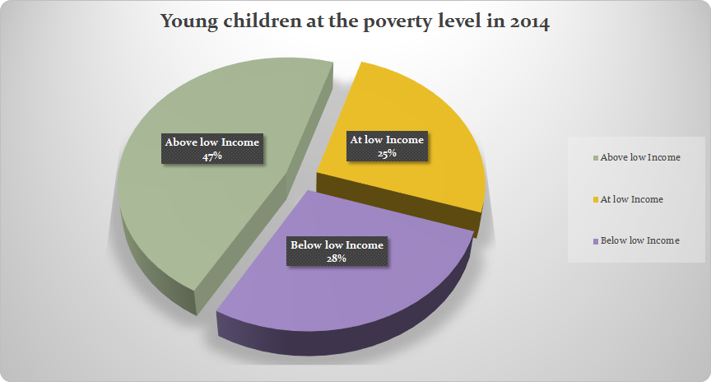
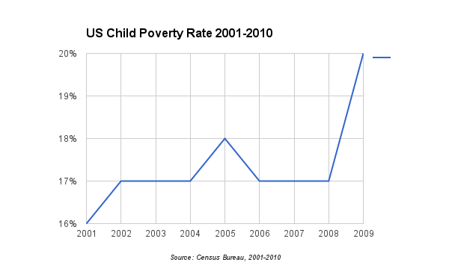
Education Inequality: The Impact of Poverty and its Effect on the Ability to Learn in North Carolina
Rachel Ruff & Elijah King || Riverside High School
Introduction
Data
Methodology
Schools are bureaucratic organizations characterized by a variety of structural features. Among those are rules and procedures designed to focus the efforts of the students. In this study we look into the impact of poverty and its effect on education. Our guiding question is “How does poverty impact education and the ability to learn in North Carolina”. We chose this topic because children face the highest poverty rate in North Carolina than any other group of people.
We studied this topic because this is not only a problem in the US but in North Carolina as well, being that North Carolina has a higher rate of child poverty than the national rate. We also chose to study this topic because as students going to high school it interest us observing different aspects that involve our lives as well as others.
Graphs that explain and display the difference in performance between different races. The graphs also shows the percentages of young children in above low-income families, young children in at low-income families, and young children in below low-income families.
In our research we had various issues because there was much information that was outdated and many key facts were not available. Sometimes specific information about funding for poor schools were there but often times the articles and websites didn't have enough information to really support the point of our topic.
Background
Poverty is “the state of having little or no money, goods, or means of support”.
In North Carolina, around 1.6 million people out of over 9 million live in poverty, that is about 17.2% of North Carolina’s population.
Of the people living in poverty,about 25.2% are children who are directly involved.
North Carolina's child poverty rate at 25.2% and the US poverty rate is only 22% according to the US Census.
Places with high poverty are completely separated from places with little to no poverty at all because of district lines.
  District lines separate what schools students can attend
  Because of district lines, students that live in high poverty areas have to attend schools that only provide a limited amount of funding
Math students in 4th grade showed that low-income students going to schools in better areas scored almost 2 years ahead of low-income schools with high poverty rates.
According to the US department of education's data on North Carolina, 19.7% of low-income children are faced with low percent proficiency on state math tests each year and 26.9% on reading.
The various data from the US Department of Education shows that funding to low-income schools has decreased since 2010 .
This graph explains state test performance and proficiency based on race. Using the data from the NC department of education and the US department of education it is shown that in both reading and math the white student population had higher scores than the black and hispanic populations. Considering that black and hispanic people are more likely to live in poverty.
Results
In our research we found that Poverty does have an affect on children and their ability to learn. A recent study from Harvard shows that poverty causes a chronic stress weakening the architecture of a child’s brain. The study also shows that the child will become less economically aware as an adult.
Other studies similar to this show that it can also cause delayed brain development resulting to lower test scores in the children living in poverty. We also found that children in poverty will have many disadvantages in academics and life. Disadvantages such as less access to early education programs and high quality schools, food insecurity, higher stress levels than normal, and higher dropout rates.
Conclusion
We found out that poverty does in fact impact education and the ability to learn in the state of North Carolina. Many people living in poverty are often unable to attend school at the appropriate age. Families also may not be able to afford the necessary school supplies and sometimes parents may not even have a way for their children to even get to school. This shows a clear correlation between poverty and the ability to learn and without the ability to learn many opportunities seem to disappear.
The graph shows the US poverty rate for children from the year 2001 to the year of 2009. It explains how the rate of child poverty was an average of 17.8%. also how over the span of 7 years the rate spiked only once.
The graph (above) shows the percentage of children that are at the poverty level in the year 2014. It shows the amount of children that are above, at, and below low-income.

Slide 2
Works Cited
Bureau, U.s. Census. "Child Poverty in the United States 2009 and 2010: Selected Race Groups and Hispanic Origin." Child Poverty in the United States 2009 and 2010: Selected Race Groups and Hispanic Origin (n.d.): n. pag. Web. <https://www.census.gov/prod/2011pubs/acsbr10-05.pdf>.
"Census.gov." Census.gov. N.p., n.d. Web. 28 July 2016. <http://www.census.gov/>.
"The Gap between Rich and Poor Schools Grew 44 Percent over a Decade." The Hechinger Report. N.p., n.d. Web. 27 July 2016. <http://hechingerreport.org/the-gap-between-rich-and-poor-schools-grew-44-percent-over-a-decade/>.
"More Than 40% of Low-Income Schools Don't Get a Fair Share of State and Local Funds, Department of Education Research Finds." Home. N.p., n.d. Web. 27 July 2016.
"North Carolina 2015 Report - Talk Poverty." Talk Poverty North Carolina 2015 Report Comments. N.p., n.d. Web. 27 July 2016. <https://talkpoverty.org/state-year-report/north-carolina-2015-report>.
"North Carolina Demographics of Young, Poor Children." NCCP. N.p., n.d. Web. 27 July 2016. <http://www.nccp.org/profiles/NC_profile_9.html>.
"North Carolina State Snapshot." ED Data Express:. N.p., n.d. Web. 27 July 2016.
"One in Four: North Carolina’s Child Poverty Rate Remains the Highest among All Age Groups." The Progressive Pulse. N.p., n.d. Web. 27 July 2016. <http://pulse.ncpolicywatch.org/2014/09/23/one-in-four-north-carolinas-child-poverty-rate-remains-the-highest-among-all-age-groups/>.
"Poverty and School Funding: Why Low-Income Students Often Suffer." Education Week. N.p., n.d. Web. 27 July 2016.
"Poverty in North Carolina :: WRAL.com." WRAL.com. N.p., 16 Jan. 2014. Web. 27 July 2016. <http://www.wral.com/poverty-in-north-carolina/13304389/>.
"Toxic Stress Derails Healthy Development." Center on the Developing Child at Harvard University. N.p., n.d. Web. 27 July 2016. <http://developingchild.harvard.edu/resources/toxic-stress-derails-healthy-development/>.

