Slide 1
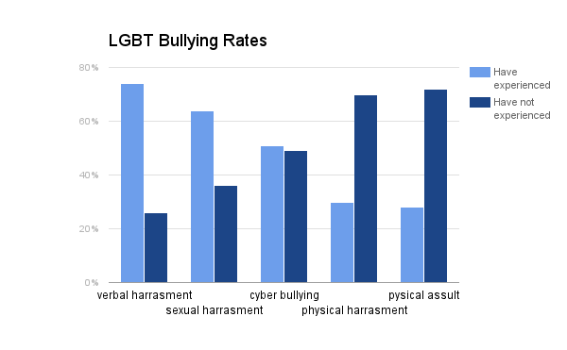

L.G.B.T. Q.: The Economic Effects of HB2 on Transgender People
Trinity Robinson & Makayla O’Neal || Durham School of the Arts & Wakefield High School
Research Question
Data
Methodology
What is the effect of HB2 on transgender people?
Our research was inspired by us with the incident in Charlotte, NC where a man dressed up as a woman which lead us to be curious about the topic of HB2 the LGBTQ
community. When researching we found that there was not much quantitative data (numbers and graphs) because it is a very new topic so be we looked for quotes and laws about transgender people dealing with their issues.
Background Information
HB2: is a law that has gained national attention for its anti-LGBT agenda
L.G.B.T.Q
The HB2 was passed for only single-sex “multiple genders being able to go to the bathroom and changing facilities in schools and in public agencies.
The HB2 was created by Pat Mccrory
Parts of the House Bill
    Bathroom usage around the concept of biological sex
    Provides support meaning if any part of the bill falls the rest will stand
    Addresses the effectiveness date of the bill raising questions about the government
Significance
HB2 is an important issue we are trying to solve in the world today. It is a topic that has many solutions but lots of problems to fix. The importance of HB2 is for people who are transgender are affected by how they think and how they feel about being transgender. The government wants them to use the bathroom in which the gender in which that they were born with and they feel that the are another gender.
Conclusion
Although there are issues like bathroom privileges and bullying still going on, there are many ways to help it:
Volunteering to build a movement across NC
Provide supportive counseling, as needed, and connect youth with LGBT community resources and program
Based on what we've research they are going to have to spend billions of dollars on the issues we have today.
Problems
The NBA’s All-Star Game out of Charlotte has lost an estimated of $100 million to the city’s economy
The NBA said that “HB2 is bad for business”
The law requires bathrooms in public facilities to be used by people based on the gender on their birth certificate.
Triggered a $40 million spending spree by Charlotte businesses and the employees of its hotels, restaurants.
People of the LGBTQ community are being bullied at schools
Quote:‘ I'm a girl I should just use the girls bathroom and just” pee in peace” and not get judged. They think I am a sexual predator but, I would be the one unsafe if i had to walk into a men’s restroom””

