Slide 1
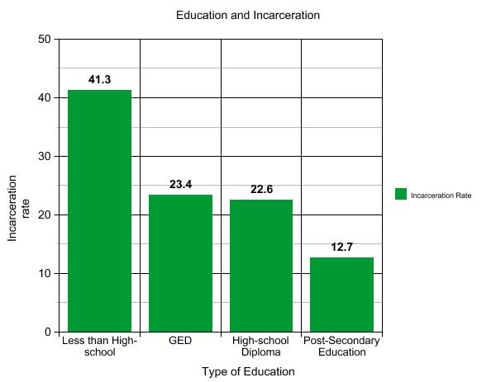
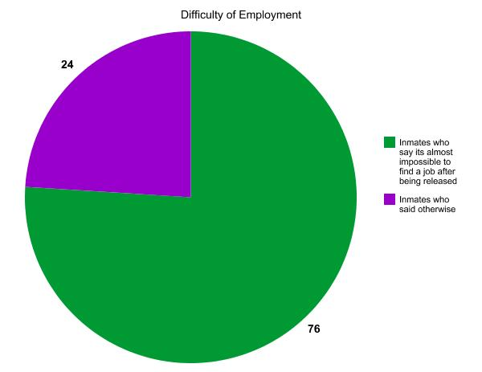
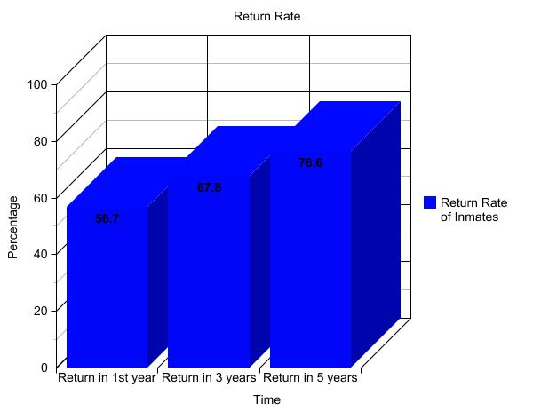
Education in the Prison Industrial Complex
Boluwatife Ajasa, Sachdeep Singh, Kyle Brown || Durham School of the Arts & Hillside High School
Research Question
Data
Conclusion
How does the lack of education in prison continue the prison industrial complex? An inmate is more likely to find a job and not return to jail/prison if they receive their high school diploma or better. However, we believe that is not attainable to the majority of the population because money is being spent elsewhere.
The lack of education inside and out of prison has prevented many inmates from finding a job . Money CNN states that 76% of inmates found it very difficult for them to find a job because of past problems with the law. Around two out of three inmates are unemployed or underemployed 5 years after being released. Based off of the research, we came to the conclusion that we need to put more money in their education and not put on some useless that will not benefit us as a whole. Some states have already taken part in putting education back in prison like Cumberland Country. We need to give inmates a shot at high school diploma,GED, and e.t.c. To be able to do this we need to work together to make or force prisons.
There was a 43% reduction in arrests among those who participate in an educational program while incarcerated
A 22 year (since 1994) congressional ban on financial aid for prisons
President Barack Obama’s administration selected 67 colleges to begin the Second Chance Pell Pilot Program to assist inmates in earning their Associate's and Bachelor's degree
Create better college level and high school education programs for prisons because as education increases the chance of being sent to prison decreases
The JES (Jail Education Solutions) program created by Brian Hill works to provide tablets for inmates who want to receive an education or vocational skills
Background
The word recidivism means a tendency to relapse into criminal behavior
The U.S holds 5% of the world population but 25% of the world's prison population
Every year 6.8 million adults are incarcerated in the United States.
Over 650,000 of those inmates are then released each year without proper education and resources:
  56.7% of those inmates return in first year due to the lack of education in prison
  67.8% return in 3 years due to the lack of education in prison
  76.6% return in 5 years due to the lack of education in prison
African Americans make up 13% of the population but make up 40% of the U.S. incarcerated population
Caucasians make up 64% of the population but only makeup 39% of the U.S. incarcerated population
U.S. employers can legally discriminate against an applicant through a background check
⅔ of American inmates had a job before being detained
The U.S. has spent at least 1 trillion dollars on the war on drugs since it began in 1971
The prison industrial complex has an estimated turnover of 74 billion dollars
Solutions
Methodology
Significance
As researchers from the Samuel DuBois Cook Center On Social Equity, we decided to research the topic of Education in Prison. My colleagues and I decided to use Duke Perkins library, a scholarly search engine, graciously provided to us by the directors of the Young Scholars Summer Research Institute. Through this, we found many articles containing various statistics that correspond to our research question such as the fact that 40% of inmates don't have a high school diploma or a GED. We were curious about this subject because we wanted to expand our research from last year while incorporating a new element into it. We decided to add the subject of education because education was a topic that was relevant to our group and to our peers here. We also decided to do this topic because of all the economic drains the prison industrial complex causes. The average taxpayer spends $31,286 per inmate which totals, roughly, $39 billion. After finding articles that aligned with our inquiry question and ensuring that our data was relevant to our hypothesis we began to organize our findings.
This topic is significant because it helps to bring alive the problem that we have with the prison education system. This has been a big problem in the U.S. Due to the lack of education, inmates are more likely to go back to prison. This is significant because an education can help prisoners to have better jobs and more knowledge. If inmates have a chance to better educate themselves the return to prison rate will decrease which will make the world a better place for the inmates and for society. This is significant because with a better education inmates can get a job so once they are released they can fend for themselves.

Slide 3
Works Cited
Findings, Key. Employment after Prison: A Longitudinal Study of Releasees in Three States (n.d.): n. pag. URBAN INSTITUTE Justice Policy Center. Oct. 2008. Web. 26 July 2016.
"Helping Ex-Prisoners Find Jobs - Prison Fellowship." Prison Fellowship. N.p., n.d. Web. 26 July 2016.
"Money CNN." N.p., n.d. Web. 26 July 2016.
Santora, Marc. "City’s Annual Cost Per Inmate Is $168,000, Study Finds." The New York Times. The New York Times, 23 Aug. 2013. Web. 26 July 2016.
"Our Purpose." PrisonEducation.com. N.p., n.d. Web. 27 July 2016.
"Education for Prisoners, Inmate Locator & Job Training." PrisonEducation.com. N.p., n.d. Web. 27 July 2016.
Merriam-Webster. Merriam-Webster, n.d. Web. 27 July 2016.
"The Effect of Education on Crime: Evidence from Prison Inmates, Arrests, and Self-Reports." Latest TOC RSS. N.p., n.d. Web. 27 July 2016.
"Education and Correctional Population." Special Report. Bureau of Justice, n.d. Web. 7 July 16.
Mckinley, Jesse, and James C. Mckinley. "Cuomo Proposes Higher-Education Initiative in New York Prisons." The New York Times. The New York Times, 2016. Web. 27 July 2016.
Notes:
https://www.theguardian.com/society/2011/jul/24/war-on-drugs-40-years
http://www.biztechmagazine.com/article/2014/12/what-it-takes-bring-education-behind-bars

