Slide 1

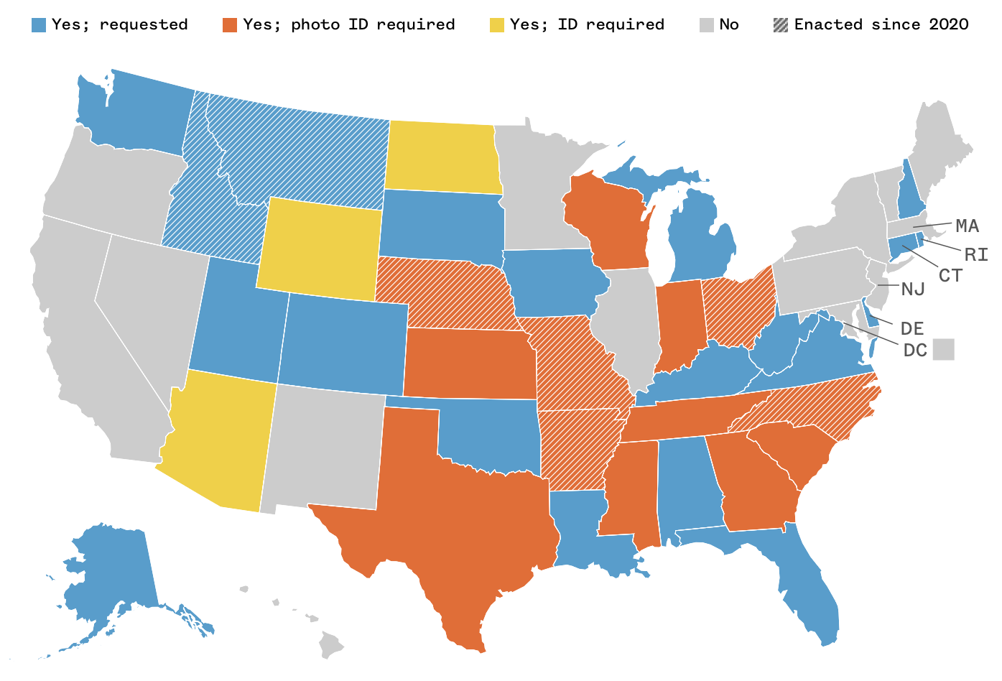
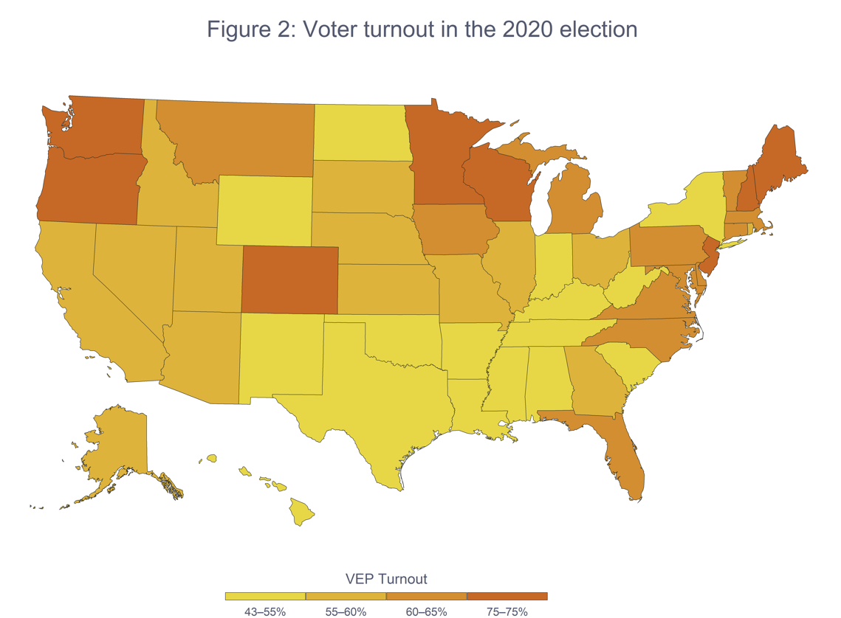
How Voter Identification Laws Disenfranchise Minorities
Zachary Blizzard | Durham School of the Arts
Introduction
Visuals
Findings
In recent years, controversy has erupted around the implementation of new voter identification laws. Although some forms of these laws have been around for over a century, and when they were first put in place back in 1896 had caused little controversy, today they are the center of a fierce debate surrounding election fairness. It also should be mentioned how since the Civil War black Americans have been kept from voting through poll taxes and unpassable tests. I chose this topic because I wanted to explore how these laws disproportionately impact minorities trying to vote, especially as we near a very important presidential election. Voter identification laws are being implemented with the intent to disenfranchise minority voters. Minority voters are more likely than other demographics to not have an identification and have limited access and means to acquire identification, which acts as a barrier to their ability to exercise their right to vote. How do voter identification laws impact minorities’ access and ability to vote?
Voter Identification Laws By State
In the 2022 U.S House vote, 60% of Hispanic voters and 93% of African American voters voted blue, while 57% of white voters voted red (Hartig, 2023)
25% of voting age African Americans are without a current government-issued identification compared to just 8% of voting age white Americans (Johnson, 2020)
The total cost of obtaining an identification, including transportation, time spent waiting, and the document fees is anywhere from 75 dollars to 175 dollars (Harvard, 2014)
The average white household had 9.2 times as much wealth as the average black household in 2021 (Kochhar, 2023)
States often don’t allow specific forms of identification based on who is most likely to have those identifications, for example Texas doesn’t allow student identifications but does allow handgun licenses to be used to vote. Over half the carriers of student identifications were racial or ethnic minorities (ACLU, 2011))
In Georgia, a program put in place called the Exact Match Program which required an individual’s name on their driver’s license or social security to match the name on their voter registration form or the individual’s voting status would be suspended, impacted 51,000 Georgians with 80% of those impacted being African American (Vij, 2020)
In North Carolina, public assistance identifications and state employee identifications are both overwhelmingly held by black voters and are not always accepted at the polls (ACLU, 2011)
Background
Vote Turnout By State
Voter identification laws are laws that require voters to present some type of identification when attempting to vote. These laws are controlled by the state government, which means requirements vary across the country. For example in North Carolina students can use student identification to vote while in Texas they can not. Voter identification laws disproportionately disenfranchise minorities compared to other voters and decrease voter turnout. Although voter fraud is extremely rare, (out of 250 million absentee ballots cast, there have only been 193 criminal convictions of voter fraud) about there is still strong support (especially in red states) for increased voter identification laws, which signals that there is political motivation behind these restrictions.
Conclusion
Voter identification laws are being put into place by politicians with the intent of preventing certain people who will vote against them from voting. These people tend to be minorities, such as immigrants, African Americans, Hispanics, and Native Americans. Although the laws don’t necessarily stem from racism, they have the unintended effect of disenfranchising these specific groups of people. As the upcoming presidential election in November looms, it is crucial that people are given affordable routes to obtain identifications that allow them to vote in their state. A couple ways that this could be done is through the local government, which could create programs to mobilize voters in the area or spread information regarding how and where to obtain identification. To conclude, laws to protect the integrity of our elections are important. Before the creation of these laws, voter fraud ran rampant across the nation. But today voter fraud has been repeatedly proven to have had no effect on the results of any recent elections.
Methodology
To conduct my research on how voter identification laws
disenfranchise minorities, I employed the secondary research
method, a literature review. During my research, I utilized
Duke library and Google Scholar to analyze primary and secondary sources for synthesis. I utilized the ACLU, the Brennan Center for Justice, ScienceDirect, the American Bar Association, the Pew Research Center, Proceedings of the National Academy of Sciences (PNAS), and the National Broadcasting Company (NBC),
The first map shows us what is required to vote in each state, while the second map shows us what percentage of each state’s population voted in 2020. What we see is that the states with the strictest voter identification laws tend to have the lowest voter turnout.

