Slide 1
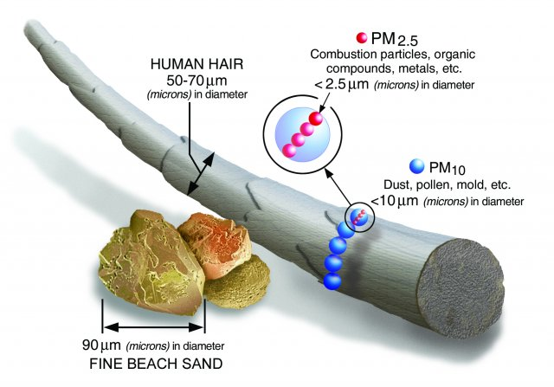
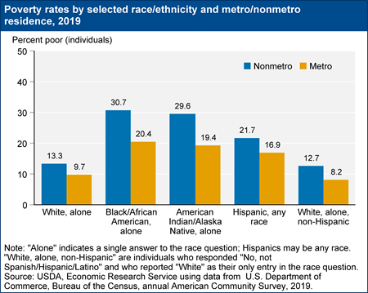
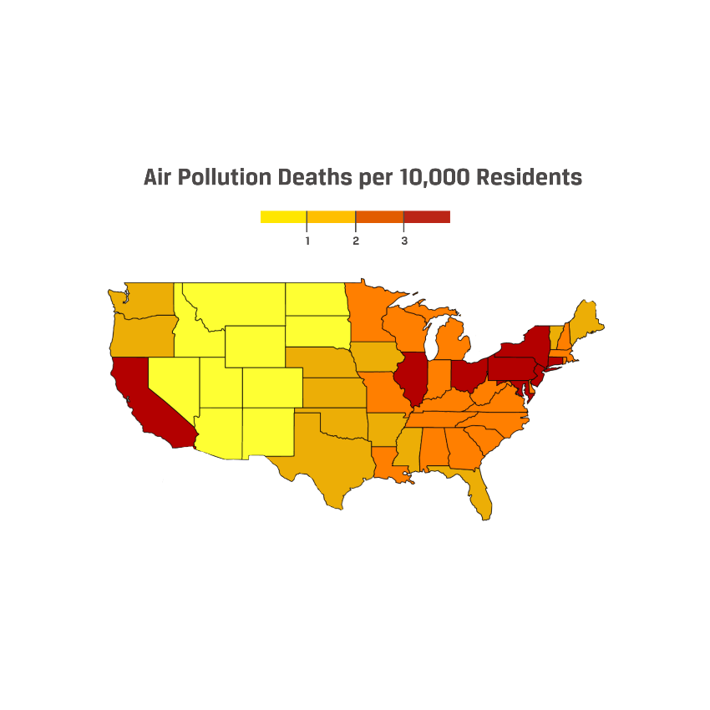

Effects of Poor Air Quality in Low-Income Rural Communities
Madeline Fuentes | Northern High School
Introduction
Data
Findings
Global air pollution has been an issue that is continuously trying to be fixed. Although it is a popular discussion, not many of us are aware how the government and companies with high power, disproportionately favor specific communities. Rural communities are often more affected, but receive little to no attention. The majority of the population in these areas are low income, families of color. Your environment plays a huge factor regarding your physical health and mental health especially as you begin developing.
Research Question: What are the effects of poor air quality in low-income rural communities?
Thesis Statement: With families that already struggle financially, minimizing landfills, power plants or industrial factories near smaller towns would help lower-income families live in pollution-free spaces, alleviating a challenge.
In rural areas pollution arises from unpaved roads, pesticides, power plants, livestock feeding and waste, cropping machines, surface mining, oil and natural gas drilling (Rural Health Information Hub). Hydraulic fracturing (“fracking”), coal production, and hazardous waste fields are more likely to be located in rural communities. Although there are laws to protect air quality, many states have exemptions for fracking (Castelli). In general, inconsistent laws are a major contributor to poor air quality. While laws and policies exist that could address the problem, they are inconsistently enforced, and are more likely to be enforced in wealthier areas (Cabrera). The largest contributor to rural pollution is agriculture, which contributes to 17,900 deaths in rural towns each year (Air Quality). In the past 8 years, towns in North Carolina with a high population of Black, Native American and Latino residents, have had a significant increase in farm animal operations, despite laws promising to limit them (Graddy).
What are the effects of this population? PM 2.5 pollutants cause health conditions such as heart disease, asthma, and chronic bronchitis (Particulate Matter Basics). Swine, cattle and poultry waste cause significant harm to the respiratory system as well (American Academy of Pediatrics).This is particularly true for at-risk groups such as pregnant women, children, and the elderly (UC Irvine, American Lung Association, Asthma California). Because individuals in rural areas also tend to be lower-income, their housing, which often consists of mobile homes (i.e., trailers) can be inadequate to protect them from the effects of this pollution (Rural Health Information Hub). In addition, their distance from hospitals and healthcare mean that treatment is often less accessible. (American Hospital Association).
100x smaller than a single hair strand and stays in the air for long periods of time. This causes severe health issues such as nonfatal heart attacks, aggravated asthma or premature death (Particulate Matter (PM) Basics).
Background
The idea that people should be concerned about the environment is not new. The environmental conservation movement began in the United States over a hundred years ago (University of Michigan). In 1963, the “Clean Air Act” was passed to address causes of air pollution. The Act is still in effect today, with many updates, but it only applies to certain areas, leaving rural communities still in danger (Castelli). For example, Central Valley California is home to one of the largest agricultural productions, including huge tracts of almond, citrus, produce, dairy operations, and livestock and agricultural commodities that are worth $36.5 billion. Farm operations and factories like these release high levels of PM 2.5 polluants. Regulations by the EPA (Environmental Protection Agency) have been created, but have not been implemented, and some communities like those in California often almost never meet the standards. “We need more, but we are ignored,” said a research and policy director from Central California Environmental Justice Network (Gwen). One reason for the disparity may be race. 41% of the population living in rural central Valley are Hispanic/Latinx, with a majority working in low-paying jobs (Hans).
Key Terms
Environmental Injustice: Unequal treatment between minority groups when mistreatment of the environment is concurrently taking place.
Particulate Matter (PM): solid or liquid particles found in the air. it is 2.5 micrometers in diameter and harmful to your respiratory system.
Fracking: Drilling method used to extract petroleum.
This graph illustrates the percentage of rural/nonmetro vs. urban/metro individuals who live below the poverty line, subdivided by race. It indicates that people in rural areas are more likely to be poor, especially when they are people of color (USDA Economic Research Service).
Conclusion
My research helps identify the minority group being affected by air pollution and how this harms them in ways people think is inconsequential. Many residents from these places seek for a positive change, but are not being taken into consideration when harmful pollutants are placed near their homes. Lawmakers and others in power prioritize industry over the lives of individuals in low-income communities. By holding lawmakers accountable for enforcing the laws that already exist, passing additional laws and regulations about industrial and agricultural chemicals in populated areas, and supporting access to healthcare for those in rural communities, we can alleviate the effects of air contamination for some of the most vulnerable citizens.
Methodology
To conduct my research on air-pollution disparities in rural areas, I employed the secondary research method, a literature review. During my research, I utilized Duke Library and Google Scholar to analyze primary and secondary sources for synthesis. I utilized the American Lung Association (ALA), World Health Organization(WHO), American Academy of Pediatrics (AAP). These findings were informative and relevant data. I used more qualitative research by adding examples of different cities going through this issue as well as three images to get a clear understanding how vital air is. Key words such as “Disproportionate” “Particulate matter “ “Rural “ and “Environmental Injustice “ were used to find principle facts. To get the latest Information I made sure to use articles from 2006 to present day.
The map shows the amount of deaths caused by air pollution in each state. Red means most deaths and yellow means less deaths. The red and orange states have more diversity and many low-income towns (Currit).
Notes:
Add to citations:
University of Michigan History Department. “I. Origins of the Environmental Movement.” Give Earth a Chance - Environmental Activism in Michigan, Omeka RSS, michiganintheworld.history.lsa.umich.edu/environmentalism/exhibits/show/main_exhibit/origins#:~:text=Public%20pressure%20and%20grassroots%20activism,enacted%20several%20early%20federal%20laws. Accessed 29 July 2024.

