Slide 1

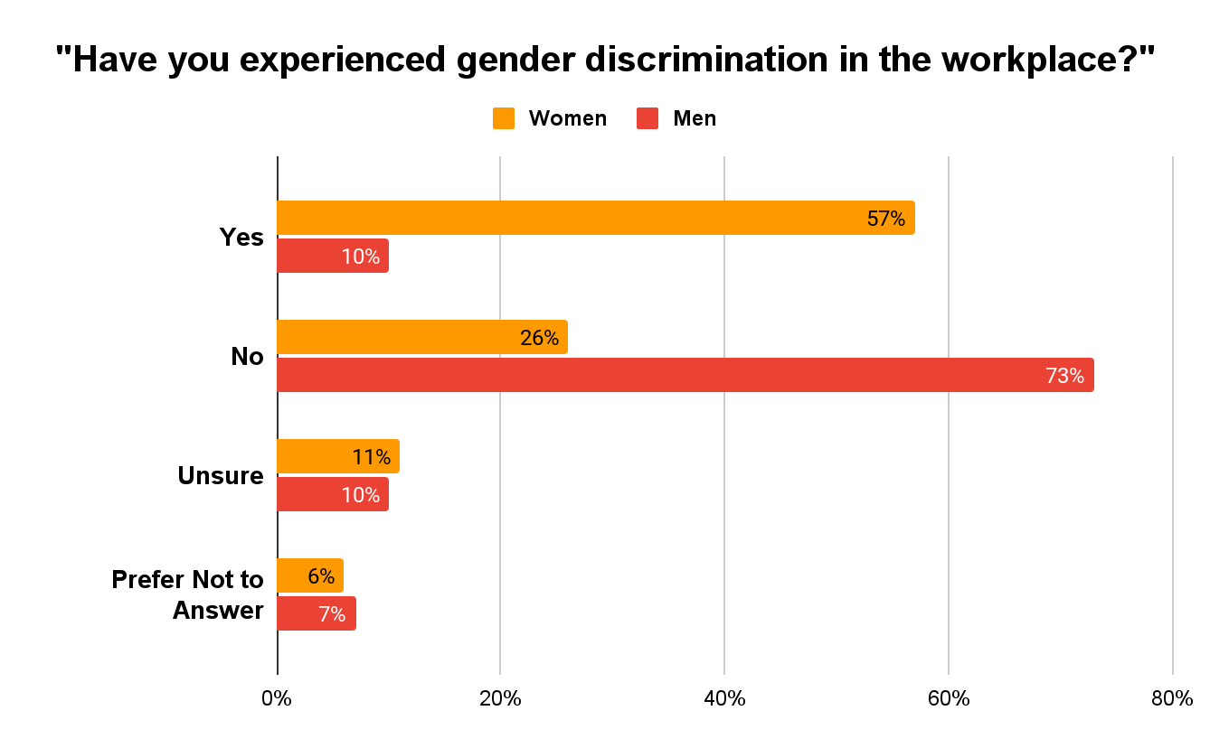
Mental Health in Higher Education
London Saxon | Charles E. Jordan High School
Introduction
Background
Data
The Higher Education system has raised many eyebrows when pertaining to the discrimination towards their Black faculty, particularly Black women. Black faculty have begun to openly share their challenges in higher education and how those challenges have impacted their mental health.
Thesis: Gender-based discrimination impacts the mental health of Black women in higher education, causing an increased Mental Health Rate such as depression.
Research Question:How does Gender-Based Discrimination affect the mental health of black women working in Higher Education
Gender- Based Discrimination is when individuals are treated negatively or unequally based on their gender
Majority who struggle from this are women and girls
Women have struggled to find their place in society since the early 1800’s ( Little).
24% of women say they have earned less than a man doing the same work
A black women stated she did not fit in and spoke on being routinely isolated by peers and potential mentors in the workplace (Aya).
In a 2020 survey for Black students and women in Higher Ed the results came that participants often felt like because of the isolation that they were missing out on various opportunities (Aya)
When speaking on mental Health I am referring to depression
A Black professor “Candia Bailey” at Lincoln University took her own life on January 8,2024 because of the Discrimination and bullying in her workplace (Lawson).
Experience of Gender Discrimination
Source:8 charts that show the impact of race and gender on technology careers
Methodology
Findings
Conclusion
In a 2020 study 220 U.S. Black college professors found that even though being seen as a strong black women came with benefits it also came with the cost of their mental and physical health (Aya).
Black women who participated in a study that showed those who did face discriminations in their workplace struggles with excessive eating and substance use (Aya).
Research from 2020 shows that depression often occurs with substance use particularly alcohol use disorder (El-bahnasawi).
The hostility that black women face in higher education can be hazardous to their health. The women in the study told that they were stuggling with depression, had though about suicide and felt physically ill when they go to campus(Aya).
Gender based discrimination can be many things such as bullying, unequal pay, lack of opportunity and gaps in mental health care.
I have concluded that Gender-Based discrimination has taken full effect within the workplace and is something not spoken of enough. African American women have tried to take a stand and have been ignored time after time, resulting in depression and anxiety rates shooting out the roof. There are many ways to prevent this, such as providing more free and accessible counselors and therapists for black women in the roles of chancellor, professor, Dean, etc. This could be seen as providing free and accessible counselors along campus grounds to support these black women instead of ignoring their cries for help. Women should not feel scared or isolated in their place of work or feel like their opportunities are being taken away because of their gender.
To conduct my Research on Black women's Mental Health in Higher Ed I employed the secondary research method, a literature review. During my research method, I utilized Duke Library and Google Scholar to analyze primary and secondary sources for synthesis, I utilizes the Journal of School Psychology (JSP), Inside Higher Ed (IHE), National Library of Medicine (NLM), abc News article (ABC).

