Slide 1
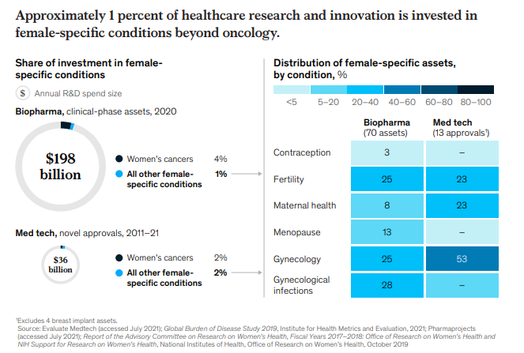
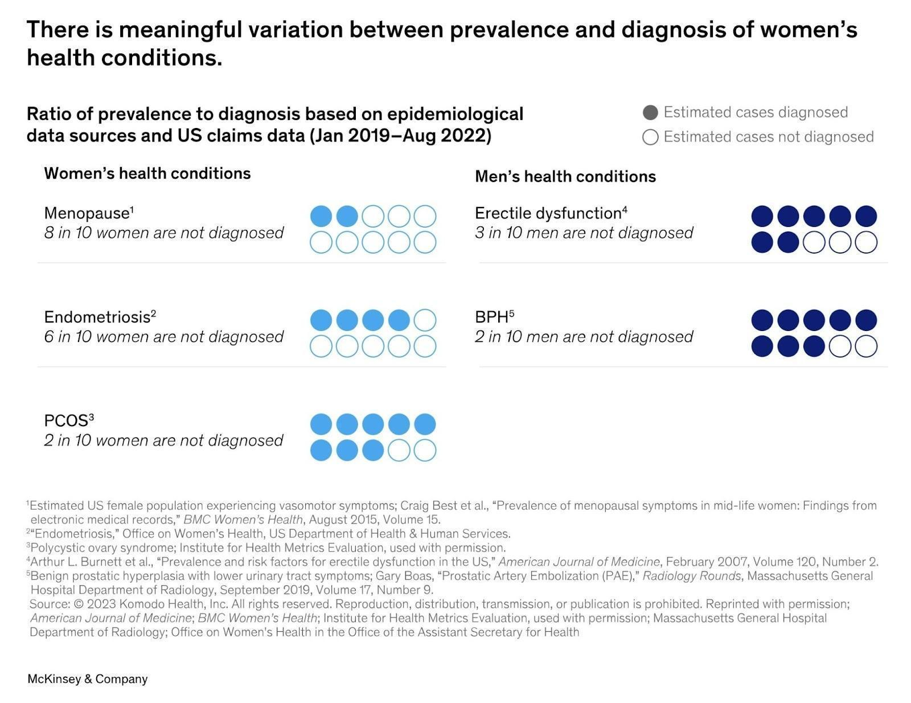
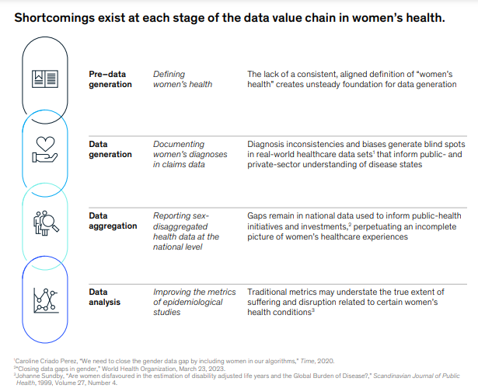
The Gender Health Gap: Healthcare Disparities Faced by Women in the U.S.
Layla Mahoney
Middle College High School at Durham Technical Community College
Introduction
Data Analysis
Results
The subject of women’s health has largely been met with ignorance from the public and medical professionals alike, leaving women across the United States, ignored, undiagnosed, and sick due to the significant lack of research into the matter. Caroline Criado-Perez’s book, Invisible Women: Exposing Data Bias in a World Designed for Men, highlights the importance of this issue by stating that “[f]or millennia, medicine has functioned on the assumption that male bodies can represent humanity as a whole. As a result, we have a huge historical data gap when it comes to female bodies [..] That this is still going on in the twenty-first century is a scandal. It should be the subject of newspaper headlines worldwide. Women are dying, and the medical world is complicit. It needs to wake up” (Criado-Perez, 2019).
Research Question
How do gender bias and discrimination affect the quality of healthcare for women in the United States, and what are the consequences of this gender health gap?
Thesis Statement
Gender bias and discrimination in the U.S. healthcare system result in significant disparities in research funding, education, diagnosis, and treatment for women, leading to poor health outcomes and a critical need for focused studies and reforms to address this inequity.
Methodology
The Gender Health Gap: Healthcare Disparities Faced by Women in the U.S. is a research project on the various effects of gender bias and discrimination on women’s healthcare. It utilizes both qualitative and quantitative methods and secondary data to collect the research presented throughout the project. In addition, secondary data was gathered by using searches on Google Scholar and the Durham Technical Community College Library database to locate credible, peer reviewed articles primarily from the National Library of Medicine database.
Disparities in Research Funding
This research examined the National Health Institute’s funding and revealed huge disparities in the funding given in medical research. According to Miron, in his study, “Gender Disparity in the Funding of Diseases by the U.S. National Institutes of Health”, “[i]n nearly three-quarters of the cases where a disease afflicts primarily one gender, the funding pattern favors males, in that either the disease affects more women and is underfunded (with respect to burden), or the disease affects more men and is overfunded.” Additionally, according the McKinsey organization, an overwhelmingly small share (1%) of the funding budget for healthcare research and innovation goes towards female-specific conditions beyond oncology (McKinsey, 2022). This data suggests that funding not only favors male health issues, but also neglects to effectively address the majority of female-specific health problems.
Education on Female Health
Another problem uncovered while researching is the issue of education in healthcare. This remains a key factor because while what we do know about the female body is largely limited due to a history of neglecting to study women in health research, much of it isn't always explicitly taught to students entering the medical field. For example the World Economic Forum reported that “out of 112 internal-medicine residency programs reviewed in a 2016 study, approximately 25 percent did not include menopause in the core curriculum, 30 percent did not include contraception, nearly 40 percent did not include PCOS (Polycystic ovary syndrome), and more than 70 percent did not include infertility.” Additionally, a 2021 study, that surveyed medical students at several colleges on their knowledge of “sex and gender based medicine” found that “only 36% (12/33) of questions related to other medical knowledge on [Sex and Gender Specific Health] topics had more than a 50% correct response rate” (Rydberg et al., 2021). These data points highlight the major blind spots in medical education when it comes to gender, which plays a key role in the gender health gap as medical professionals are not often as well versed as they should be in matters of sex and gender as it applies to healthcare.
A Lack of Effective Treatments and Diagnosis
Another issue brought up by the research concerns the difficulty some women face in getting a diagnosis, the first step towards treatment for many. Data from the US claims and a report from the World Economic Forum which can be found in the data analysis section of this project, demonstrates that the medical community often struggles to diagnose women on a large scale for a variety of health issues, and particularly endometriosis (World Economic Forum, 2024); ( McKinsey, 2023). This often leaves women unable to effectively treat their health issues in the same way they would be able to with a diagnosis (Woodruff Medical). Additionally, when it does come to treatment, medication is often harmful or ineffective. For example a 2020 article found that “women are more likely than men to suffer adverse side effects of medications because drug dosages have historically been based on clinical trials conducted on men” (University of California Berkeley, 2020). This data suggests that when it comes to healthcare, medical professionals are ill prepared to both diagnose and treat female patients due to men being used as the standard for the larger history of medicine.
Overall Impact
A 2024 study, “Gender(ed) science: How the institutionalization of gender continues to shape the conduct and content of women's health research”, highlights the importance of the issue and the consequences of not addressing the social biases around gender by stating that “[Gender] operates as a major social organizing principle that confers unequal power, status, and resources to men and women, with direct consequences for health” (Philbin, 2024). Additionally, a report by the World Economic Forum found that “the women’s health gap equates to 75 million years of life lost due to poor health or early death each year. Closing the gap would give the 3.9 billion women in the world today an extra seven healthy days a year, or an average of 500 days over a lifetime.” This data demonstrates the true impact of the gender health gap and highlights the need for a solution to this national medical emergency, that if left unaddressed will leave millions of women across the United States to suffer from society’s neglect.
Background
The above graph depicts the small percentage of funding that goes towards female-specific research especially for health issues past oncology (McKinsey & Company, 2022).
According to a report from the World Economic Forum and the McKinsey Health Institute. “Women spend 25% more of their lives in debilitating health than men.” (World Economic Forum, 2024).
“According to US claims data from January 2019 through August 2022, the prevalence of women’s health conditions (estimated by epidemiological data sources) is roughly five times that of their documented diagnosis… In comparison, the difference between epidemiological prevalence and documented diagnoses for men’s health conditions narrows to roughly 1.5 times” (McKinsey, 2023)
A report by the World Economic Forum states that “Globally, [endometriosis] affects 10% of women and girls of reproductive age, but in the US, for example, only two out 10 cases are diagnosed, with diagnosis taking more than seven years – and even longer for Black women.” (World Economic Forum, 2024)
In the times of ancient Greece, while studying the sexes, the philosopher Aristotle --among his many other sexist and misogynistic theories-- characterized the concept of a woman as a “mutilated male” (Schoch, 2023). The many misogynistic ideas that have evolved throughout history, including Aristotle’s, are still reflected in many areas of society today, and the healthcare system is no exception. A study examining the historical inclusion of women in clinical trials found that for many years, researchers used the idea that women are simply more difficult and more complex than men to exclude women participants from the majority of clinical trials (Liu and Mager, 2016). It wasn't until 1993 that the National Institute of Health (NIH) officially required women and minorities to be included in clinical trials (Institute of Medicine, 1994). This led to the creation of a large research gaps that leaves many at a loss when confronted with women’s health issues simply due to a lack of data of the female body (Institute of Medicine, 1999). According to a 2024 study, “[h]istoric patriarchal and misogynistic beliefs and values are reinforced through social institutions, including health science, which reify gender inequities” (Philbin et al., 2024). To ensure an equitable society it is necessary to effectively and swiftly address the research gap, which is known today to leave women across the United States unable to be properly diagnosed and treated.
The image below serves as a visual aid to understanding how women’s healthcare is undermined at every level of research (McKinsey & Company, 2023)
Conclusion
This research brings light to many of the hidden health disparities faced by women as a result of gender bias and discrimination throughout medical history. This issue, despite its importance, has not brought the attention it deserves. The reality is that this is a national medical emergency and it is imperative that it is quickly and effectively addressed. Issues such as disparities in research funding and a male bias in education only serve to exacerbate the gender health gap and ensure the ignorance of the United States medical professionals. The deficit of knowledge behind women’s health is largely responsible for the poor health of women across the U.S., due to a lack of diagnoses and effective treatments. For millennia, men have been considered and treated as the default human in the medical world; however, this neglects to consider the medical needs of women and often leaves them, undiagnosed, sick, and dismissed. Fortunately, the solution to this long neglected issue is quite obvious. The medical ecosystem's disturbing lack of knowledge about women's health needs can be effectively addressed with an increase in studies and research focusing on how sex and gender impact general health conditions as well as female-specific healthcare. Women have been forced to suffer the consequences of an ignorant medical world. Now is the time to close the gender health gap else we run the risk of more dead, sick and dying women nationwide.
The above graph compares the misdiagnosis rates between largely male-affected diseases to majorly female-affected diseases (McKinsey & Company, 2022).

Slide 2
Bibliography
Ac, Mastroianni, et al. “Women and Health Research: Ethical and Legal Issues of Including Women in Clinical Studies: Volume 2: Workshop and Commissioned Papers.” National Academies Press, Jan. 1999, www.ncbi.nlm.nih.gov/pubmed/25144106.
Anwar, Yasmin. “Lack of Females in Drug Dose Trials Leads to Overmedicated Women.” Berkeley News, 12 Aug. 2020, news.berkeley.edu/2020/08/12/lack-of-females-in-drug-dose-trials-leads-to-overmedicated-women. Accessed 24 July 2024.
Bundy, Rick. “Four Conditions Underdiagnosed in Women.” Woodruff Medical, woodruffmedical.edu/four-conditions-underdiagnosed-in-women. Accessed 24 July 2024.
Burns, Delaney, et al. “Closing the Data Gaps in Women’s Health.” McKinsey & Company, 3 Apr. 2023, www.mckinsey.com/industries/life-sciences/our-insights/closing-the-data-gaps-in-womens-health#. Accessed 24 July 2024.
Ellingrud, Kweilin, et al. “Closing the Women’s Health Gap: A $1 Trillion Opportunity to Improve Lives and Economies.” World Economic Forum, World Economic Forum, Jan. 2024, www.weforum.org/publications/closing-the-women-s-health-gap-a-1-trillion-opportunity-to-improve-lives-and-economies. Accessed 24 July 2024.
Liu, Katherine A., and Natalie a. DiPietro Mager. “Women’s Involvement in Clinical Trials: Historical Perspective and Future Implications.” Pharmacy Practice, vol. 14, no. 1, Mar. 2016, p. 708. https://doi.org/10.18549/pharmpract.2016.01.708.
Medicine, Institute Of, and Committee on Ethical and Legal Issues Relating to the Inclusion of Women in Clinical Studies. Women and Health Research: Ethical and Legal Issues of Including Women in Clinical Studies, Volume 1. National Academies Press, 1994.
Mirin, Arthur A. “Gender Disparity in the Funding of Diseases by the U.S. National Institutes of Health.” Journal of Women’s Health, vol. 30, no. 7, July 2021, pp. 956–63. https://doi.org/10.1089/jwh.2020.8682.
Perez, Caroline Criado. Invisible Women: the Sunday Times number one bestseller exposing the gender bias women face every day. Random House, 2019.
Philbin, Morgan M., et al. “Gender(Ed) Science: How the Institutionalization of Gender Continues to Shape the Conduct and Content of Women’s Health Research.” Social Science & Medicine, vol. 351, June 2024, p. 116456. https://doi.org/10.1016/j.socscimed.2023.116456.
Rydberg, Ann, et al. “Sex And Gender Specific Health Topics in Medical Student Learners: Pulse Check Eight Years Later.” Biology of Sex Differences, vol. 12, no. 1, Oct. 2021, https://doi.org/10.1186/s13293-021-00397-w.
Schoch, Silke. “Histories and Hysteria: How Women’s Words and Bodies Are Mistreated by the Health System in America - National Health Council.” National Health Council, 23 Mar. 2023, nationalhealthcouncil.org/blog/histories-and-hysteria-how-womens-words-and-bodies-are-mistreated-by-the-health-system-in-america. Accessed 24 July 2024.
“Unlocking Opportunities in Women’s Healthcare.” McKinsey & Company, 14 Feb. 2022, www.mckinsey.com/industries/healthcare/our-insights/unlocking-opportunities-in-womens-healthcare. Accessed 24 July 2024.
World Economic Forum. “6 Conditions That Highlight the Women’s Health Gap.” World Economic Forum, 19 June 2024, www.weforum.org/agenda/2024/06/womens-health-gap-healthcare. Accessed 24 July 2024.
Notes:
Rydberg, Ann et al. “Sex and gender specific health topics in medical student learners: pulse check eight years later.” Biology of sex differences vol. 12,1 53. 9 Oct. 2021, doi:10.1186/s13293-021-00397-w

