Slide 1

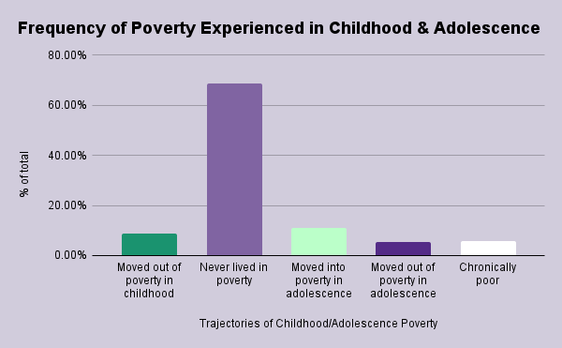
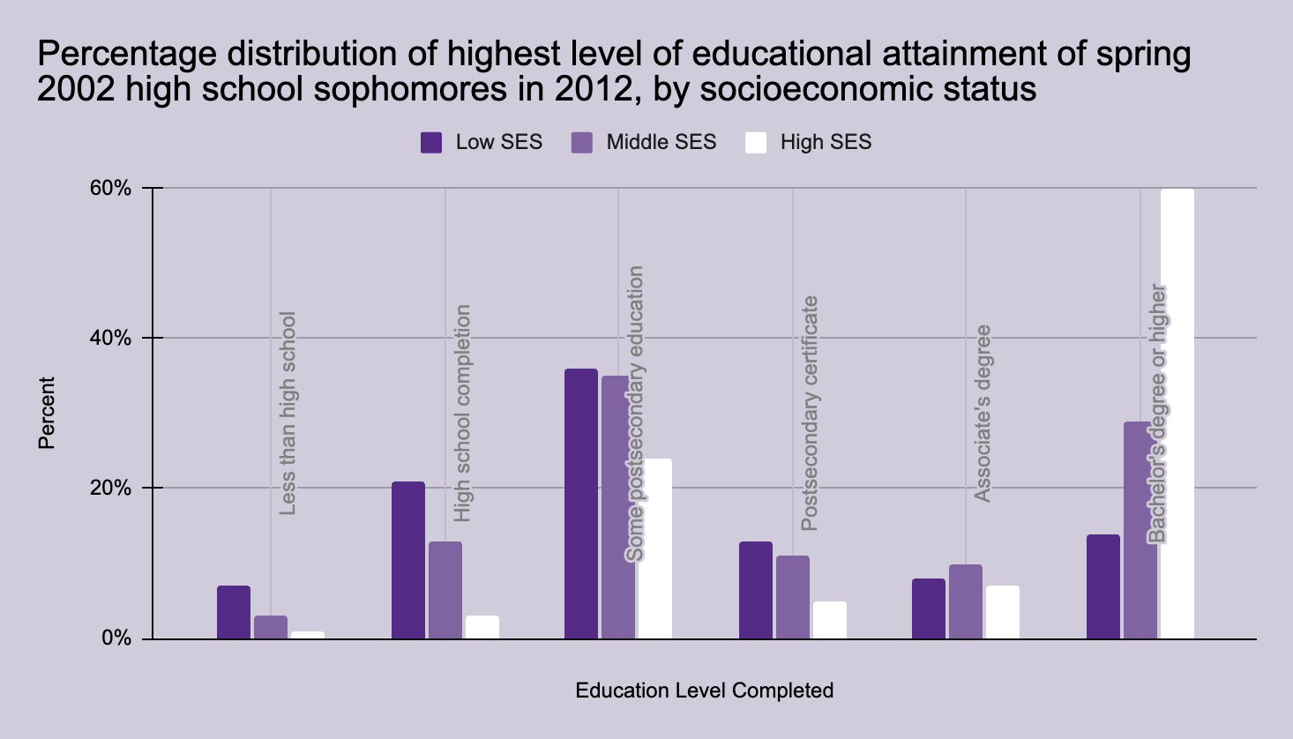
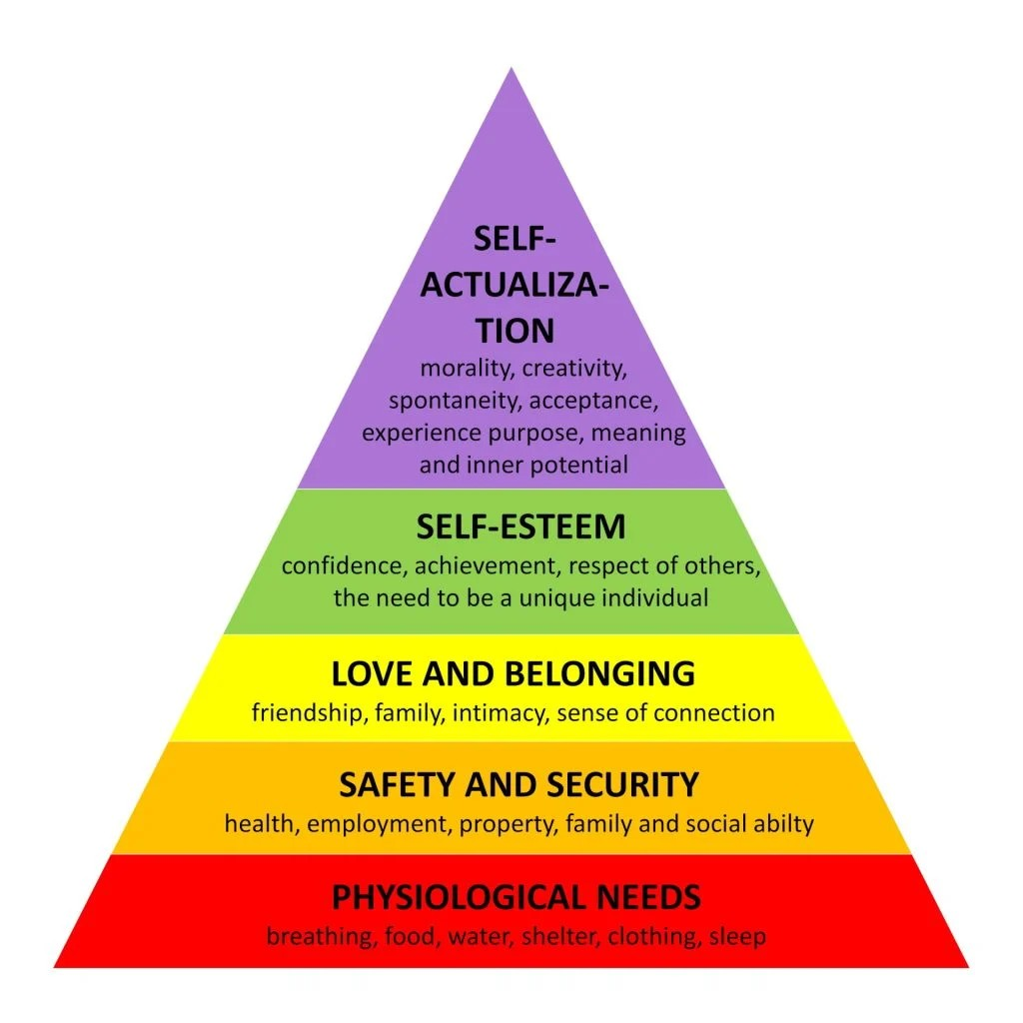
Location Affects Mental Health:
Basic Needs or Higher Education?
Kayla M. Lewis | Charles E.Jordan High School
Introduction
Data
Methodology
People of color, particularly Black Americans, are more likely to live in poverty than their white counterparts. These living conditions, such as lack of access to healthy food and inadequate shelter, means that they must focus their energy on meeting their basic needs, rather than striving for higher goals. This directly impacts the academic achievement of students living in these conditions, who are more likely to be non white than their higher-income peers.
Research Question: How does socioeconomic status, impact college readiness of low-income students?
Thesis: If students’ basic biological needs are not met, they cannot be expected to focus on academic success or future goals.
To conduct my research on how does socioeconomic status, particularly housing, impact the academic performance of low-income students? I employed the secondary research method, a literature review. During my research, I utilized Duke library and Google scholar to analyze primary and secondary sources for synthesis I used ProQuest, Taylor & Francis Online, Journal Of Child And Family Studies and Official Journal of the World Psychiatric Association.
Findings
Background
Understanding What Can Promote Higher Education
A family's socioeconomic status impacts home environments, the resources available to children, the neighborhoods they live in, and the school they attend (Rouse, Kimberly).
Families and other social context affect young adult outcomes. Coming from an advantaged socioeconomic background allows for valuable privileges, opportunities, and safeguards in contrast. ( Rouse, Kimberly).
Once the physiological needs of the child are met, the physiological needs serve as motivators (Rouse, Kimberly)
Lower level basic needs like food, water and safety must be met first before higher needs can be fulfilled (Rouse, Kimberly)
Low - income students physiological needs are not met based on Maslow’s Hierarchy of Needs, which makes them less likely to be college-ready.
Understanding Maslow's Hierarchy Of Needs
Human beings most basic need is physical survival this is the first thing that motivates our Behavior.Once that level is fulfilled, the next level up is what motivates us. ( Rouse, Kimberly )
Once an individual’s physiological needs are satisfied, the need for security and safety becomes important (Family, Society, Schools, Workplace, etc)
When safety needs have been fulfilled the third level of human needs is social and involves feelings of belongingness. ( Rouse, Kimberly )
Key Terms
Self-actualization: achieving one’s highest potential and vision for oneself
Quality of life: a person's emotional, social, and physical well-being, and their ability to function in daily life.
Maslow’s Hierarchy of Needs: an idea in psychology that says that an individual’s survival needs (food, water, shelter, etc.) must be met before more complex needs (achievement, esteem) can be considered.
Mental health: person's emotional, physiological, and social well being that affects how they think feel or act.
Social Selection Theory:
Black Americans represent 14.1% of the population. Of that group, 17.1% live in low-income areas (Shrider).
Black and Latinx Americans are overrepresented in those who live below the poverty line. One reason for this overrepresentation is predicted by social selection theory. This theory postulates that whites have a greater propensity to avoid living in poverty communities because they are more likely to enjoy social and economic advantages (Shrider).
Figure 1: This graph shows the trajectories of childhood and adolescent poverty in America; that is, the experiences that school-age individuals have with living in poverty. Although about ⅔ of the individuals in the survey never lived in poverty, of those who did, the largest group moved into poverty in adolescence - the time immediately before high school graduation and university enrollment.( Gradin )
Conclusion
According to Maslow’s Hierarchy of Needs, individuals must satisfy basic needs such as food, shelter, and safety before they can satisfy higher needs such as academic achievement. This would indicate that individuals who live in poverty would be less likely to achieve academic success.
My research indicates that there is no single factor that predicts a student's educational outcomes. Environment, housing, and community resources all play a role. When a student's basic needs are not met, it limits their ability to be academically successful. As I continue my research, I plan to investigate options to reduce poverty in my own community and to support the basic needs of low-income students so that they are better equipped to focus on their education and break the generational cycle of poverty.
Figure 2: A 2012 longitudinal study from the National Center for Education Statistics analyzed the educational trajectories of students of various socioeconomic levels. According to the study, students from high socioeconomic status (represented by white on the graph above) were roughly twice as likely as middle-class students and three times as likely as low-income students to achieve a 4-year college degree or higher.
(National Center for Education Statistics)
Notes:
https://nces.ed.gov/programs/digest/d17/tables/dt17_104.90.asp

