Slide 1
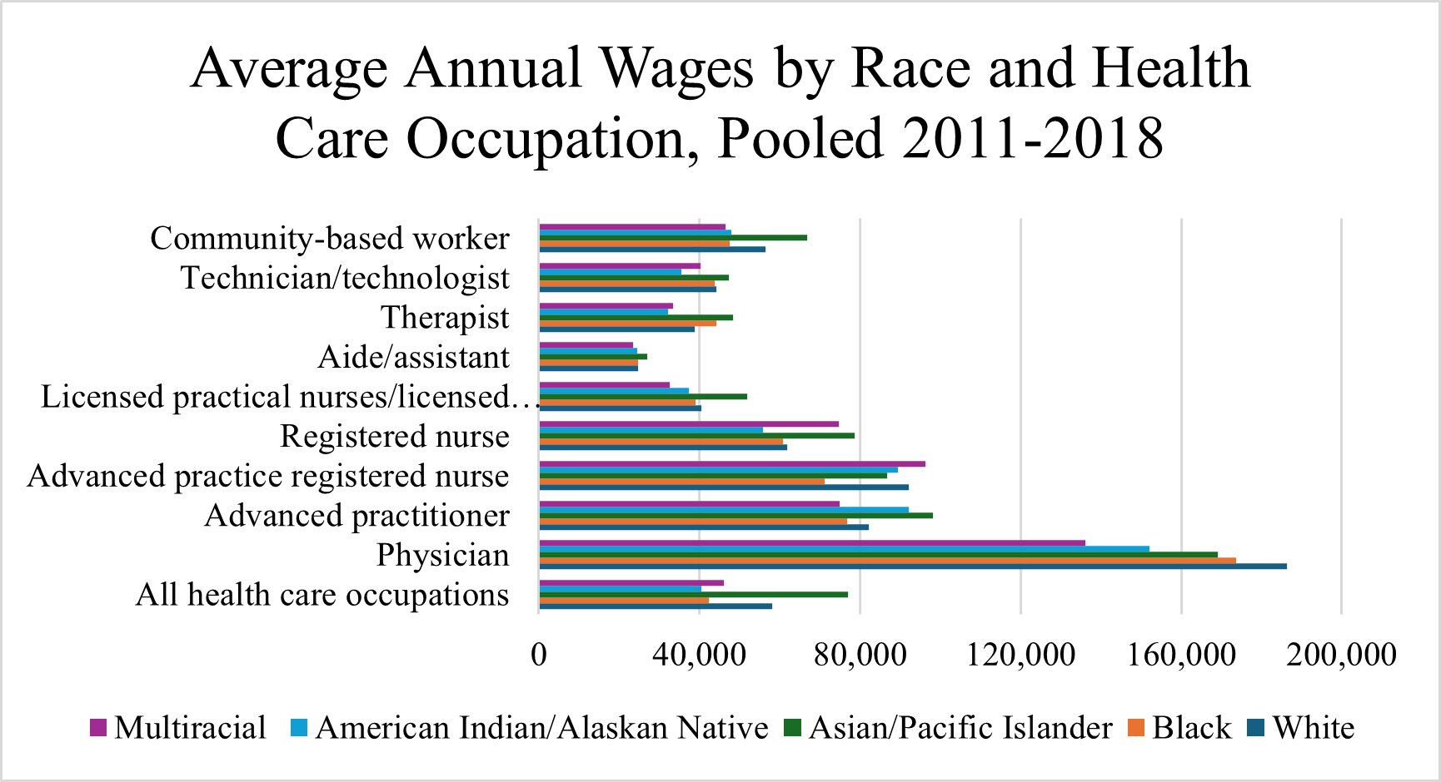
Gender and Racial Wage Disparities in Healthcare
Josephine Babarinlo
JD Clement Early College High School
Introduction
Data Analysis
Findings
Black healthcare workers receive lower wages based on their race and gender, resulting in a wage gap in certain professions. Black healthcare workers also experience disparities in professional advancement, which lead to underrepresentation in the field. Over the last 20 years, the wage gap has widened in lower-level healthcare professions.
Research Question: How do gender and racial wage disparities impact the representation of Black healthcare workers?
Thesis Statement: Black healthcare workers make significant contributions to the healthcare system but continue to face substantial gender and wage disparities, perpetuating extensive inequalities and hindering their opportunities for advancement and representation.
Black healthcare workers face a higher risk of gender and race discrimination, even with higher income and education levels, because they are part of a predominantly white healthcare profession (Stepanikova, 2017).
Black women face higher levels of racism, sexism, and discrimination compared to Black men or White women (Chinn, 2021)
Racial wage disparities affect the advancement of black healthcare workers. Lower wages may lead to financial difficulties and poverty, hampering their progress (McDermott, 2022).
Black nurses often encounter discrimination in the hiring process, where the quality of their education and experience is called into question. This bias can lead to fewer promotions and career advancement opportunities compared to their White counterparts, ultimately resulting in lower wages for Black nurses, including nursing assistants (Frogner, 2021).
"Black women have historically faced exclusion from medical schools and other necessary training programs to advance in the healthcare profession. This historical barrier continues to impact black healthcare workers today, perpetuating stereotypes (Dill, 2022).
It has been observed that Black women in healthcare tend to stay in the same profession for a long time. Many Black healthcare workers apply for lower-paying jobs within the same profession, but they do so because of the reliability these positions offer (Dill, 2022).
Graph 1.0 Data collected from Structural Racism And Black Women’s Employment In The US Health Care Sector (2022). The amount of people in each health care profession by race and gender.
Methodology
I conducted secondary research using Google Scholar and scholarly journals from the National Institute of Health and the citation of American Medical Colleges. I also used the expertise from Dr. Keisha Bentely-Edwards, an Associate Professor in Medicine. The keywords I used to search this topic were “human capital," “Black healthcare professions," "wages," under-representation," “health inequities," and "disparities.”
Background
Black healthcare workers face lower wages due to historical racial and domestic barriers that existed before and after the Civil Rights Movement. Black healthcare workers earn 76 cents for every dollar earned by white healthcare workers, resulting in a 34% wage gap. (Frogner, 2021). There are 5% of black healthcare worker working in higher occupational professions in healthcare, while there are 42% working in lower-paying occupational jobs (Konstantopulos, 2023). They are due to limited resources; they are often relegated to "lower paying jobs" in healthcare professions due to limited resources. These barriers have hindered the professional advancement of Black individuals in the healthcare industry. Despite an increase in the number of Black healthcare workers since the 1960s, wage disparities persist.
Conclusion
In conclusion, black healthcare workers face significant wage disparities, as well as gender wage disparities. The wages given to black healthcare workers may not be sufficient to sustain their lifestyle. These disparities contribute to discrimination within the field. The insufficient wages and lack of stability for certain demographics cause them to remain in a specific healthcare profession for extended periods of time.
Graph 2.0 Data collected from Examining Wage Disparities by Race and Ethnicity of Health Care Workers (2021). This data shows that there are differences in wages not only across professions but in the same profession by race.

