Slide 1

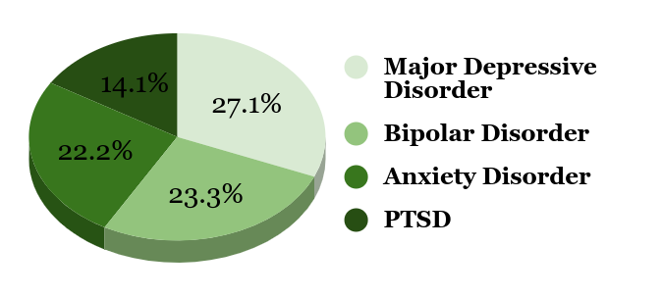
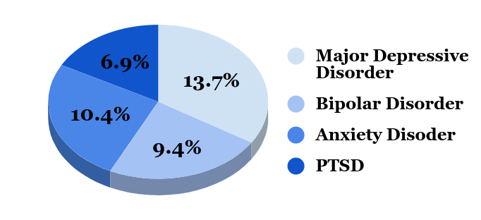
Men's Mental Health In The Prison System
Jaiden Uludong | Northern High School
Introduction
Data
Findings
The population of men that are struggling with their mental health does not exclude those who are in prison. A large number of prisoners do not have accessible mental healthcare or attainable mental health programs within the prison system. Numerous incarceration facilities generate different environments and inmates respond in various ways. Whether that is developing or exacerbating mental disorders, resources should be within reach. Along with long-term mental effects, many have contracted physical health conditions; such as cardiovascular disease, weight gain, or hypertension. Funding the proper health care for prisons have been a critical issue. This leaves many have to tackle their mental disorders on their own.
Mental Disorders vs. 1,159,100 Male State Prisoners
Recidivism
Both physical and mental health has been investigated within the prison system. But maintaining health outside of incarceration is a hardship many struggle with. An individual who does not successfully manage their mental disorders may be more susceptible to criminal attitudes and activities. This will only increase the chances of recidivism. (Wallace)
The Theory of Differential Association emerged from a criminologist, Edwin H. Sutherland. It states that those who come in contact with others involved criminal activity learn and replicate those attitudes. Subsequently, many who commit crimes have a tendency to commit more or have what is called a “criminal career” (Maloku).
To reduce recidivism while treating underlying mental disorders, programs have been implemented such as Drug Courts, Mental Health Courts, and Veterans Courts. (Mental Health America)
Social
Prison environments have high levels of overcrowding and routine exposure to violence, leading to further negative effects (Penal Reform International).
Loneliness and social isolation have higher risks of health issues such as depression and cognitive decline (National Institute of Health)
Race, Age, & Crime
In both State and Federal prisons, studies convey a significant higher percentage of white male prisoners who display mental disorders compared to other races (U.S. Department of Justice).
Ages 18-44 demonstrated a higher concentration of mental disorders in State prisons. Compared to Federal prisons containing men 55+ years old with the higher concentration of mental disorders (U.S. Department of Justice).
Those who are clinically depressed are three times more likely to commit violent crimes such as robbery, sexual offences and assault (Kelland).
Research Question: What are the long-term effects of incarceration on mental health in men, and how can they be treated?
Thesis: Men who have been incarcerated are more likely to display psychological disorders such as depression and bipolar disorder (BPD).The transition of these men from prison back to community requires effective healthcare as the most fitted solution.
U.S. Department of Justice
Office of Justice Programs
Bureau of Justice Statistics
Mental Disorders vs. 162,700 Male Federal Prisoners
Background
The federal prison system in the United States began in 1891. The Three Prisons Act enabled funding for three prison facilities, located in Leavenworth, KS, Mcneil Island,WA and Atlanta,GA. But before the bill was passed, federal prisoners were held in the state prisons. Many who suffered from mental disorders were placed in these facilities without proper care. That was until the 1840’s, a reformer named Dorothea Dix advocated for those with mental disorders. This would later lead to the creation of mental institutions within the United States, with varying degrees of helpfulness - some were more like prisons than hospitals, but others provided real treatment. The 1980s would be the destruction of many mental health institutions due to the Omnibus Budget Reconciliation Act of 1981 being signed by President Reagan. Deinstitutionalization - the closing or defunding of mental health facilities - began trickling through the U.S., creating understaffed and underfunded organizations.
(Bell)
U.S. Department of Justice
Office of Justice Programs
Bureau of Justice Statistics
Methodology
Conclusion
To conduct my research on the long-term effects on mental health from incarceration in men, I employed the secondary research method, a literature review. During my research, I utilized Duke Library and Google Scholar to analyze primary and secondary sources for synthesis. I utilized the American Psychological Association (APA), the U.S. Department of Justice, and National Institute of Health (NIH).
Treatments such as Psychotherapy, Interpersonal therapy, Behavioral therapy, and Cognitive therapy are only some of the suggested therapies to many battling mental disorders. Determining what is suitable for each person will dictate their path of treatment. Informing others about this topic can give another perspective and insight on those who do not have much of a say on their well-being. Continuing research on this specific topic will keep not only others informed, but can enlightened those to create resources and refine the mental healthcare system to decrease the chances of recidivism.
Key Terms
recidivism: The tendency to repeat a crime. (Dictionary.com)
Mental Health Courts: A program for those with mental disorders that acts as a alternative to the traditional judicial system. (APA)

