Slide 1
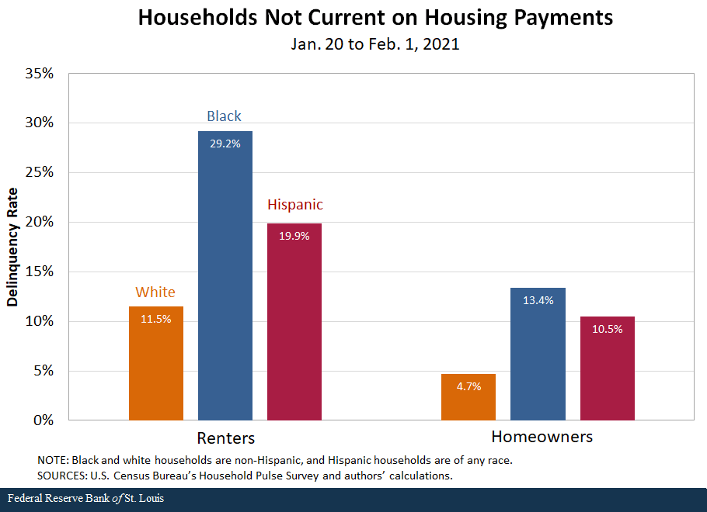
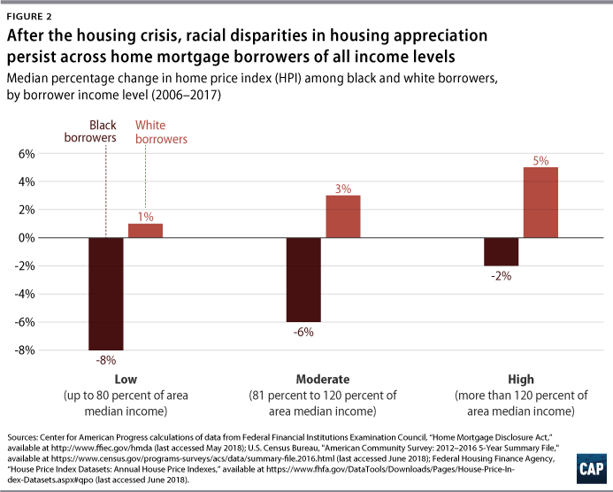
The Impact of Housing Insecurity on Low-income Families in NC
Funmi Shabu
Northern High School
Introduction
Data Analysis
Results
Housing insecurity in North Carolina is a major concern. According to a report by Princeton University’s Eviction Lab, between 2000 and 2016, there were over one million eviction filings in North Carolina. This translates to an average of more than six evictions filed every hour during this timeframe. In 2016, Greensboro, NC ranked as the seventh city with the highest number of evictions in America. With an average of 13 families being evicted every day. Being cost-burdened by housing can have many effects on people's health (physical and mental) and well-being. According to the CDC, “Housing-insecure adults are more likely to delay medical care and utilize emergency care, have poorer health care access, experience adverse mental health outcomes, and have a higher prevalence of substance use than individuals with stable housing do.” Many families also struggle with food insecurity and crime in these poorer neighborhoods as well as physically unsafe housing like lead pipes and faulty electricity. Housing insecurity can lead to less access to healthcare, higher crime rates, and physically unsafe housing that many cost-burdened people are forced to live in. Housing insecurity needs a solution that solves all of these issues that come with it.
Research Question
How are low-income families affected by housing insecurity in North Carolina today?
Thesis Statement
The lack of safe, affordable housing in North Carolina is imperative because of the rise in housing insecurity and housing-related deaths.
Methodology
The Impact of Housing Insecurity on Low-income Families in North Carolina project entails qualitative data and secondary peer reviewed articles from the CDC, Princeton University, Vanderbilt University’s medical center and Google Scholar. It was not difficult finding research pertaining to racial disparities in housing insecurity; on the other hand, there was difficulty finding scholarly sources regarding the mental health disparities related to housing insecurity. This was due to the lack of research regarding mental health issues. In conclusion, there is more research to be done concerning the effects of housing insecurity on health which will be critical in solving the housing crisis in NC.
According to a study done by Vanderbilt University Medical Center, 5% of ED (Emergency department visits) were for current homeless and housing insecurity and those experiencing these issues were more likely to have drug and suicide-related concerns. The study states: “Unstable housing and homelessness can exacerbate adverse health outcomes leading to increased risk of chronic disease, injury, and disability. However, emergency departments (EDs) have no universal method to identify those at risk of or currently experiencing homelessness.” Housing insecurity and homelessness can affect access to health care due to variables like transportation, and finances. Another article found that the high housing costs in NYC negatively affected renters' health and their ability to afford healthcare. Another factor that impacts housing-insecure people is crime. A study by Joseph Quednau found that there is a higher percentage of poverty and Black people in high-crime cities. People in poverty and who cannot afford better housing often have to live in unsafe neighborhoods with shootings and other violent crimes many in areas of color. A study was done on how violent crime rates in U.S cities were affected by overtly. “Results show that 30.43% of the population in high-crime cities is black while on average only 14.22% of the population is black in low-crime cities.” Unsafe neighborhoods can go hand in hand with unsafe housing which is another problem that financial issues exacerbate.According to WRAL, high levels of lead and carbon monoxide poisoning is prevalent NC. In 2020, two babies died at McDougald Terrace in Durham, potentially as a result of elevated levels of carbon monoxide poisoning.
Effects in Healthcare Access
Housing insecurity affects access to healthcare, leading to delayed treatment and decreased emergency visits. Unstable housing is linked to higher rates of substance abuse, which increases health risks. Living in poor conditions exacerbates mental health issues like stress and contributes to the onset of chronic diseases. Little financial resources also restrict access to healthcare. This can cause treatable diseases and issues to quickly become fatal.
Effects in Crime
Housing insecurity can increase the risk of violent crimes and safety concerns, due to mental health and lack of resources necessary for survival. This is especially true in low-income communities where access to things is restricted due to lack of finances and crime is an easy way to make money. Criminal activities can also lead to poor neighborhood connection and resident discrimination, weakening the sense of community in these areas.
Effects in Unsafe Housing
Unsafe living conditions present substantial dangers to both physical and mental well-being, raise the chances of accidents, and hinder children's growth. These factors disproportionately affect low-income families and are very harmful to their well-being. As seen in MacDougall Terrace, unsafe housing can easily take lives and cause health issues.
Many factors exacerbate poor health for housing insecure families, those targeted are majority people of color. An article by Richard B Duque talks about how these situations affect the Black community “This tragic brew of intersecting and compounding factors experienced in isolated, overcrowded, low-income, minority communities reinforces the cycle of health risks to underlying conditions like asthma, cancer, diabetes, heart disease, and obesity, all of which are considered by the CDC as strongly associated with Covid-19 infection and death.”
Conclusion
The graph above represent which ethnic groups are currently missing housing payments.
Ultimately, housing insecurity is increasing as inflation and the pandemic affect housing costs while income and wages are not bridging the gap causing many families to be financially unstable. Low-income housing which is all some families can afford is usually of a lower quality and can be very unsafe, has less access to healthcare, as well as high levels of crime which make it extremely unsafe to live in and unhealthy mentally and physically. Due to this housing insecurity in NC has become a multifaceted issue. Many things need to happen to improve this issue. First, there needs to be more affordable housing units and harsher enforcement of keeping buildings up to code to ensure the safety of the residents. Next, there needs to be financial support programs to help families find permanent residence and gain education to get better jobs as well as defray the cost of healthcare. Thirdly, there needs to be better access to healthcare in these lower-income communities so building new clinics and hospitals in these areas so fewer people die due to treatable diseases like diabetes. There also needs to be economic growth to keep these people out of poverty so more jobs would need to be created to support the growing economy. Implementing these strategies would help release the pressure people who currently face housing insecurity feel and allow them to get to a better place health-wise and financially.
Background
How does housing insecurity affect people? To answer that question, we must define what housing insecurity is. The Center for Disease Control (CDC) defines housing insecurity as “high housing cost relative to income, but it also has been used as an umbrella term to describe multiple housing issues, such as poor housing quality, unstable occupancy, overcrowding, and unsafe neighborhoods.” Housing insecurity can also be defined as spending 30% or more of your income or family's income on housing. Housing insecurity today is tied to a practice called redlining. According to the National Library of Medicine (NLM), “Historic redlining was created when the Home Owners’ Loan Corporation (HOLC) grading/coloring of neighborhoods was initiated in the 1930s. Neighborhoods were graded from A, considered “Best” and colored green on maps, to D, considered “Hazardous” and colored red on maps, with implications of grading that included denial of residents within hazardous areas access to credit for home purchases.” Redlined neighborhoods were primarily occupied by non-Hispanic Black individuals limiting the ability of those living in these neighborhoods to access credit, purchase homes, or build equity to make repairs. Redlining limited African American people's ability to access housing and financial opportunities by refusing or limiting loans and mortgages due to the places where they lived. These practices continued to put African Americans at a disadvantage and the effects are still being seen today.
The graph above shows racial disparities in housing. This demonstrates how African American borrowers are at a negative deficit.

Slide 2
Bibliography
Linde, Sebastian, et al. “Historic Residential Redlining and Present-Day Social Determinants of Health, Home Evictions, and Food Insecurity Within US Neighborhoods.” Journal of General Internal Medicine, vol. 38, no. 15, June 2023, pp. 3321–28. https://doi.org/10.1007/s11606-023-08258-5.
Nardone, Anthony, et al. “Historic Redlining and Urban Health Today in U.S. Cities.” Environmental Justice, vol. 13, no. 4, Aug. 2020, pp. 109–19. https://doi.org/10.1089/env.2020.0011.
Appel, Ian, and Jordan Nickerson. “Pockets of Poverty: The Long-Term Effects of Redlining.” SSRN Electronic Journal, Jan. 2016, https://doi.org/10.2139/ssrn.2852856.
Meltzer, Rachel, and Alex Schwartz. “Housing Affordability and Health: Evidence From New York City.” Housing Policy Debate, vol. 26, no. 1, Apr. 2015, pp. 80–104. https://doi.org/10.1080/10511482.2015.1020321.
“Socioeconomic Factors | CDC.” Centers for Disease Control and Prevention, 1 Sept. 2023, www.cdc.gov/dhdsp/health_equity/socioeconomic.htm.
Ball, Madeleine a. Z., et al. “Characteristics and Health Care Utilization of Patients With Housing Insecurity in the ED.” JAMA Network Open, vol. 7, no. 4, Apr. 2024, p. e248565. https://doi.org/10.1001/jamanetworkopen.2024.8565.
Duque, Richard B. “Black Health Matters Too… Especially in the Era of Covid-19: How Poverty and Race Converge to Reduce Access to Quality Housing, Safe Neighborhoods, and Health and Wellness Services and Increase the Risk of Co-morbidities Associated With Global Pandemics.” Journal of Racial and Ethnic Health Disparities, vol. 8, no. 4, Sept. 2020, pp. 1012–25. https://doi.org/10.1007/s40615-020-00857-w.
“How Are Violent Crime Rates in U.S. Cities Affected by Poverty?” by Joseph Quednau. digitalcommons.iwu.edu/parkplace/vol28/iss1/8.
Krueger, Sarah, et al. “Infant Deaths Could Be Linked to Carbon Monoxide in Durham Housing Complex.” WRAL.com, 3 Jan. 2020, www.wral.com/story/infant-deaths-could-be-linked-to-carbon-monoxide-in-durham-housing-complex/18863811/#:~:text=Out%20%26%20About-,Infant%20deaths%20could%20be%20linked%20to%20carbon%20monoxide%20in%20Durham,at%20the%20public%20housing%20complex.
Michaels, Will. “5 Durham Parks Confirmed to Have Elevated Levels of Lead.” WUNC, 14 Aug. 2023, www.wunc.org/environment/2023-08-14/5-durham-parks-confirmed-to-have-elevated-levels-of-lead.

