Slide 1

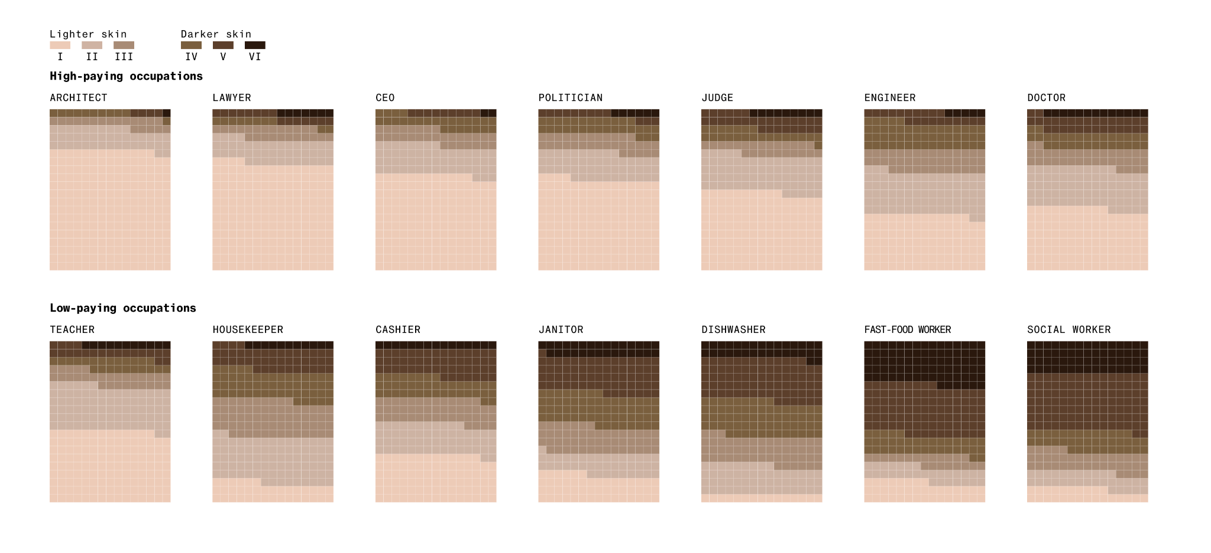
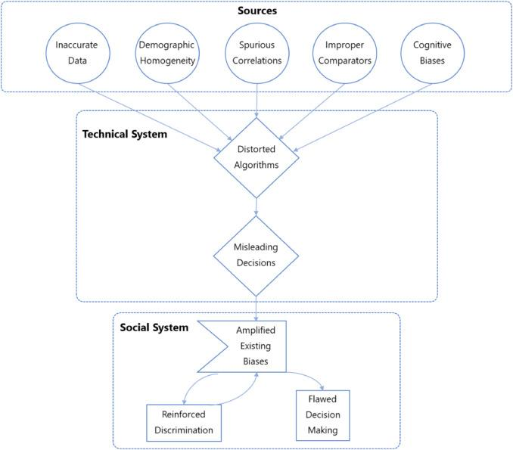
Bias In Generative AI: A Manifestation Of Stereotyped Data
Celine Gamino | Josephine Dobbs Clement Early College
Introduction
Data & Statistics
Findings
Are AI Engineers applying biased and harmful stereotypes to Generative AI? (AI developing new content based on the assigned prompt, primarily on text, images, music, etc.) As the usage of AI rises in popularity, images, and illustrations have become an unconscious source that's perceived as trustworthy, but many are unaware of the dangerous works of generative AI. Since the 1960s, AI has been implemented on the internet for over half a century, and an average of 6 out of 10 individuals (globally) have used Generative AI; moreover, there are vast results of implicit stereotypes, bias, and misinformation derived from Generative AI.
RESEARCH QUESTION: Are there implicit biases and stereotypes created by Generative AI?
THESIS STATEMENT: Prevalent AI Models have been deemed useful by all audiences, but is still set with limitations: Generative AI models are capped by its erroneous and deceptive outputs from operating programmatically based on its training data, perpetuating the biased beliefs and implicit stereotypes in our online community.
“Humans Are Biased, Generative AI Is Even Worse.”
In addressing gender bias in AI, it's crucial to recognize the impact of limited diversity in the training data for AI models. Without proper representation of diverse populations in the data, AI models can perpetuate gender stereotypes unintentionally. This underlines the need for diverse and inclusive training data to ensure fair and unbiased AI outcomes.
“Historical discrimination is ingrained in datasets, necessitating extensive transparency and cleaning interventions. The prevailing demographic homogeneity and lack of diverse perspectives is an under-examined but primary source of harm. Homogeneity perpetuates structural inequities and inhibits impartiality essential for truth-seeking. Tools based solely on technical features often exacerbate prejudice through unexamined feedback loops across interacting algorithmic systems over time” (Wilberforce. 9).
Survey respondents (Computer engineers) acknowledged their susceptibility to blind spots due to limited team perspectives, compared to real-world users. Increasing diversity in the development process could address bias and improve product development. "Failing to improve diversity in the computing field while advancing bias mitigation technologies is setting up for failure, leaving researchers and practitioners under-resourced to preempt sources of unfair bias in the technologies they design and build" (Kuhlman 4).
Biased AI models, especially when used on a large scale, can pose social risks. If the data used for training these AI models lacks diversity and quality, the models will perform well on the training data but poorly on new data. "Data Bias: Besides vast amounts, data also needs to have good ‘qualities’: accurate, clean, balanced, and representative." Bias occurs when the training data does not fully represent the diversity of the general population. A dataset can be biased toward a distinct gender, race, or class, and this significantly increases the likelihood of creating an inaccurate model. For example, A facial recognition algorithm trained only on Western populations may struggle with recognizing African or Asian faces, leading to inaccuracies (Nguyen).
STEREOTYPES & BIAS DERIVED FROM OTHER FORMS OF AI
Hope Reese, a professional writer working for Stanford Business alongside Columbia University graduate Ashley Martin and Professor Malia Mason, offers their expertise on the trend of Gendering Inanimate Objects. They discuss how AI tools are being given human-like features for business strategies and profit, leading to the gendering of AI products. This has resulted in societal conflicts and the encouragement of harmful stereotypes. According to the experts, participants have shown a preference for gendered voice assistants over genderless ones, which suggests that gendering products may lead to higher sales and consumer loyalty. However, they caution that while gendering may be good for marketing, it could also reinforce outdated or harmful ideas about power and identity. Ashley Martin emphasizes that highlighting gender stereotypes could potentially reinforce men's greater power in society.
The limitations of AI, including the quality of training data sources, constraints of generative models, and inherent challenges in AI design, lead to significant inaccuracies. These inaccuracies manifest in AI-based commercial gender classification systems, resulting in notable disparities in accuracy across different genders and skin types. Research has shown that these systems exhibit better performance on male and lighter-skinned faces, highlighting the urgent need to address the substantial errors in darker-skinned females (MIT Sloan Teaching & Learning Technologies).
Methodology
To conduct my research on implicit bias and stereotypes in Generative AI, I employed the secondary research method, a literature review. During my research, I utilized Duke's libraries, NC Central Library, MIT's research, and Google Scholar to analyze primary and secondary sources for synthesis. Thus, by sampling from various sources, I highlighted each citation's purposes for how these sources form a connection so that it may assist in answering my research.
Figure 1: Tech experts, Nicoletti Leonardo and Dina Bass, formed an experiment that sampled over 5,000+ Generative AI images using the Generative AI, “Stable Diffusion.” With the main concept of generating through job titles and crime. This graph chart records the sample size in regards to skin color, by using the Fitzpatrick scale (a numerical classification based on human skin color), here’s what is shown.
Background Information
“Bias Propagation Pathways Across Socio-Technical Dimensions.”
Usage of Generative AI unveils primary users are Millennials or Gen Z, with 72% employed. Over half believe they are mastering the technology, and many Gen Z users trust it for informed decisions. A majority report increased use over time. These users are interested in expanding generative AI to workplace applications, with 75% looking to automate tasks and use it for work communications. However, workers express concerns about accuracy, bias, and data security and feel they lack necessary training from employers to adopt generative AI effectively (Salesforce Inc).
Regarding Gender Bias, human research indicates strong stereotyping in 35% compared to AI exhibiting strong stereotyping in 59.4%. The results of this study emphasize the need for a diverse and inclusive AI development community to serve as the basis for a fairer and less biased AI (Ull 1).
“AI models perpetuate discrimination by making automated decisions.” For instance, an AI model trained on data containing gender bias can lead to unfair judgments. In the case of hiring, such models can perpetuate gender discrimination by relying on stereotypical traits, like assuming women lack leadership abilities. This demonstrates how AI can inadvertently become a tool for digital violence (Ull 3).
Training Data: Data used for AI models to produce that designed outcome to make decisions. AI functions its responses based on its training data, so depending on the datasets used, could dictate possible bias.
Algorithmic Bias: Flawed training Data results in an algorithm that repeatedly produces errors, amplifies misinformation, and creates unfair decision-making, implicating a room of unconscious bias — a possibility of unintentional discrimination.
Data Collection: Known as Data Gathering, is a systematic process of collecting information on certain variables, such as surveys, experiments, graphics, documents, interviews, etc. “Bias often originates here. The AI algorithm might produce biased outputs if the data is not diverse or representative” (Chapman University).
Model Training: A procedure for AI to process Machine Learning Algorithms and data to produce accurate responses. “A critical phase; if the training data is not balanced or the model architecture is not designed to handle diverse inputs, the model may produce biased outputs” (Chapman University).
Cognitive Bias: When processing information and making judgments, we are inevitably influenced by our experiences and preferences. As a result, biases may be built into AI systems through the selection and weighting of data.
Conclusion
Implicit stereotypes and biases are the result of “subtle messages” that have been internalized in one’s society, culture, language, and everyday life. There is, however, a critical distinction between humans and AI. Addressing these biases requires implementing techniques to diversify data and reduce bias. Since AI has various applications, it may directly or indirectly influence our interpersonal relationships. It's crucial to ensure that these systems are used fairly, equitably, and ethically. Although majority of AI applications out there, relies solely on its developers and trainers to provide less biased training data, "once individuals become aware of their own biases and prejudices, the responsibility is on us to seek out more inclusive, diverse, and representative training data—or, in human terms, to engage with more diverse communities, cultures, and experiences" (Piers, clinical psychologist).
Figure 2: “Research identified five primary sources of unfair bias originating from data inadequacies, demographic homogeneity, spurious correlations, improper comparators, and embedded cognitive biases. It also revealed associated ethical tensions, such as conflicting priorities, threats to sound judgment, impartiality erosion, privacy violations, and marginalizing impacts. Furthermore, the study found that even isolated technical biases can propagate through socioeconomic structures, limiting opportunities for vulnerable communities” (Wilberforce. 11).

