Slide 1

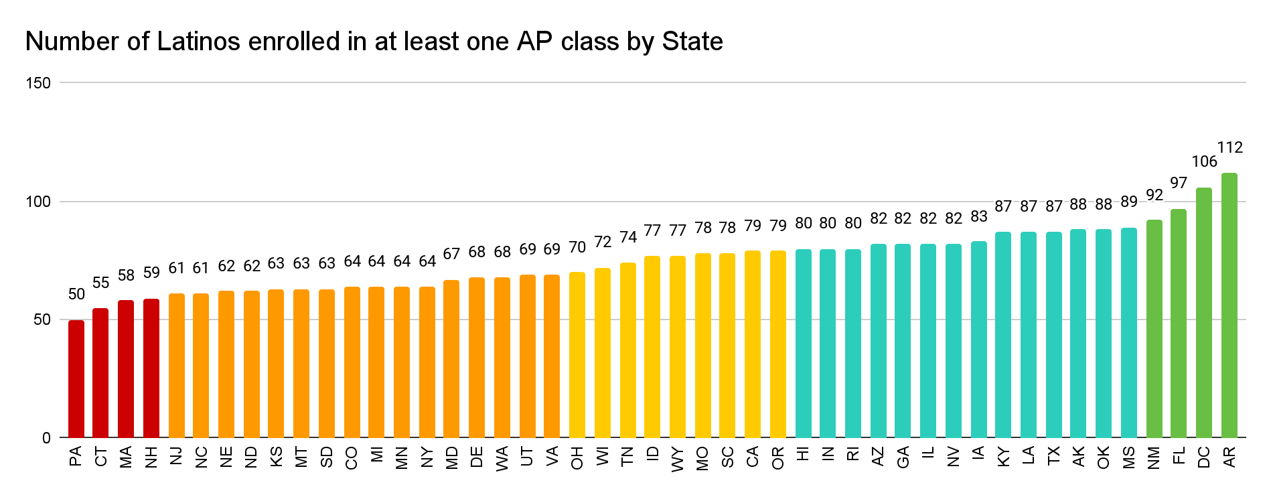
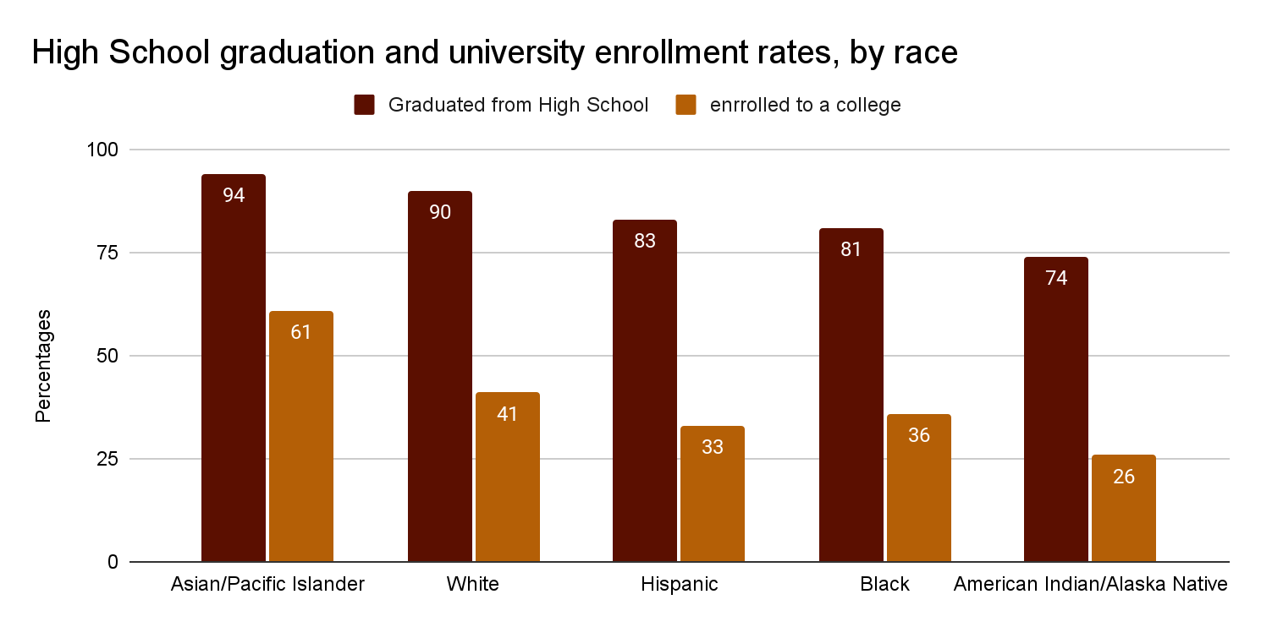
From borders to classrooms: Central American immigrant students and Higher Education Enrollment
America Barrera | Riverside High School
Introduction
Background
Findings
American education is always changing, but when comparing the experience of native-born American students and immigrant Central American students, a great difference can be noticed. As a Mexican immigrant student, I am aware of the disadvantages like lower expectations or less support that exist between immigrant students and those born here in high school education. The implementation of information in other languages, the right to know about opportunities for help, and opportunities to improve their academic development are ways in which these disadvantages can be addressed.
Research Question: What disadvantages do Central American immigrant students experience in high school education that contribute to low enrollment in higher education?
“Latinos are a social, economic and political force to be reckoned with as this group is expected to grow” (Rendon). In 2009, the Latino population was expected to grow 13% by 2000 and 24% by 2050, but in 2022, of the entire population living in the United States, almost 20% are Latino; therefore, Latino population is growing at faster rates than expected.
In 1965, President Lyndon B. Johnson signed the Elementary and Secondary Education Act, which stipulated the right to receive the same level of education regardless of race or status, although today there are still many academic inequalities between different races (U.S. Department of Education, 2024).
Although 83% of Hispanics graduated from high school, only 33% enroll in a university, thus becoming the 3rd with the most graduates but with the lowest rank of university enrollment (National Center for Education Statistics, 2024).
If Hispanic students are accepted into university, they must find a way to pay for it. However, the Free Application for Federal Student Aid (FAFSA) is only available to students who are legal residents or citizens, which many Hispanic students are not (U.S. Department of Education, 2024).
For undocumented students even DACA (Consideration of Deferred Action for Childhood Arrivals) was put on pause and the requirements are still difficult to meet, such as being here since 2012 or living intermittently since 2007 when the new generations that enroll to a university were born in those years (U.S. Citizenship and Immigrations Services, 2024).
“In 44 of 48 states, Latino students are disproportionately denied access to AP courses in the School that offer them” (Trust).
The biggest cause of the difference between immigrant and non-immigrant students is inequality of opportunities. First of all, we have the education gap. For many immigrant students, school-issued iPads and Chromebooks were the first computers in their homes, so in schools where information about classes, clubs, and sports they can take to become competitive and register for is mostly found online, it can be a challenge for these students (Carhill-Poza).
Most of the staff of the schools only speak English and only 12% are bilingual, which makes communication between student and teacher or counselor difficult (Williams).
In classes, American teachers set lower expectations for English learners, and are not aware of the needs that the student may have (Garcia quoted in Ferlazzo).
There are English as a Second Language (ESL) classes where students are taught to speak English, but many of these classes are also substitutes for core classes such as history, math, or English. The content is often taught at a lower level than non-ESL versions of the same class, even though they are supposed to be the same (Jover quoted in Ferlazzo). No ESL core classes are offered at the Honors or Advanced Placement (AP) level.
If Hispanic immigrant students hope to attend university, they often lack the criteria (sports, rigorous classes, etc) that the university expects, because they were not informed (Hurtado). Even if they are accepted to university, the next problem is money. “Undocumented students in many states are charged out-of-state tuition, which is several times the in-state tuition rate” (Broder).
Data
Number of Latinos enrolled in at least one AP class for every 100 Latinos who would need to be enrolled by state. Trust, Ed. “Advanced Coursework in Your State.” The Education Trust, 26 Oct. 2020
Conclusion
Even though we are in 2024 and academic opportunities have improved, there is still a large difference between the opportunities between Central American immigrant students and native-born students. To overcome this gap and give more opportunities to everyone, the school must be more equitable. If there is academic advising in English, it must also be in Spanish for those who are newcomers who do not know how the school works. We also need more bilingual staff so that the language barrier does not affect the well-being of the student. English learners should be able to take bilingual advanced classes, or regular advanced classes with the same expectations that exist for other students. Finally, counselors and school staff must be aware of financial aid resources specific to immigrant students.
Methods
To conduct my research on the education outcomes stemming from disadvantages of immigrant students in high school, I employed the secondary research method, a literature review. During my research, I utilized Duke library and Google Scholar to analyze primary and secondary sources for synthesis. I utilized the U.S. Citizenship and Immigrations Services (USCIS), U.S. Department of Education, National Center for Education Statistics, and National College Attainment Network (NCAN).
Percentage of students by race who graduated from high school and percentage by race who enrolled in college. “High School Graduation Rates.” Coe - High School Graduation Rates, National Center for Education Statistics. 2024.

