Slide 1

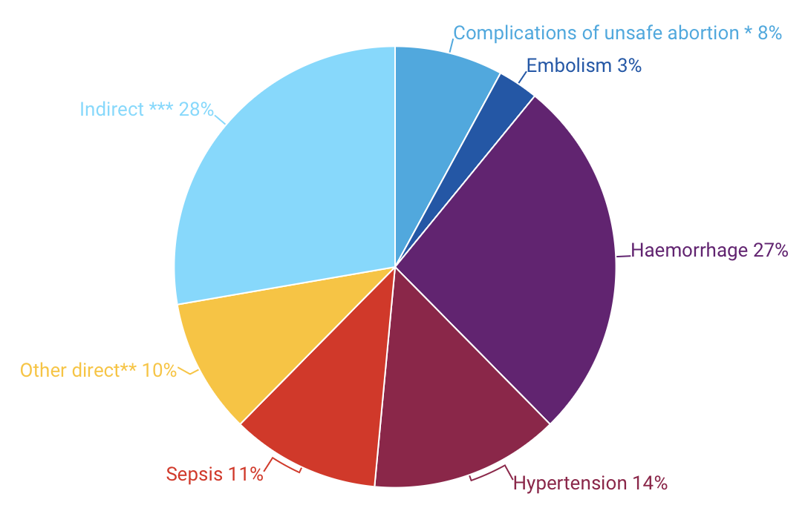
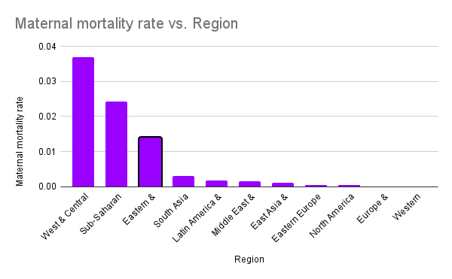
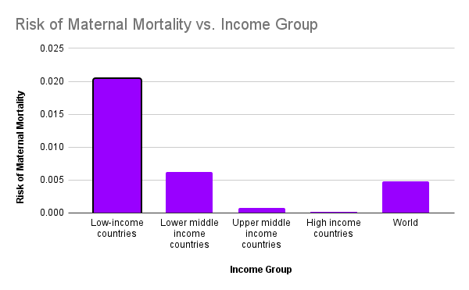
Decreasing Maternal Mortality In South Sudan
Amaya Clough | Northern High School
Introduction
Data
Methodology
South Sudan's huge assets and determined citizens make it a promising country. The high rate of maternal mortality in South Sudan is brought on by a number of causes, such as poor health education, a lack of skilled birth attendants, insecurity and conflict, a high rate of fertility and early marriage, and challenges with the healthcare system.
Research Question: What factors drive high maternal mortality in South Sudan, and how can they be addressed ?
Thesis: By supporting a healthier and more equal society whose all women have an equal chance to survive childbirth and lead healthy lives, reducing maternal mortality may favor public health and human rights.
Causes of Maternal Death
To conduct my research on recent studies on the causes, complications ,maternal morbidity, and frequency . I employed the secondary research method, a literature review. During my research, I utilized Duke Library and Google Scholar to analyze primary and secondary sources for synthesis. I utilized the World health organization (WHO) , PubMed, Yale Medicine, UNICEF, National Center for Health Statistics CDC) and National Library of Medicine (NCBI)
Findings
With a population of roughly 11.38 million people, the majority of whom are children, adolescents and young adults, South Sudan, a landlocked nation in northeastern Africa, remains one of the nations with the worst maternal mortality rates in the world 181. (international Rescue Committee)
The health care system is suffering from an acute lack of staff, funding and medical supplies. In addition to repeated attacks, looting and occupation of medical facilities and hospitals. More than 70 percent of health facilities in conflict-affected regions of Sudan are inoperable or closed. (International Rescue Committee)
South Sudan had the world’s worst 2020 maternal mortality rate, at 1,222.5 per 100,000, with fellow neighbor chad close behind at 1,063.5. (Davis)
Background
Maternal Mortality: a term used to indicate a mother's death due to a pregnancy-related condition or a general illness made acute by pregnancy.
Maternal Near Miss: A woman who faced an illness during their pregnancy, during childbirth, or within 42 days following the pregnancy concluded yet able to survive
Maternal Mortality Rate: The number of mothers who died within an amount of time per 100,000 live births
Obstetric hemorrhage is the most common and dangerous complication of childbirth (UNICEF). Postpartum hemorrhage is the leading cause of morbidity and mortality in childbirth (UNICEF DATA)
The rate of maternal mortality (MMR) is an important issue for global public health. High MMR levels are currently a widespread issue in global public health, especially in developing nations. South Sudan has the fifth highest maternal mortality rate in the world. (Pubmed, 28) Women's and newborns' lives can be saved by seeking care from skilled medical experts at all stages of childbirth.
Source: Say L et al., ‘Global causes of maternal death: a WHO systematic analysis’ Lancet Global Health. http://dx.doi.org/10.1016/S2214-109X(14)70227-X, May 6, 2014.
This graph includes deaths due to obstructed labour or anaemia. Indirect causes are medical causes such as pre-existing conditions aggravated by pregnancy.
j Conclusion
The Lifetime Risk of Maternal Death by Income Group
Solutions must address underlying problems with healthcare, skilled caregiver access, and wealth gaps so as to lower maternal mortality in South Sudan. We may significantly reduce the quantity of maternal suicides and near-misses by prioritizing the construction of healthcare facilities, increasing professional training, and promoting community education. The commitment of governments, healthcare providers, and international organizations to ensure that every woman has access to safe childbirth and essential care should not waver. By affording these efforts priority, we protect the fundamental human rights of women and babies in South Sudan and around the world, but improving public health effects.
Source: WHO, UNICEF, UNFPA and The World Bank, Trends in Maternal Mortality: 2000 to 2020, WHO, Geneva, 2023.
*Income groups refer to World Bank income classification in 2018.
Notes:
be ready to get asked about civil war or human rights and policies about women
citations
fix conclusion
develop methodology
the take away in the conclusion
and what to do
how to fix it

